Slide 1
Unified Solution
Texas A&M University
Peter Lange

Slide 2
VIP
Enforcement
Exceptions
Access
Bikes
Reserved
Temp
Spaces
Access
LP
Exceptions
Targeted
Communication
Notes:
Interfaces
Integration
Workarounds
Compromises
Business rule changes
Loss of functionality
Revenue Control - Dispenser tickets – card-in/card-out, in-lane cashier, central cashier, pay-on-foot, pay-by-cell
Access Control - Credentials, transponders, manned booths, proximity cards, gates and lane equipment
Permits - Application, registration, wait-lists, hangtags, online sales, kiosk, decals
Metering Devices - Single-space, multi-space, pay-by-space, pay-and-display, in-car meters, mobile LPR
Enforcement - Warnings, tickets, citations, handhelds, appeals, processing, scofflaw, boot, tow
Money - Debits, credits, receivables, transfers, collections

Slide 3
VIP
Enforcement
Exceptions
Access
Bikes
Reserved
Temp
Spaces
Access
LP
Exceptions
Targeted
Communication
Notes:
System means Parking System, not software system

Slide 4
Temp Access

Slide 5
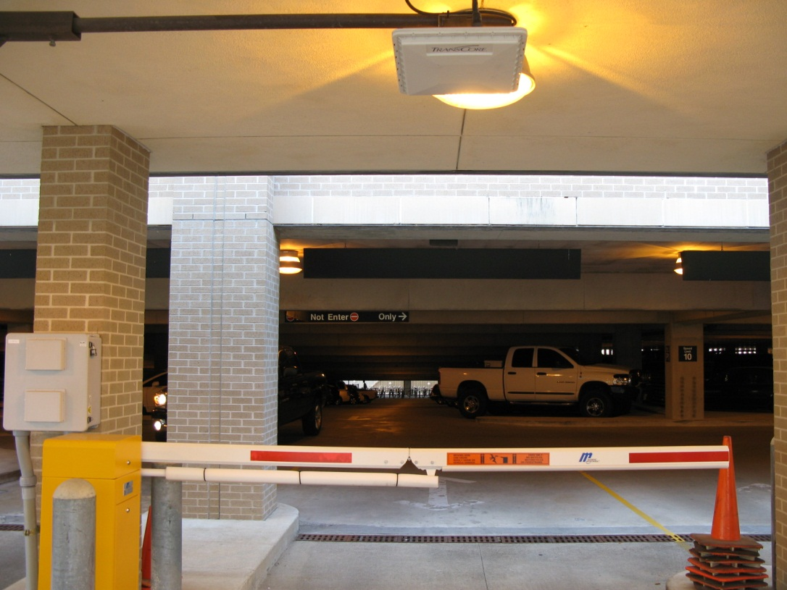
Temp Access
Notes:
Mag stripe can parse DL or any mag stripe

Slide 6
Targeted Communication
1/7/15 day citation notices
Construction advisories
Game day notices
One off letters to customers
Monthly statements
RV customers (non-affiliates)

Slide 7
Targeted Communication

Slide 8
Permit Now
Notes:
Temp access
Sharing of handheld
Credit cards in the field
Better control
Professionalism
Data comes back into flex
Setup in flex

Slide 9
My Account

Slide 10
Data Flow Between the Data Warehouse and Other Systems

Slide 11
Network Diagram

Slide 12
Server Config
Notes:
BACKUPS for ORACLE SERVER:
Snapshots daily at 12:40a – Time to complete?
System backup 9pm
Remote backup 10:30p
Exports to DMP file 5 days a week – restart db and begins at 1:00am and runs until 10am online
Cold Copy files weekly – run for 2 hours on Sundays db offline

Slide 13
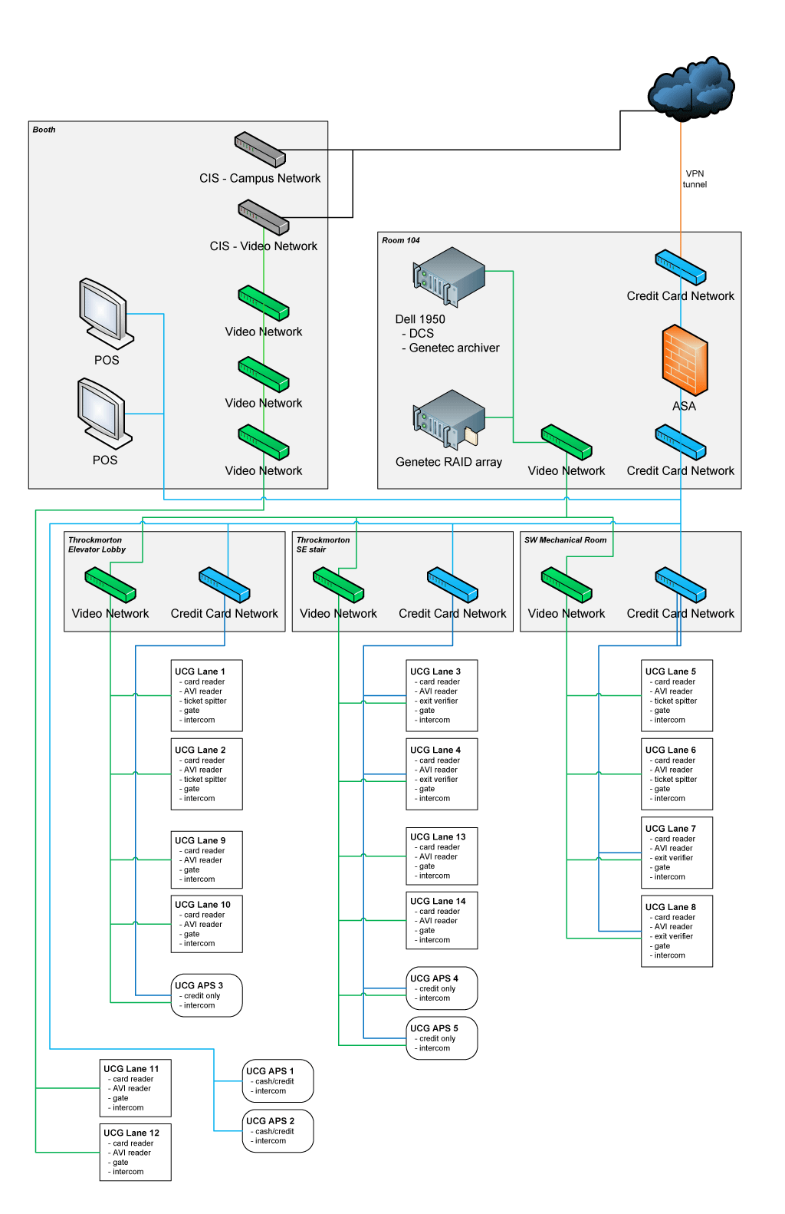
University Center Garage Network Diagram

Slide 14
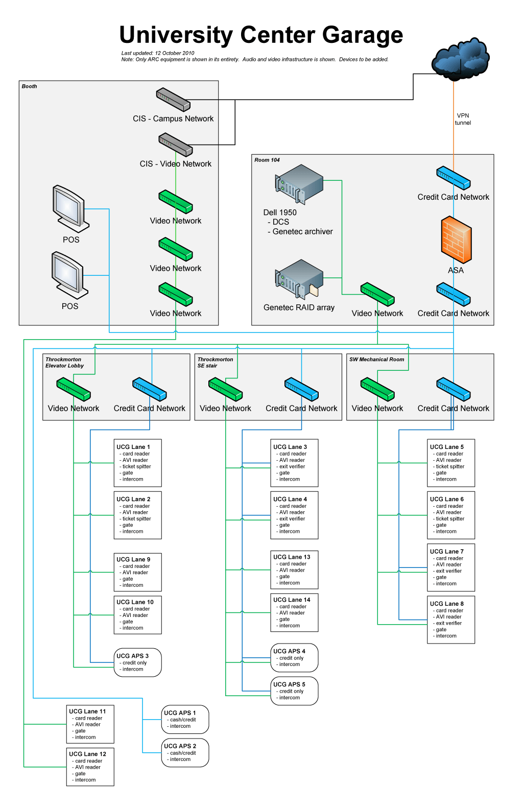
University Center Garage Network Diagram

Slide 15
Dashboard

Slide 16
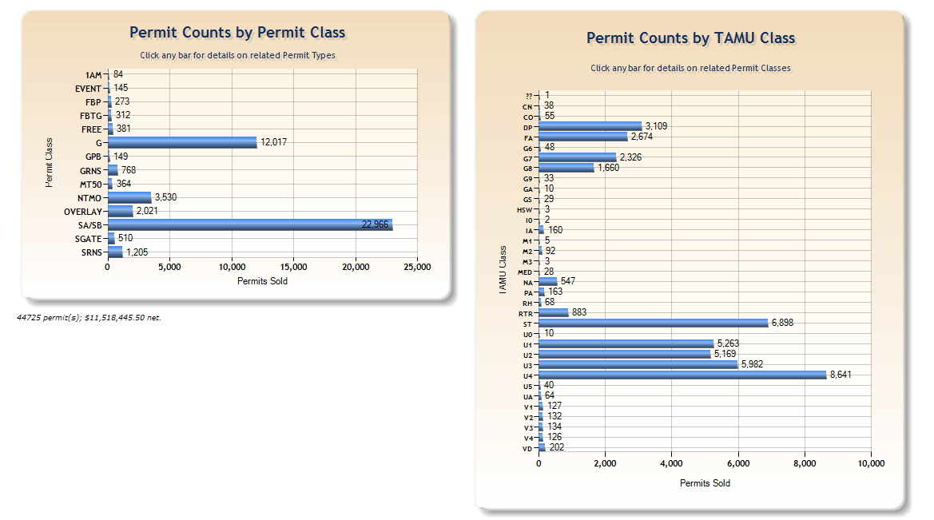
Dashboard

Slide 17
Dashboard

Slide 18
Have one system that pulls it all together
All financial information to help us manage and report on revenue from multiple sources
Taking payment for any parking item at any outlet – ISF at the office or online; citations at the pay station in a garage, all online, etc.
Have a complete view into our operation, rather than multiple separate views
Unified inventory and management of all parking spaces, audited or access/revenue-controlled.
Upgrade one piece without reconfiguring all of the other pieces
Notes:
Patrick
For each transaction type, you can select the processing requirements
you want and don’t want – including customer information, customer
history, supervisor approval, dual entry, reference fields
and more. All of the information captured by these processing
options is stored in the database and available for reports, customer
letters and invoices
Let’s say that your permit holder forgets his permit,
enters with a ticket, and wants to exit without paying. You can
set a threshold that allows this to happen up to a specified limit.
For example, you can set a threshold that allows a permit parker
to exit free with a ticket one time a month. Once the threshold is
exceeded, the permit parker must pay to exit.

Slide 19
Have one system that pulls it all together
Have one point of contact for questions and maintenance of the pieces
Managing all permits and access cards in one database with no duplication of data or data entry.
Single point of online access to everything parking for our customers.
Unified reporting and business-process configuration and tracking.
Notes:
Patrick
For each transaction type, you can select the processing requirements
you want and don’t want – including customer information, customer
history, supervisor approval, dual entry, reference fields
and more. All of the information captured by these processing
options is stored in the database and available for reports, customer
letters and invoices
Let’s say that your permit holder forgets his permit,
enters with a ticket, and wants to exit without paying. You can
set a threshold that allows this to happen up to a specified limit.
For example, you can set a threshold that allows a permit parker
to exit free with a ticket one time a month. Once the threshold is
exceeded, the permit parker must pay to exit.

Slide 20
Have one system that pulls it all together
Single organization for software support and consolidated training for software users
Customized transaction-processing requirements
Configurable thresholds for transaction types and permit activity
Cashier performance trend reports
Easily configurable cashier stations with programmable hot keys, and unlimited number of validation
Notes:
Patrick
For each transaction type, you can select the processing requirements
you want and don’t want – including customer information, customer
history, supervisor approval, dual entry, reference fields
and more. All of the information captured by these processing
options is stored in the database and available for reports, customer
letters and invoices
Let’s say that your permit holder forgets his permit,
enters with a ticket, and wants to exit without paying. You can
set a threshold that allows this to happen up to a specified limit.
For example, you can set a threshold that allows a permit parker
to exit free with a ticket one time a month. Once the threshold is
exceeded, the permit parker must pay to exit.

Slide 21
Questions?
?
?
?
?
?
?
?
Presentation posted online at
http://transport.tamu.edu/presentations

