Slide 1
Access Control
Weighing the Pros and Cons
Darren Craig
Manager, Parking Operations and Technology
York University – Parking Operations
(416)736-5394
darren@york.ca
Peter Lange
Executive Director
Texas A&M University – Transportation Services
979-845-9700
plange@tamu.edu

Slide 2
About York About A&M
Third-largest Canadian university in enrollment
7000 faculty/staff, 55,000 students
Comparatively small campus 542 acres
Sixth-largest US university in enrollment
12,000 faculty/staff, 50,000 students
One of largest campuses – 5500 acres
Notes:
Peter

Slide 3
About York About A&M
Glendon bilingual French/English campus
Schulich School of Business
Leader in Environmental Studies and Sustainability
Land-Grant, Sea-Grant and Space-Grant university
Home to George Bush Presidential Library and Museum
Texas’ first public institution of higher learning
Notes:
Peter

Slide 4
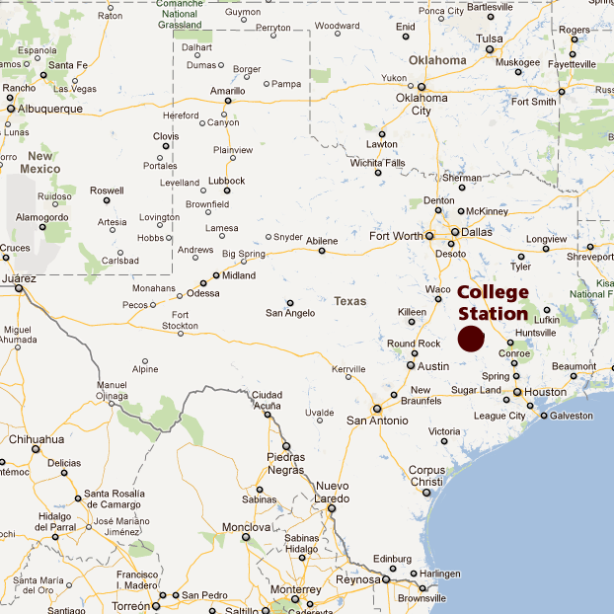

Slide 5
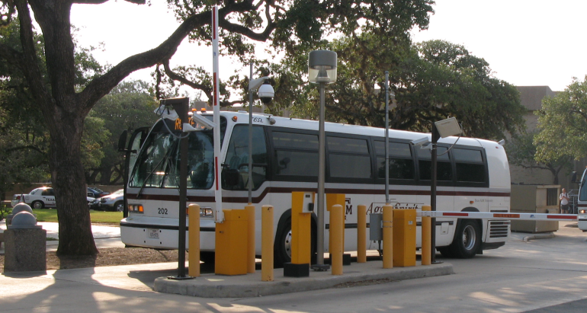
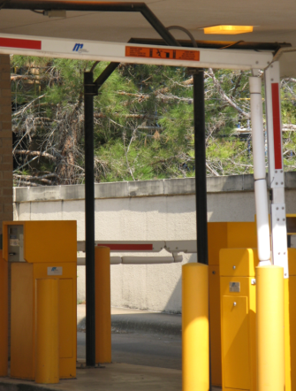
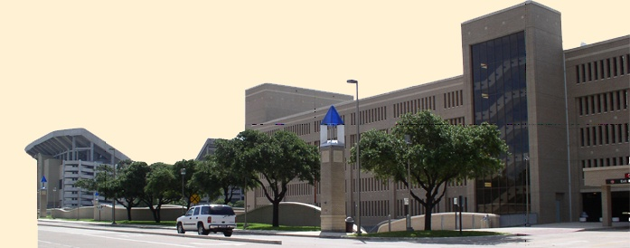
A&M Transportation Services
York Parking
Services
36,310 parking spaces
120 surfaces lots
5 garages
79 lanes of access control equipment
9748 parking spaces
35 surfaces lots
3 garages
70 lanes of access control equipment
Notes:
York – all at once in 2001 and debt
A&M over time and cash
Parking budget of $17 million
Transit budget of $8 million
164 employees full time and 300 students
Fleet $5 million
Peter

Slide 6
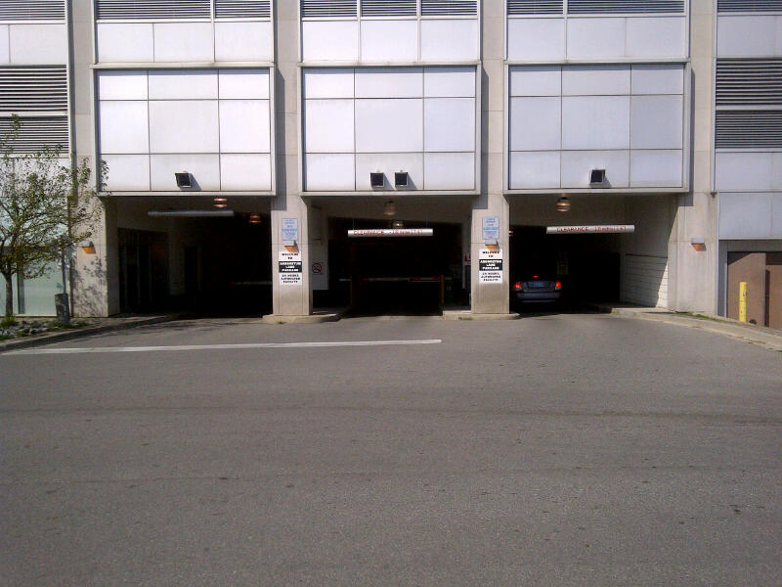
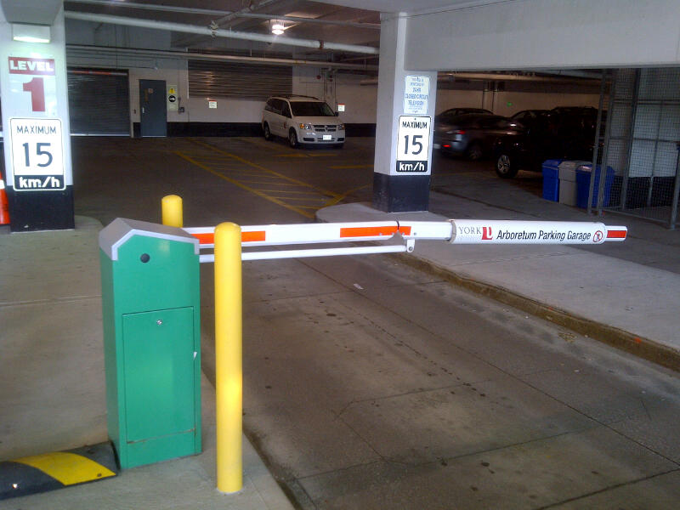
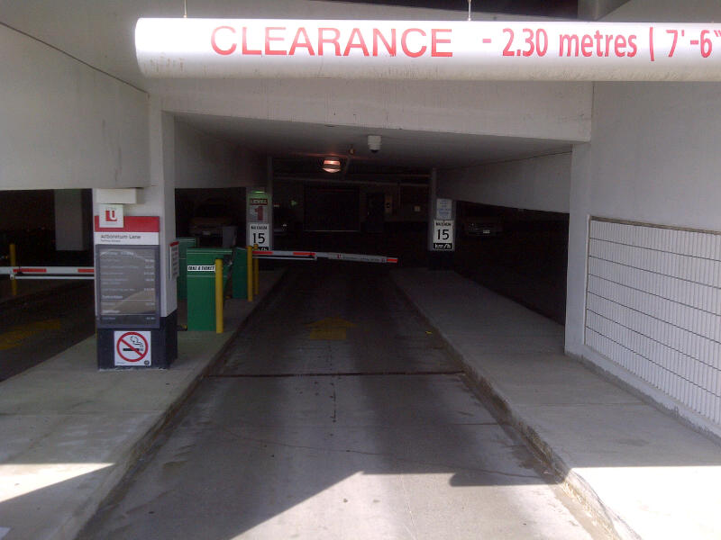
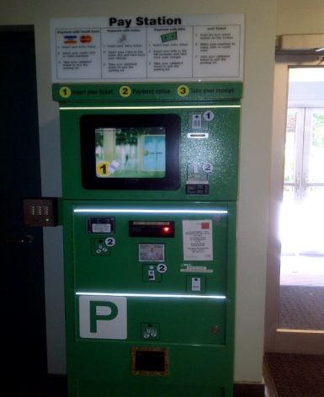
A&M Transportation Services
York Parking
Services
6 reversible, 12 revenue lanes, 61 AVI readers, 25 barcode readers
4 reversible, revenue lanes, AVI readers, barcode readers
Notes:
Department budget of $30 million
Parking budget of $17 million
Transit budget of $8 million
164 employees full time and 300 students
Fleet $5 million
Peter

Slide 7
What We Do
Support the University – “Parking should be a non event”
What’s our focus, revenue or compliance ?
Auxiliary / Ancillary Services – self sustaining
Charge for parking and provide value for our customers
Reinvest in the parking system

Slide 8
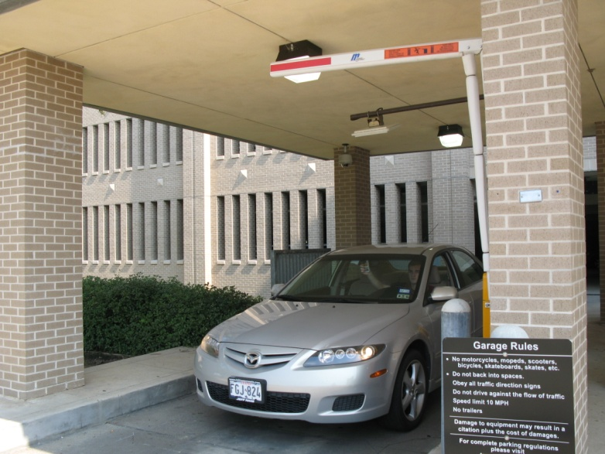
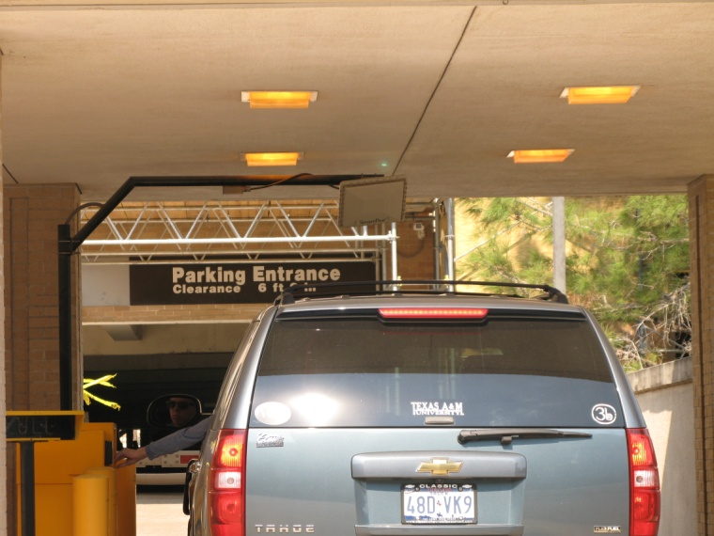
Why Do We Gate?
To improve compliance areas with high levels of violators
Protect small high value areas or limited access areas
Protect areas during peak hours
Gives customer more confidence their space will be available
Notes:
Gating can be a justification for higher revenue rates
to improve compliance areas with high levels of violators
In areas of campus where there are nooks and crannies where people might want to get into for drop off/pick up but there is no legitimate place for them to park and where they may be tempted to violate in the very few parking spaces within those areas (service, loading, RNS)
To get time stamps at entry for collecting revenue from those who pay to park
To assist with the enforcement effort – keeps violators down
To protect areas where high level administrators are parking to help ensure space availability when they arrive – “take care of the big dogs”
Likes:
Gates protect areas during peak hours, but can still be lifted to increase access to others in off hours – gives flexibility
Gating gives customer more confidence their space will be available when they arrive because they feel it has extra protection – increases customer satisfaction
Creates a record of access – helpful for a variety of reasons: security; amount of usage; record of violation if overstayed in an unauthorized area
In a unified system, we like that all the access records are in one place and many members of our staff can view and problem solve without interaction with technical experts on our team. Customer service staff, gate operators, management, etc. can all see without assistance from others.
Reduces pass through traffic – improves safety
Handsfree access is perceived as a huge perk by customers

Slide 9
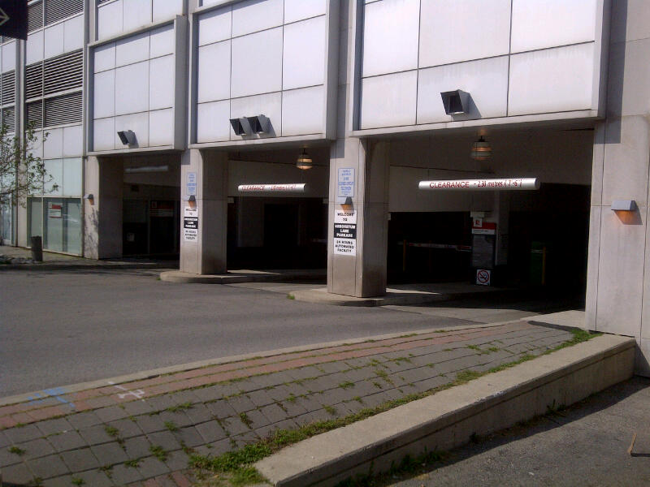
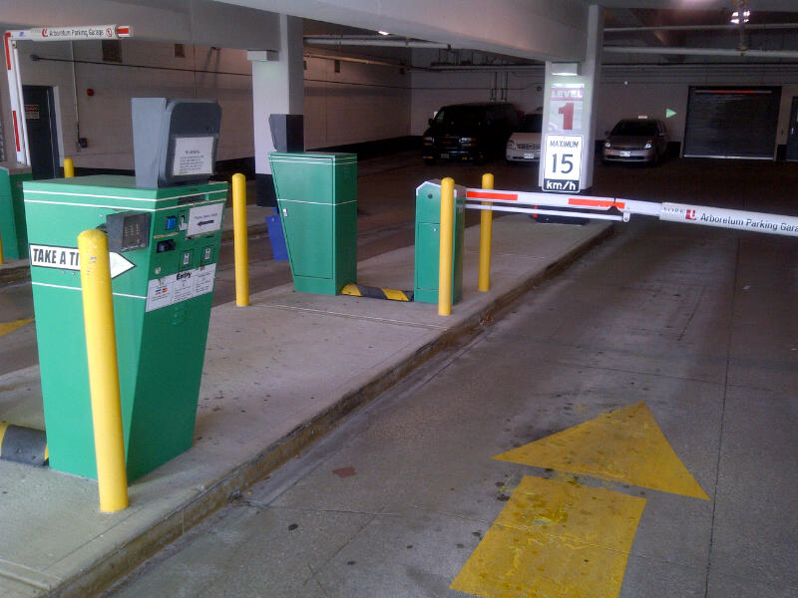
Why Do We Gate?
Help enforcement reduce their coverage in gated areas and focus their attention in other areas
Flexibility to raise gates and operate in a less restrictive operational mode
Allows for creating subsets of customers using gates –
nested areas
Notes:
To improve compliance areas with high levels of violators
In areas of campus where there are nooks and crannies where people might want to get into for drop off/pick up but there is no legitimate place for them to park and where they may be tempted to violate in the very few parking spaces within those areas (service, loading, RNS)
To get time stamps at entry for collecting revenue from those who pay to park
To assist with the enforcement effort – keeps violators down
To protect areas where high level administrators are parking to help ensure space availability when they arrive – “take care of the big dogs”
Likes:
Gates protect areas during peak hours, but can still be lifted to increase access to others in off hours – gives flexibility
Gating gives customer more confidence their space will be available when they arrive because they feel it has extra protection – increases customer satisfaction
Creates a record of access – helpful for a variety of reasons: security; amount of usage; record of violation if overstayed in an unauthorized area
In a unified system, we like that all the access records are in one place and many members of our staff can view and problem solve without interaction with technical experts on our team. Customer service staff, gate operators, management, etc. can all see without assistance from others.
Reduces pass through traffic – improves safety
Handsfree access is perceived as a huge perk by customers

Slide 10
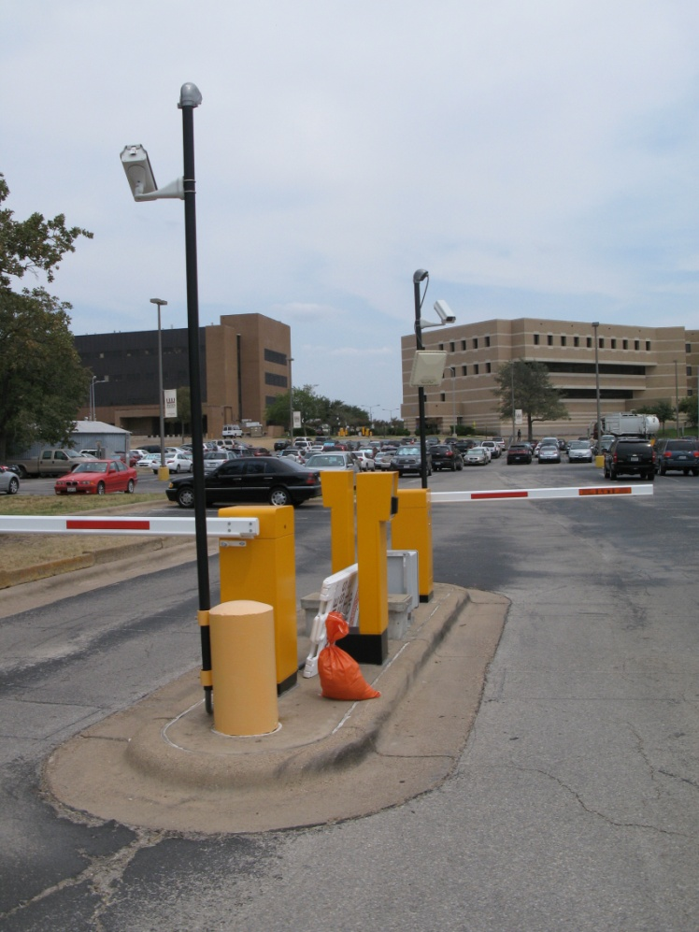
Why Do We Gate?
Allows for the opportunity for parking fees to be fully or partially paid by departments or others
Gives customer more confidence their space will be available
Notes:
Potential Benefits
Provides for greater control over ‘open’ facilities
Allows advance credential/access planning
contracted permits/access
pre-issued credentials for conferences, special events, etc.
Allows on-demand credential production
pull a ticket
Prevents pass-through traffic for non-authorized or non-paying vehicles
reduces congestion
provides for greater pedestrian safety
Allows the flexibility to raise gates and operate in a less restrictive operational mode
Allows for creating subsets of customers using gates
nested areas
segregation of monthly and transient parkers
Allows for control of customer subsets via:
FULL lights
disabling of access methods
disable ticket spitters, continue to allow monthly access
Allows for the opportunity for parking fees to be fully or partially paid by merchants or others
validations
pre-issued temporary credentials (conference tickets)
Provides for better quality data in regard to counts
differential counting based on access type
transient
monthly
special event / conference
time period specific data
trending and analysis
may be ported to web page to assist customer decision making
Allows for variable access methods
magnetic stripe
paper/plastic spitter tickets
permits
access cards
credit cards
driver’s license
bar code
spitter tickets
merchant-issued exit ticket
customer-printed from email/web page
conference registration
pre-arranged conference/visitor
electronic tokens
AVI
toll tags
operator-issued tags
keypad
biometric
attendant-assisted
remote vend
local vend (button for special event staffing)
vehicle detection (free exit)

Slide 11
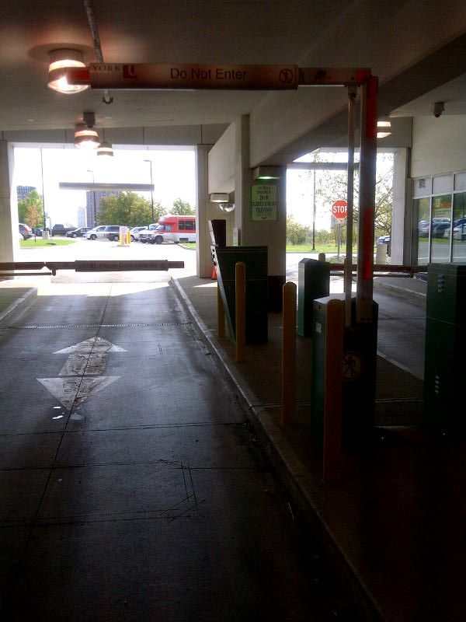
Why Do We Gate?
Provides for better quality data in regard to counts - differential counting based on access type
– transient
– monthly
– special event / conference
Creates a record of access – helpful for a variety of reasons: security; amount of usage
DATA
Notes:
Allows for multiple and complex fee structures
based on:
time
uses
event
customer type
location
provides for use of grace times
unpaid
paid
Allows for multiple cashiering options
central cashiering
automated
staffed
exit cashiering
automated
staffed
merchant-issued validation/exit ticket
Access may be enabled/disabled readily via PARC system
Provides customer prompts/feedback in lane via display
“Use card or insert ticket”
“Invalid Permit”
“Passback”
“Vehicle Blocking Lane”
“Full”
“Lane Closed”
Provides operator/attendant information via PARC system
issues with customer access attempt
passbacks
invalid credentials
tailgates
system problems/issues
offline
broken gates
Provides for control of violation situations by denying access
backout tickets
passbacks
invalid date/time
Allows for detailed fiscal checks and accountability
electronic logging of transactions
electronic reporting
‘old school’ counting of tickets may still be done

Slide 12
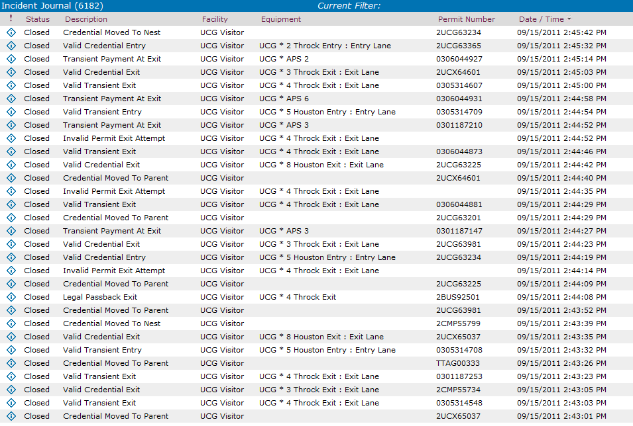
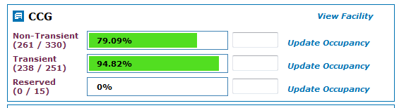
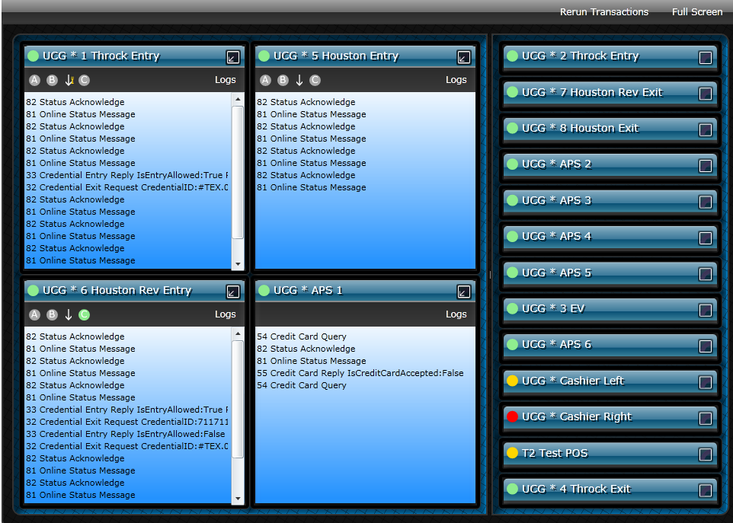
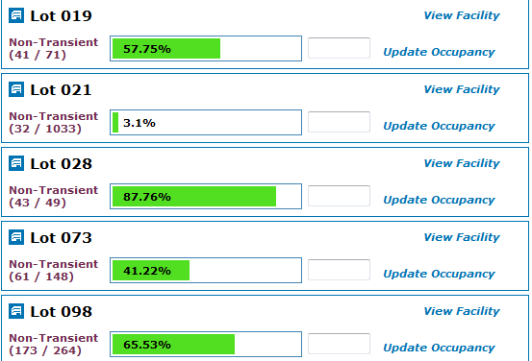
DATA
Notes:
An “authoritative source” is the system that has ownership of data or process. Many systems may access the data, but only an authoritative system can change it. Example: The DMV is the authoritative source of driver’s license numbers. A parking operation might use this number for some reason but is not allowed to change/alter it because the parking office is not the authoritative source of that piece of data.
You will have access to info that you don’t have now.

Slide 13
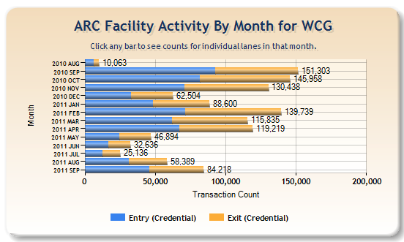
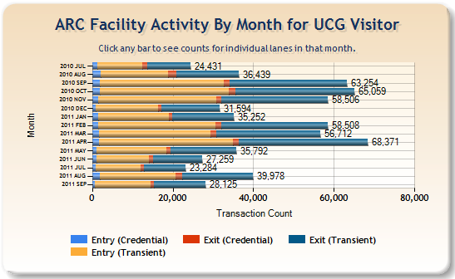
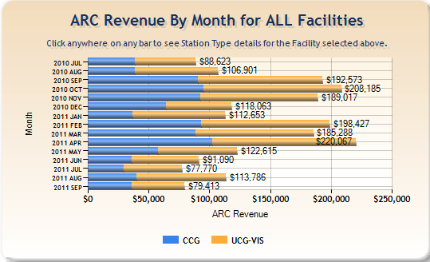
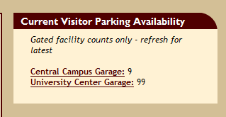
When Data Becomes Information
Notes:
Dashboard is a term now being used generally to refer to a web technology based page on which real time information is collated from various sources in the business. The metaphor of a dashboard is adopted here to emphasize the nature of the data being displayed on the page, it is a real-time analysis as to how a business is operating, just like on an automobile dashboard real time information is displayed about the performance of that vehicle.
Most parking management systems today are not designed to interoperate!
Must improve the ability to share, import and export data (batch and real-time)
Must embrace standards and standardization for networking and data management
Must adopt a more open architecture to allow user customization and third-party extensions
Parking Operations need credibility in order to be effective and provide valued services.
Credibility is earned through good record-keeping over a long time
All financial information to help us manage and report on revenue from multiple sources
Allow our customers to pay for anything related to parking at any of our physical or virtual locations
Have a complete view into our operation, rather than multiple separate views
Manage all our spaces in a consistent unified manner
Upgrade one piece without reconfiguring all of the other pieces
Have one point of contact for questions and maintenance of the pieces

Slide 14
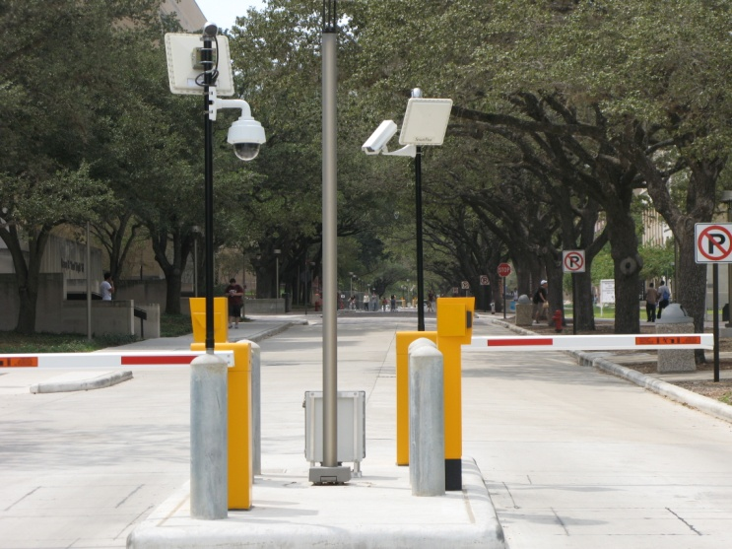

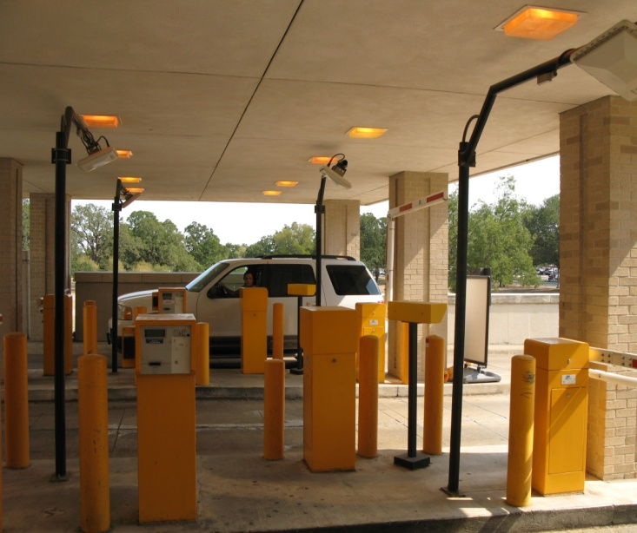
Why Do We Gate?
Allows for variable access methods
– AVI
– Barcode
– Magnetic stripe
Provides for control of violation situations by denying access / decreases fraud / anti - passback
When gating, need to consider every constituency group who will need access and plan in
Notes:
Avi can be short or long range, long range can be quite expensive
Accurate info can help with exact utilization rates, which can help with appropriate oversell percentages.

Slide 15
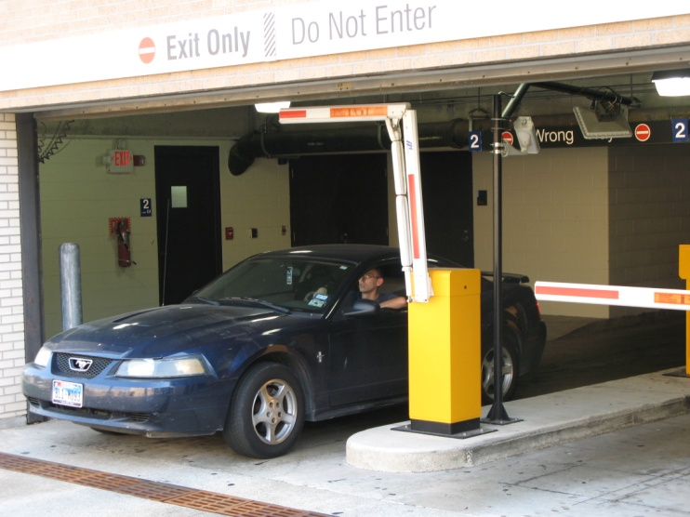
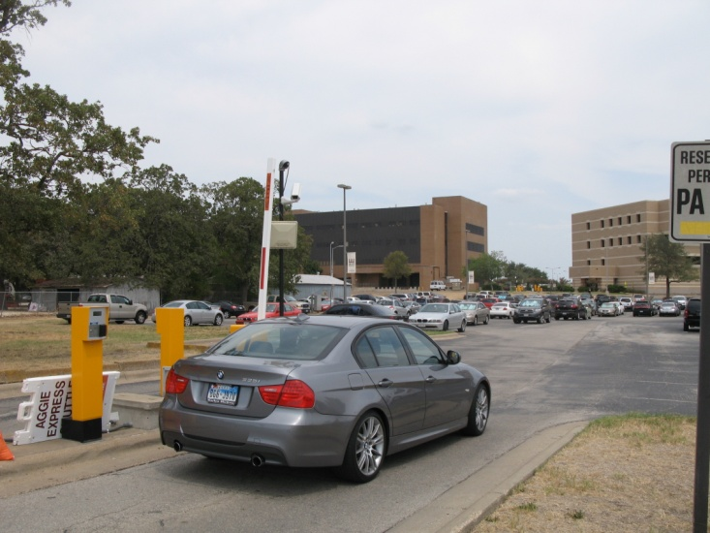
Drawbacks
No system works 100% of the time and gating increases expectations and decreases satisfaction when they don’t work Requires more user education
Notes:
Gating as a crutch anecdote
They don’t always work properly
Requires more user education – sometimes the gate isn’t working properly because the user isn’t using the access method correctly
Sometimes causes issues when disabled customers who don’t have permits for the gated lot but want access since it the closest accessible space to their destination
Sometimes requires MANY exceptions for all the people who have legitimate access needs but don’t have permits for the gated area
Equipment is expensive – may require increasing permit prices to cover costs
Requires maintenance – may not have the resources to have technicians on staff
Gating usually drives up the price point of the permit and we are already seeing price sensitivity in our customers
No system works 100% of the time and gating increases expectations and decreases satisfaction when they don’t work – ie: handsfree not working, so have to swipe – even though they can get in by swiping, they still complain because the handsfree didn’t work (increased expectations)
Requires monitoring – more staff=more resources
Control comes at a cost
equipment
initial cost
ongoing maintenance costs
infrastructure
controlled traffic lane construction
power
communication
signage
consumable supplies
tickets
access devices
gate arms
ink ribbons/cartridges
Increased potential liability due to malfunctioning equipment
property damage
personal injury
Complexity of the system is increased
Administrative overhead is increased

Slide 16

Customer Expectations
4 Seconds
2 Seconds

Slide 17
Drawbacks
Equipment is expensive / Control comes at a cost/
Requires maintenance
Requires monitoring – more staff - more resources
Increased potential liability due to malfunctioning equipment
Complexity of the system is increased
Notes:
Clients can expect such gated service. When gates are up, additional enforcement must be allocated or all the drawbacks of an ungated system can come rushing back.
York’s clients demanded refunds when the gates were up, even when there were no issues with capacity.
Either you put all your gate arms up every day, or you have to become a 24 hour operation.
Sometimes on campus Security can be used as a resource.
Some companies also hire out their services to be centrally responsible
Damage claims due to improper use, tailgating damage
They don’t always work properly
Requires more user education – sometimes the gate isn’t working properly because the user isn’t using the access method correctly
Sometimes causes issues when disabled customers who don’t have permits for the gated lot but want access since it the closest accessible space to their destination
Sometimes requires MANY exceptions for all the people who have legitimate access needs but don’t have permits for the gated area
Equipment is expensive – may require increasing permit prices to cover costs
Requires maintenance – may not have the resources to have technicians on staff
Gating usually drives up the price point of the permit and we are already seeing price sensitivity in our customers
No system works 100% of the time and gating increases expectations and decreases satisfaction when they don’t work – ie: handsfree not working, so have to swipe – even though they can get in by swiping, they still complain because the handsfree didn’t work (increased expectations)
Requires monitoring – more staff=more resources
Control comes at a cost
equipment
initial cost
ongoing maintenance costs
infrastructure
controlled traffic lane construction
power
communication
signage
consumable supplies
tickets
access devices
gate arms
ink ribbons/cartridges
Increased potential liability due to malfunctioning equipment
property damage
personal injury
Complexity of the system is increased
Administrative overhead is increased

Slide 18
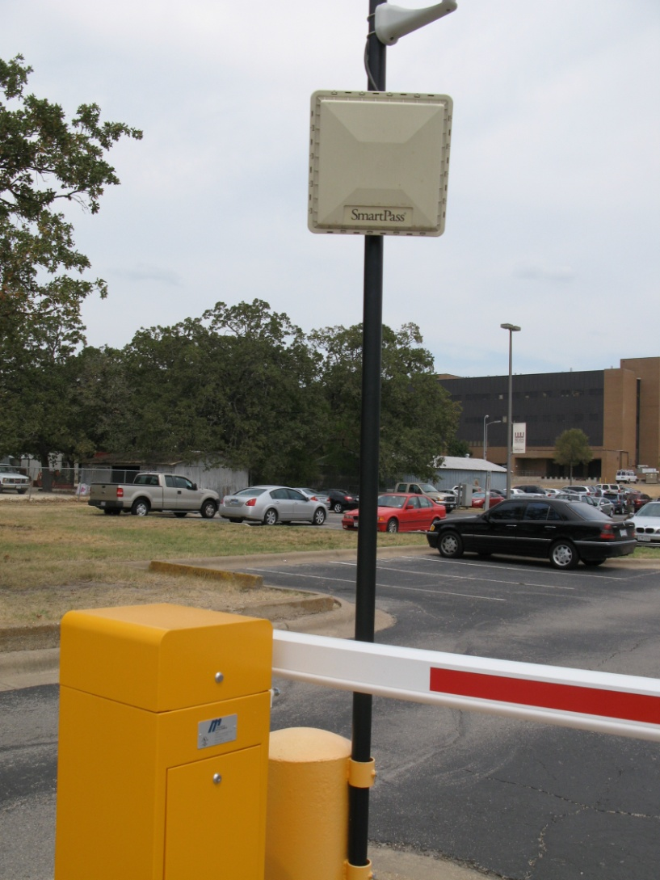
Considerations
Physical layout
Availability of infrastructure
Budget
Expected/potential use of facility
Customer needs/expectations
Notes:
Gating can obscure anecdote
Physical layout
overall space required
potential loss of spaces due to lane installation
traffic flow to direct to/from controlled lanes
traffic flow to/from surrounding streets
traffic volume in surrounding areas
pedestrian access
to pay stations
to ingress/egress points
through traffic areas
Availability of infrastructure
power
communication
Budget
expected/potential use of facility
Customer needs/expectations
long-term
short-term
protected/guaranteed parking
ease of use
Political environment
Regulatory issues
ADA
state/local codes, restrictions, etc.
Revenue generation
Potential
Limitations
Maintenance of equipment/facility

Slide 19
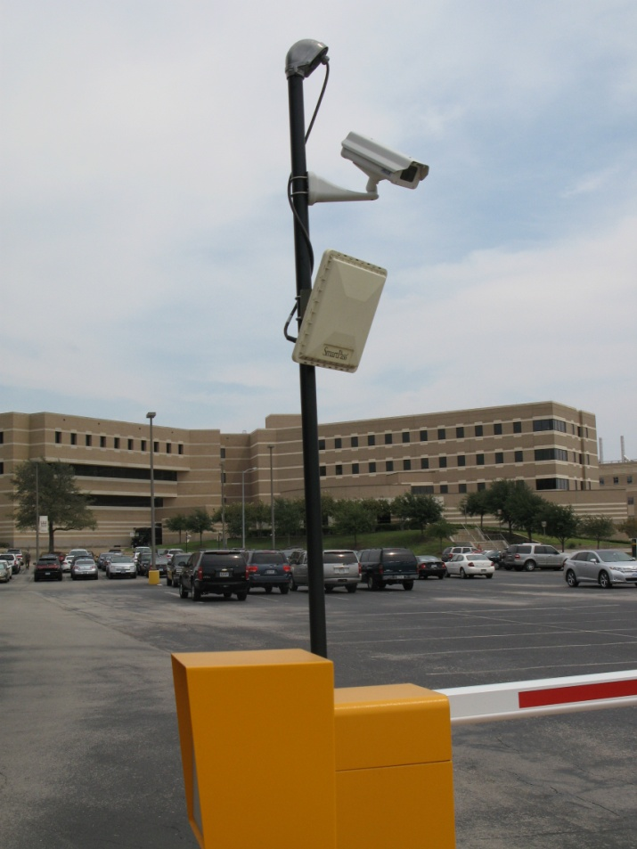
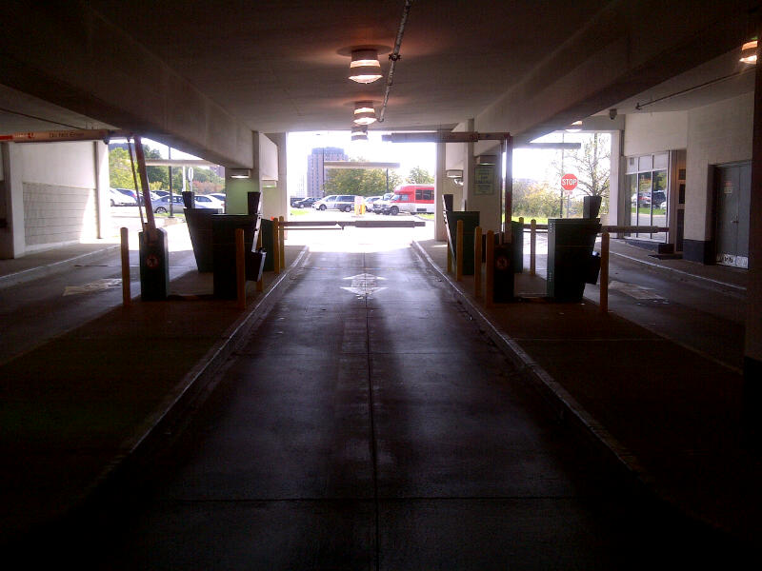
Considerations
Weather
Political environment
Regulatory issues – ADA – Fire access
Maintenance of equipment - in house or distributor

Slide 20
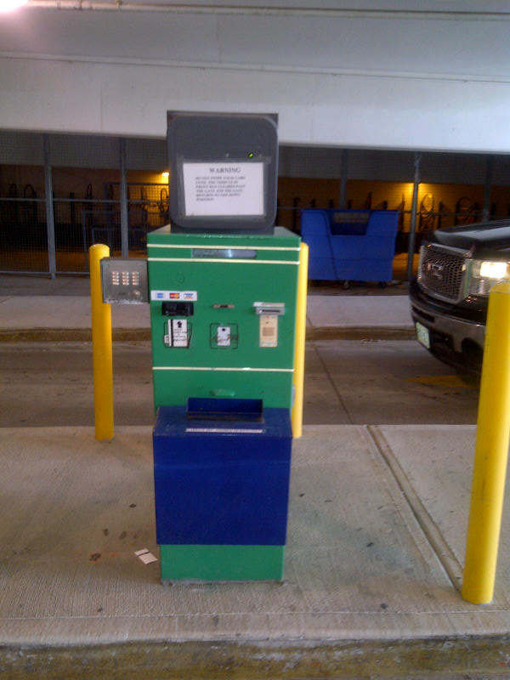
Considerations
Vendor / distributor relations
Monitoring / cameras
Intercoms
Software integration
Notes:
If you have close to 100% enforcement saturation, a culture of high daily payment compliance and citation payment compliance
Then you most likely have a stable environment and may not need access control
If some of these are causing you issues, access may be part of the solution

Slide 21

What Does the Future Hold?
LPR
Counting without gates
Audio / Video / Access Control Integration
Barcode
TICO
CICO
Mobile intergration

Slide 22
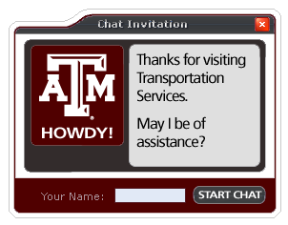
Questions?
Darren Craig
darren@york.ca
Peter Lange
plange@tamu.edu
Presentation available online:
http://transport.tamu.edu/presentations

