Slide 1
Controlling the Message
MSTPA Annual Conference
Lexington, KY
March 2011

Slide 2

About A&M
Texas’ first public institution of higher learning
Land-Grant, Sea-Grant and Space-Grant university
Seventh-largest university in enrollment
12,000 faculty/staff, 48,000 students
One of largest campuses – 5200 acres
Home to George Bush Presidential Library and Museum

Slide 3
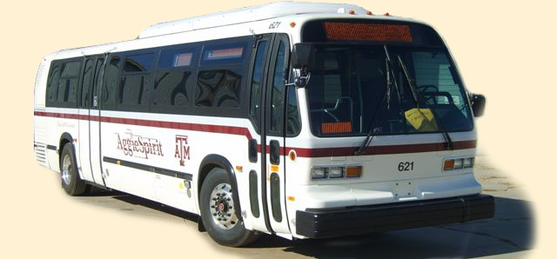
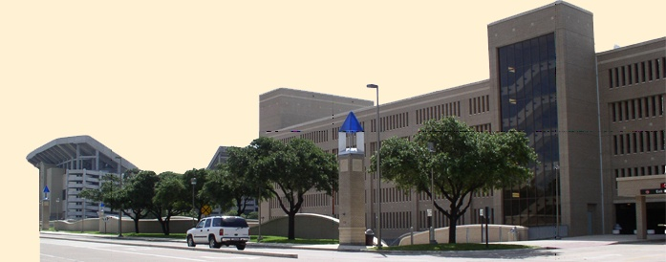
About Transportation Services
36,310 parking spaces
80 buses and 5 paratransit vans operating approximately 117,000 hours each year and 1.4 million service miles
Ridership over 5.1 million/yr
Notes:
Department budget of $26 million
Parking budget of $8 million
Transit budget of $5 million
108 employees

Slide 4
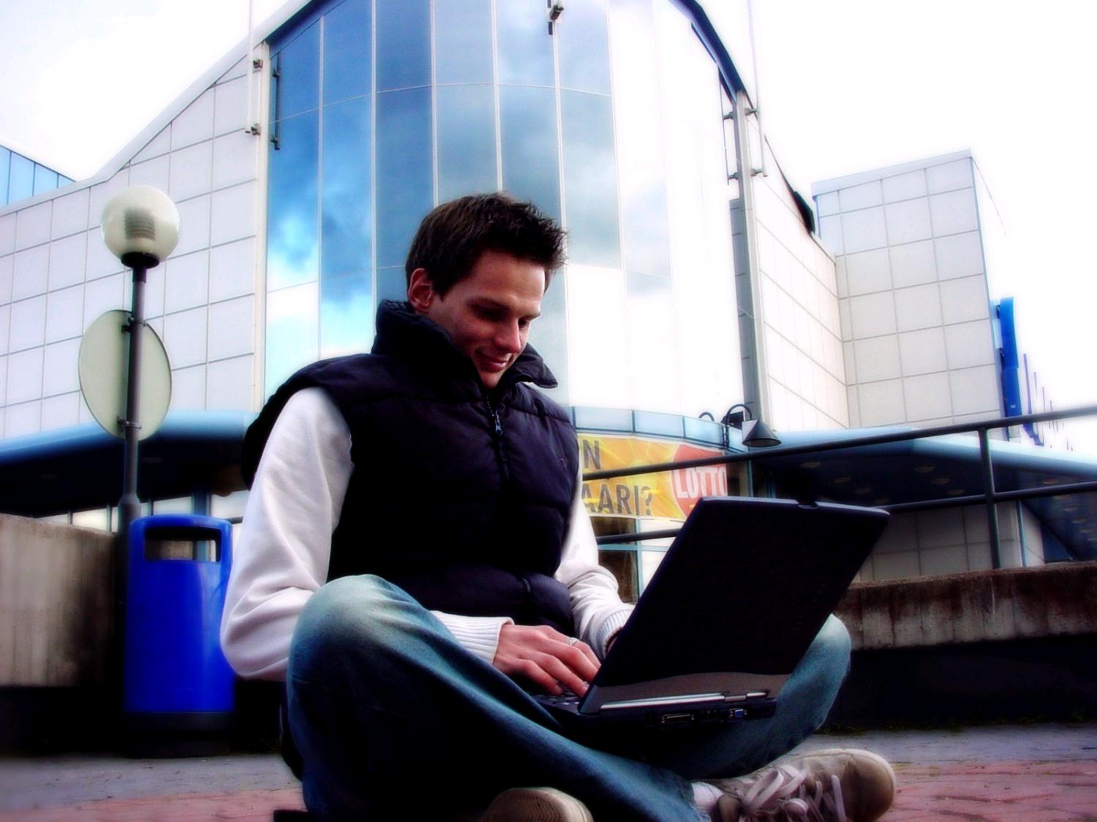
Y
Generation
Notes:
In order to effectively communicate, you have to know the best method to reach them.
Our students – largest target market.

Slide 5
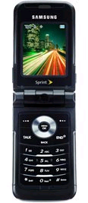

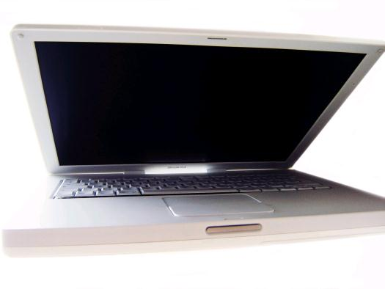

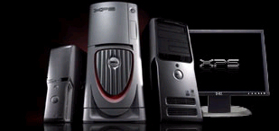

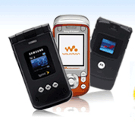
Communicating With Gen Y
Cell Phones
Laptop Computers
High-Speed Internet Access
Instant Messaging
MP3 Players (iPod)
Personal DVD players
Digital Cameras

Slide 6
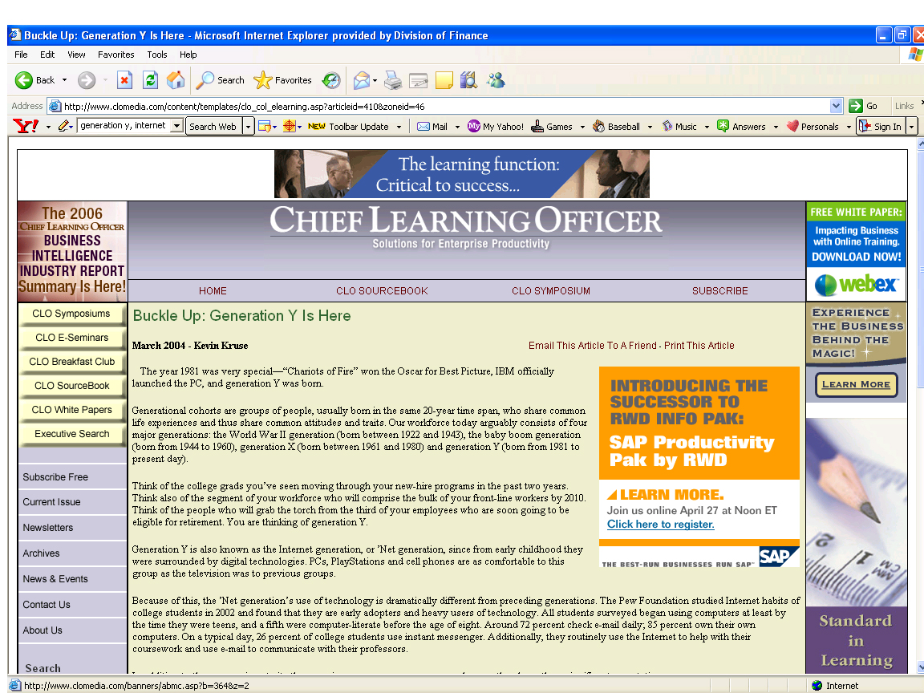
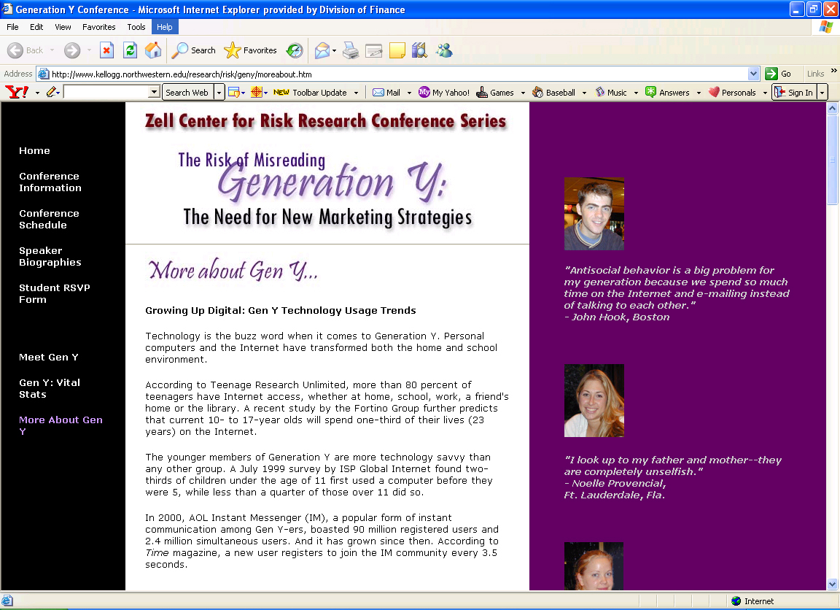

Communicating With Gen Y
Notes:
Fast paced, ever changing. Need to keep on top of the latest trends.

Slide 7
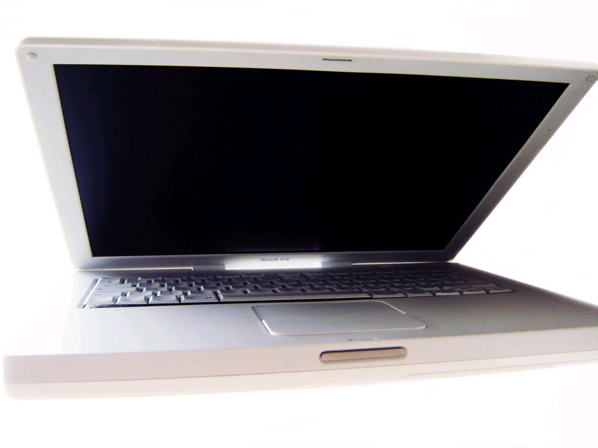
Generation Y - Technology
Internet is the media of choice.
First generation to grow up with computers in the home
75% - 90% of the of the teenagers have a computer at home
50% have access to the Internet from home
Using computers since nursery school

Slide 8
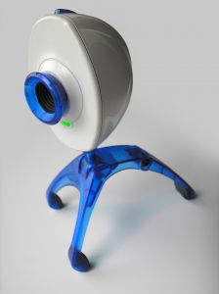
Generation Y
Graphics oriented, see text as supporting visual methods
  A picture is worth a thousand words
Thrive on change
  Variety = a few things that change frequently
Demand quick, if not instant, gratification
Self-Reliant: Used to doing it (and many other things) themselves, multi-taskers
Notes:
Show a video stream project as an example.

Slide 9
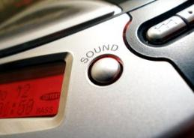
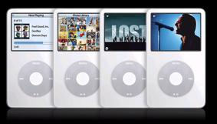
Generation Y
The Gen Y population is 32% of the total population
Grew up in media saturated, brand conscious world = raised as consumers
What do you think students look for in an advertisement? It might surprise you that from our research it is unvarnished truth, irony and humor
University Publications
California State University, Chico
Notes:
Keep this last point in mind about advertising – truth, irony and humor.

Slide 10

Annual Permit Registration
Aframe signage rotated throughout campus
Bus banners
Student Newspaper
Postcards to faculty/staff and retirees
Campus-wide emails to current permit holders
Radio
Computer lab screensavers
Website
Notes:
Print ads are kept very simple
- emails to permit holders
- ads in student newspaper
- radio ads
- signage at garages and other large parking areas
- postcards to fac/staff and retirees
- bus banners
- screen savers in computer labs
- website

Slide 11
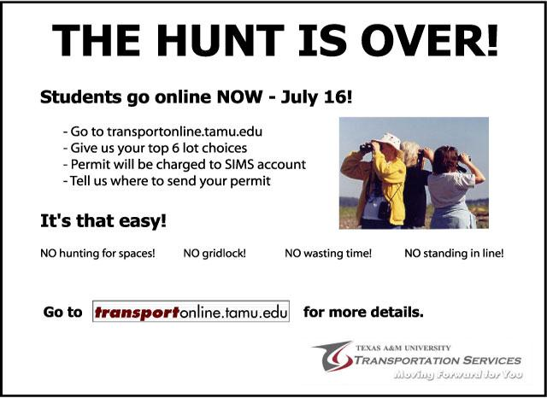

Annual Permit Registration

Slide 12
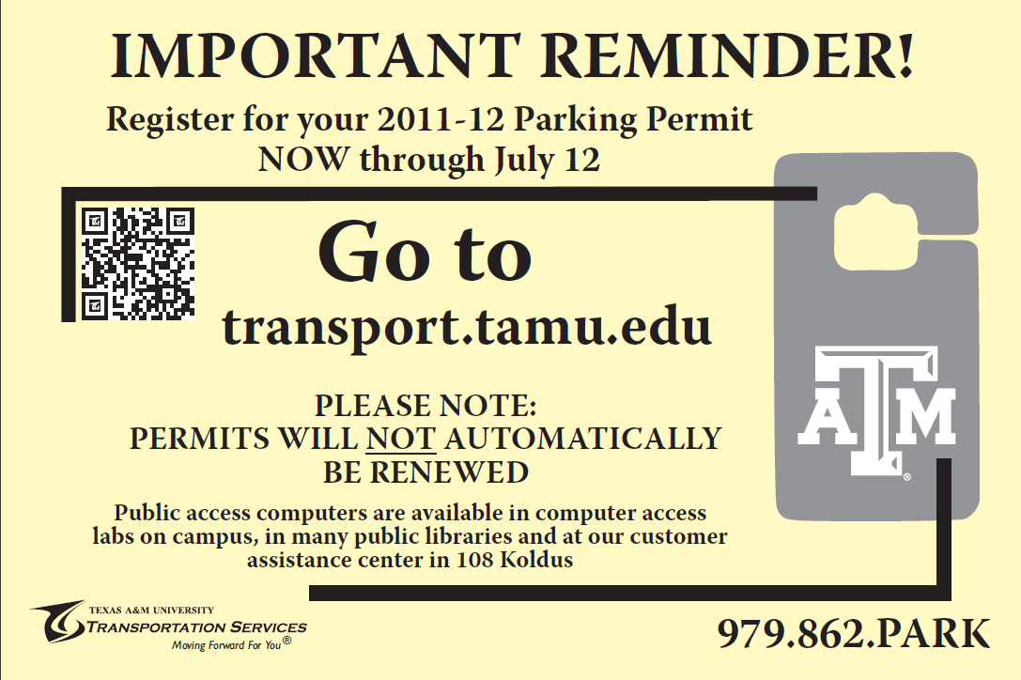
Annual Permit Registration
Notes:
ADD RADIO CLIPS – Hunt is Over and Last Year’s 30 sec spot
- emails to permit holders
- ads in student newspaper
- radio ads
- signage at garages and other large parking areas
- postcards to fac/staff and retirees
- bus banners
- screen savers in computer labs
- website

Slide 13
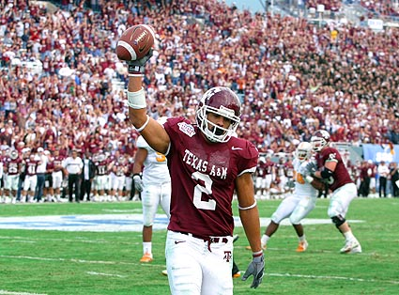
Football
Notes:
Radio
Press Releases to local and state media
Athletic website and opposing teams
Former Student Association
Hotels
Signage
Email campus
Department website
Chamber of Commerce Map
Mall

Slide 14
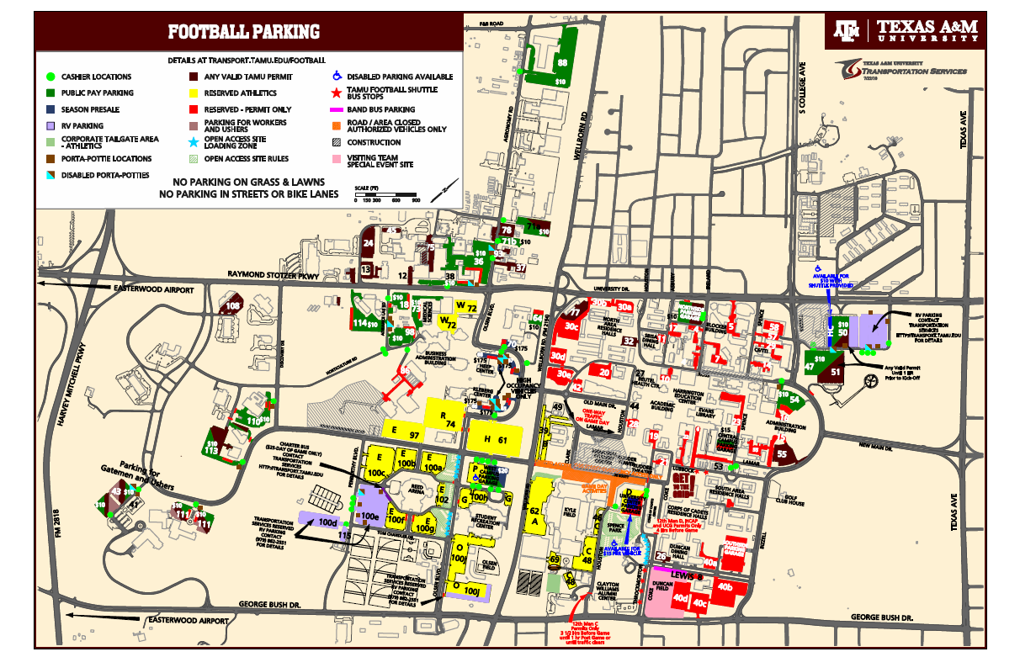

Slide 15
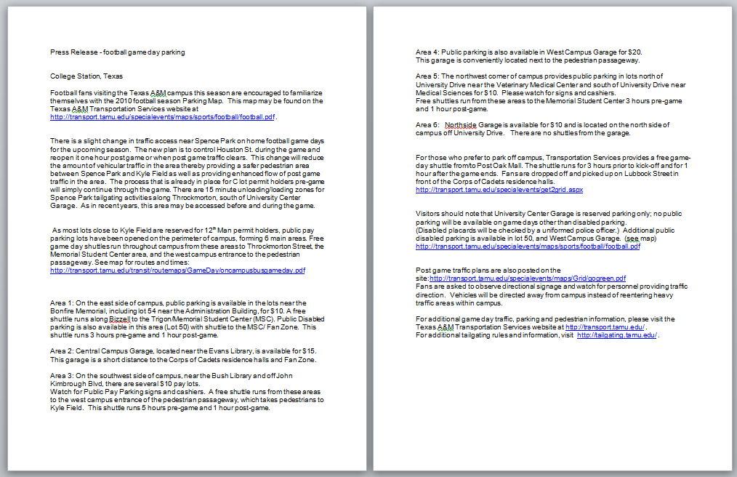
Football

Slide 16
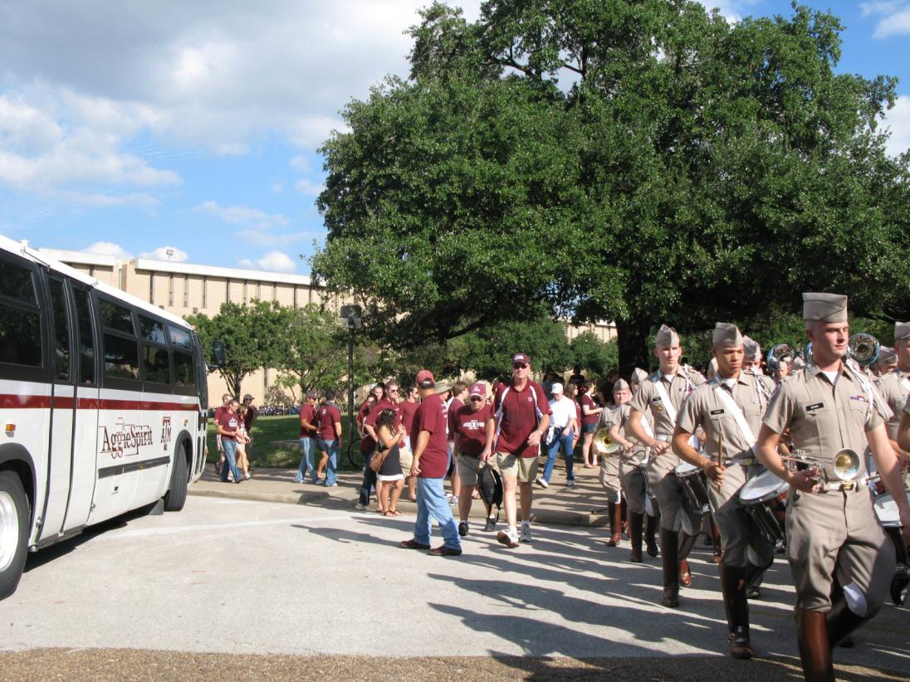
Football

Slide 17
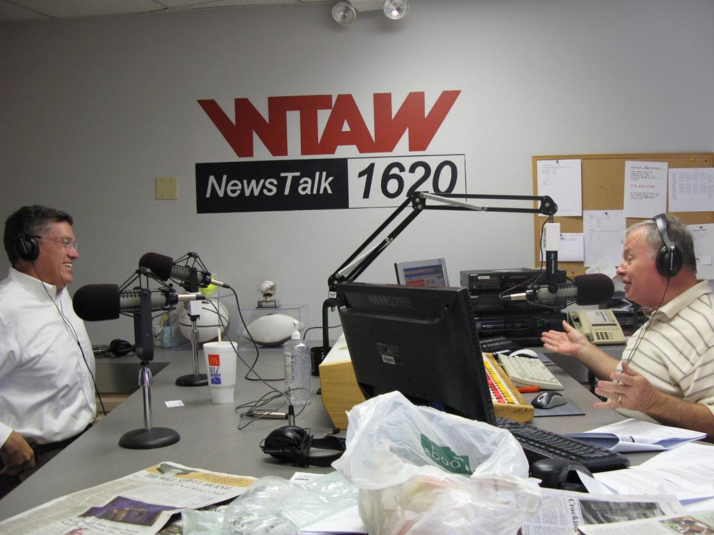
Football
Notes:
Free PR – Director Peter Lange @ WTAW
Add radio spot and video

Slide 18
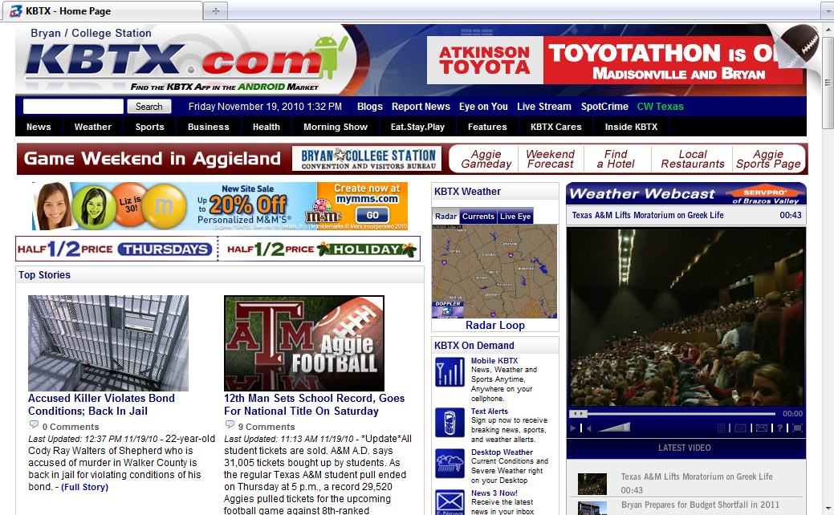
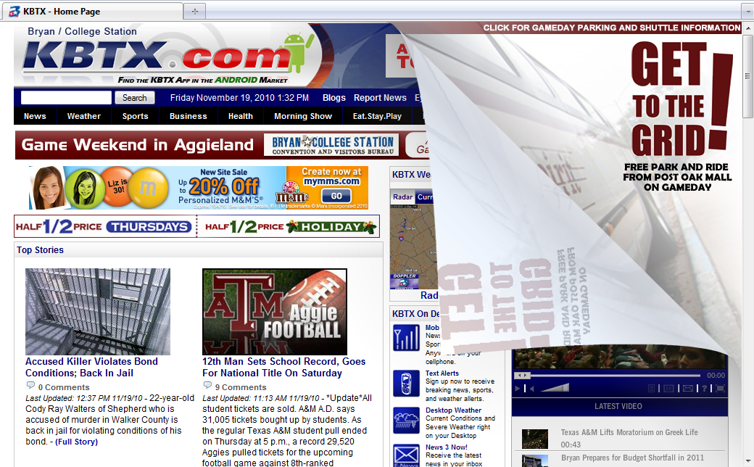
Notes:
Corner peel KBTX local CBS station

Slide 19

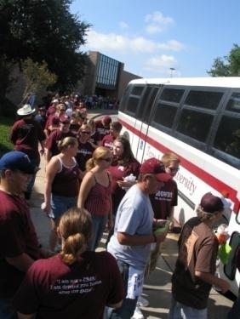
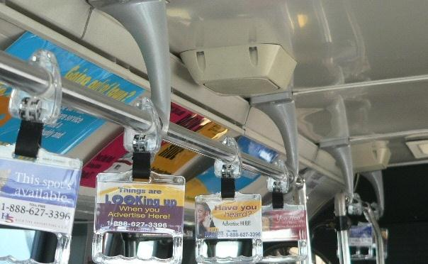
Football
Get to the Grid! Sponsor-funded game day shuttles from the mall to Kyle Field
Local charter services
Interior advertising

Slide 20
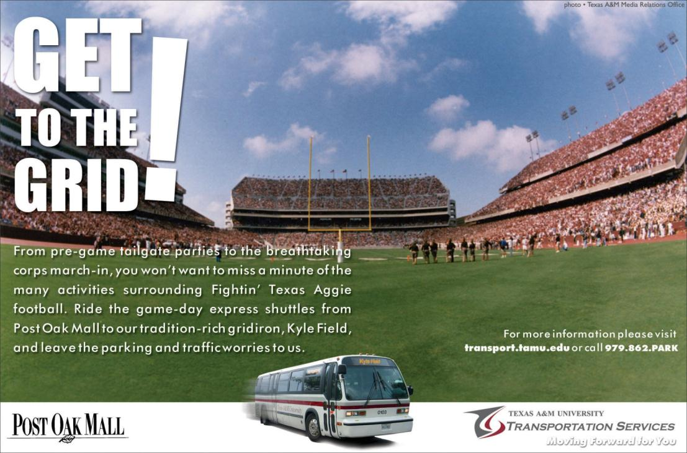
Get to the Grid!

Slide 21
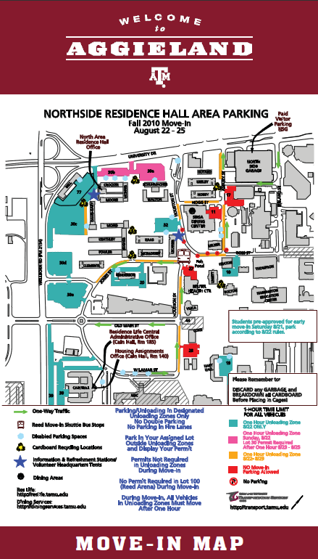
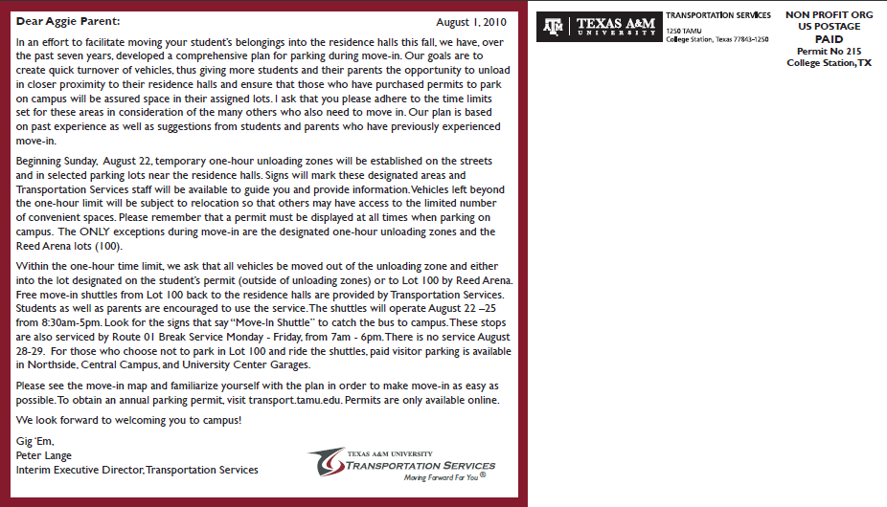
Move In
Direct mail to parents/guardians
Map corresponds to large signs posted on campus during move-in
Email to students
Aggie Hotline article to alert faculty/staff
Website
Coordination with Res Life and Dining Services
Notes:
- Postcards to parents
- Email to students
- Aggie Hotline article
- website

Slide 22




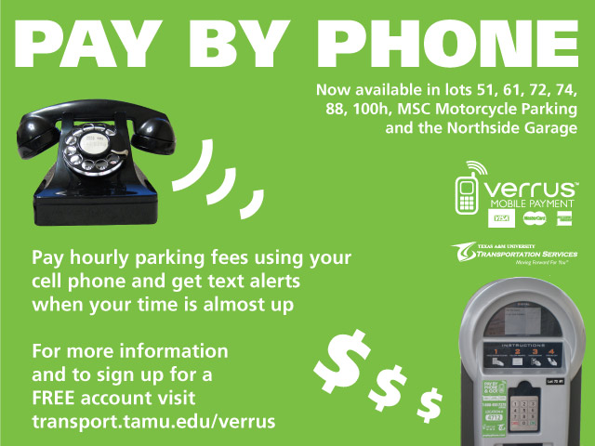
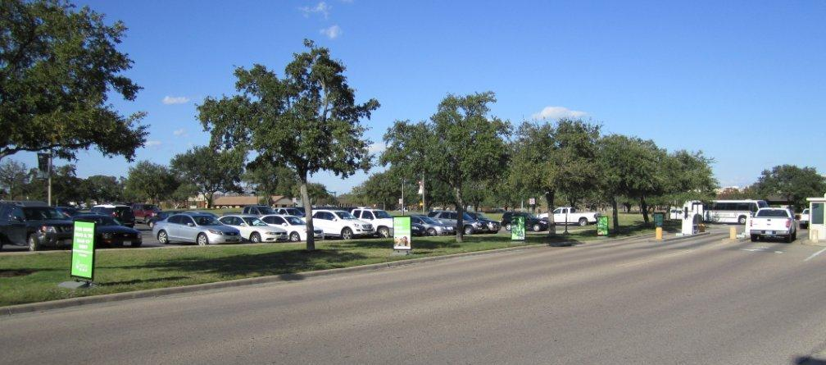
Verrus Campaign
Notes:
300 space visitor parking lot
Had 4 pay machines in the lot
Were getting negative feedback about lines at the machines
Adding machines is time consuming and expensive
Our solution was to add a pay by phone service
Needed to target the people parking in the lot
Coordinated signage – large signs along entrance, signs on machine, screensaver ads in computer labs and adjacent building, website announcements and info
Eye-catching – large photos and bright green from Verrus

Slide 23
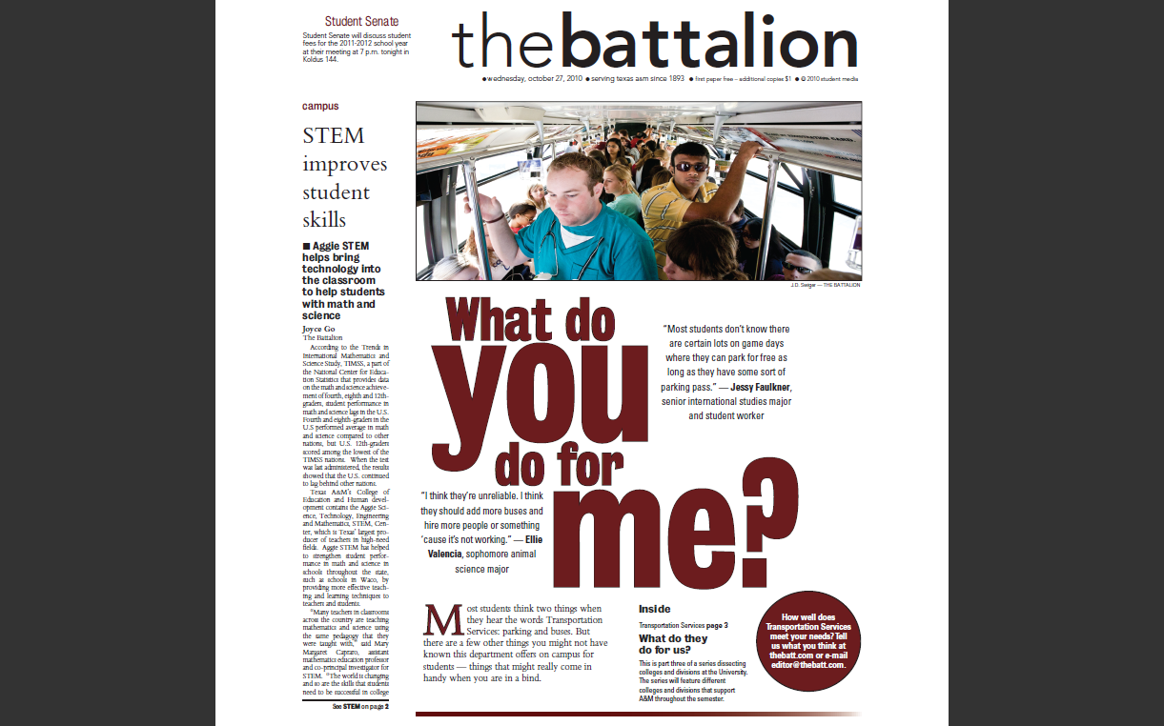
Student Newspaper

Slide 24
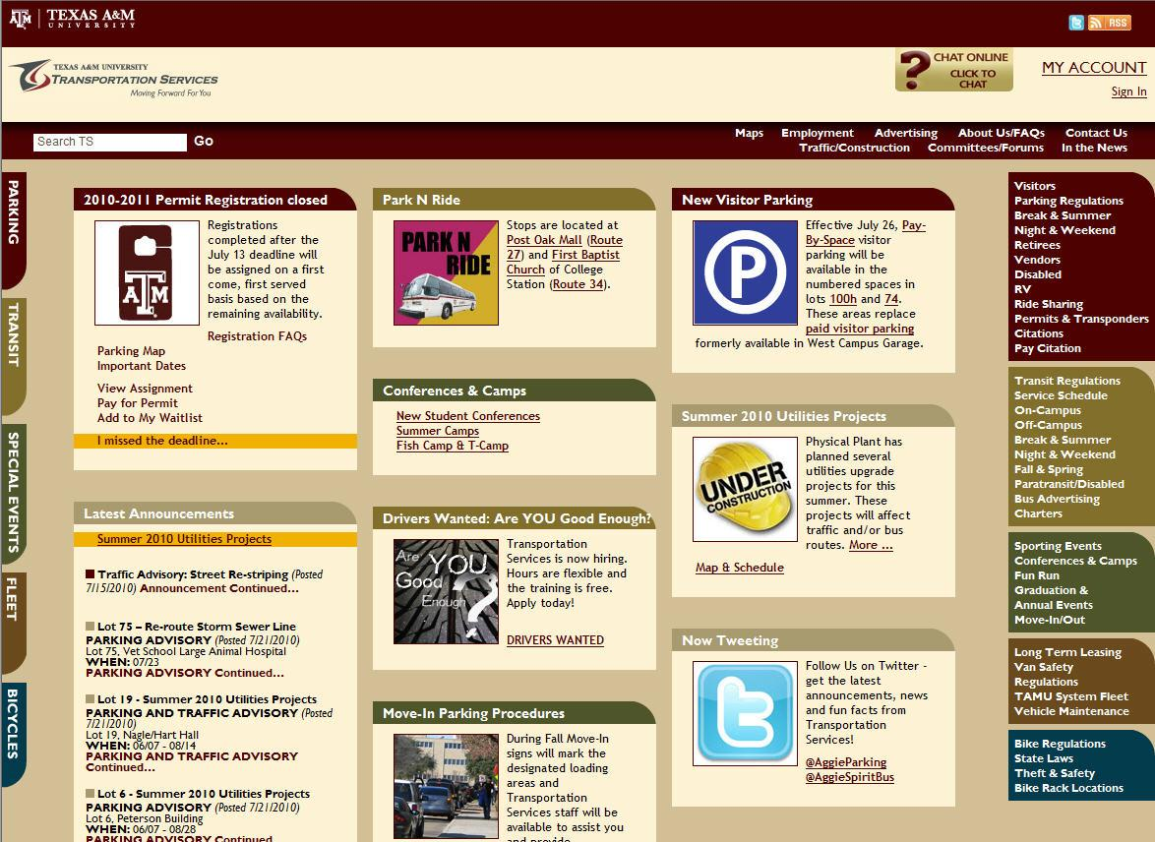
Public Website

Slide 25
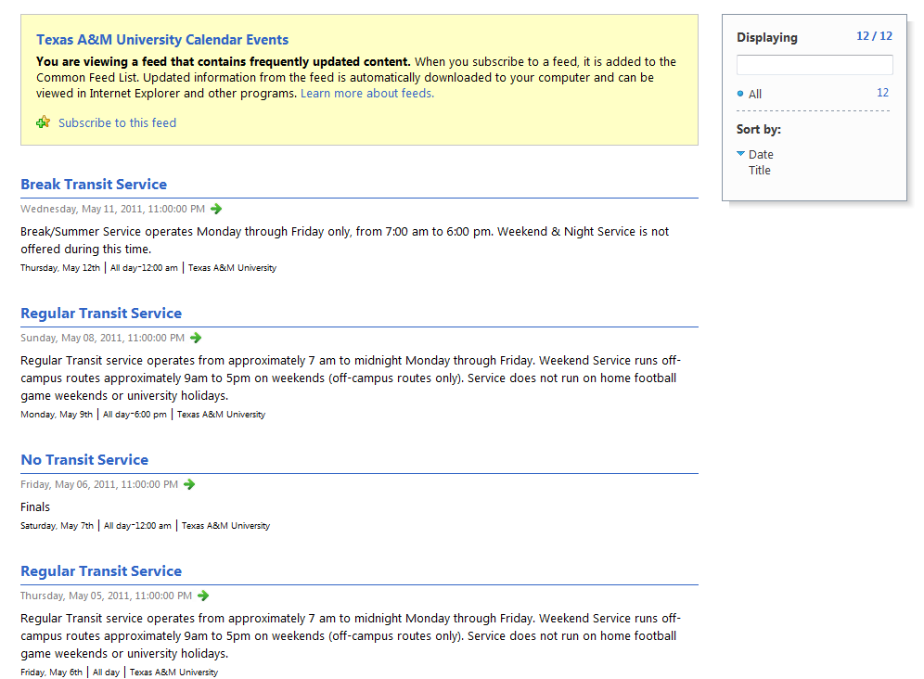
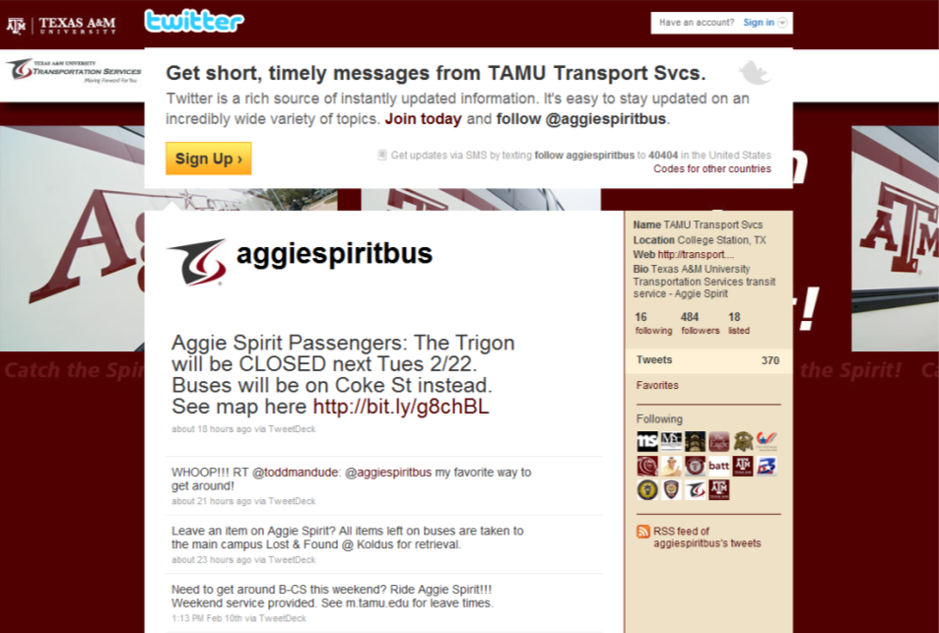



Social Media
Twitter
RSS feeds
Facebook
Notes:
Shooter – buses moving – twitter vs code maroon
RSS – Really Simple Syndication
Facebook
- staffing
- maintenance
- spam
Twitter
- Free tools for posting/maintaining: Twhirl, TweetDeck

Slide 26

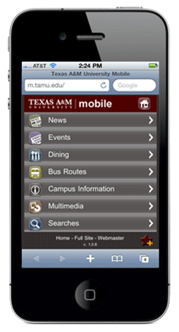
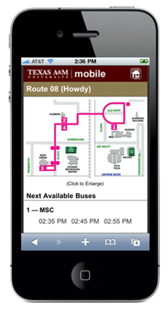
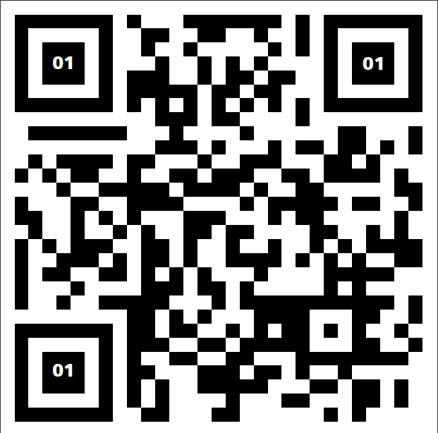
Other resources
m.tamu.edu mobile site
QR codes on bus stop signs
Notes:
University mobile site
- we post transit leave times, maps and twitter feed
QR codes – most commonly used as a URL but can also embed email, phone, YouTube video or any other text up to 4, 296 characters
Bus banners

Slide 27

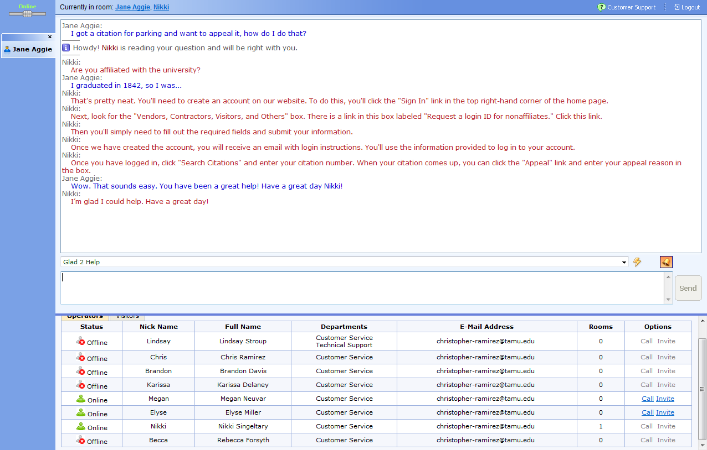
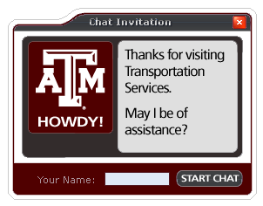
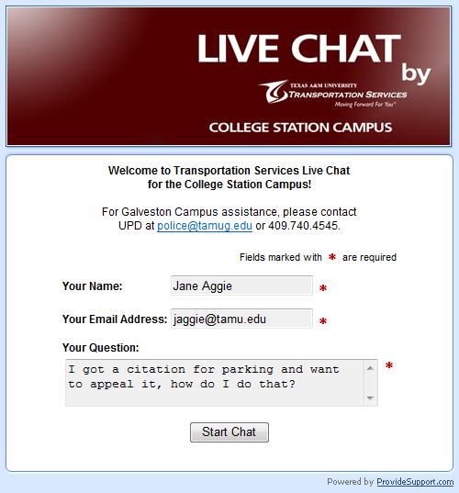
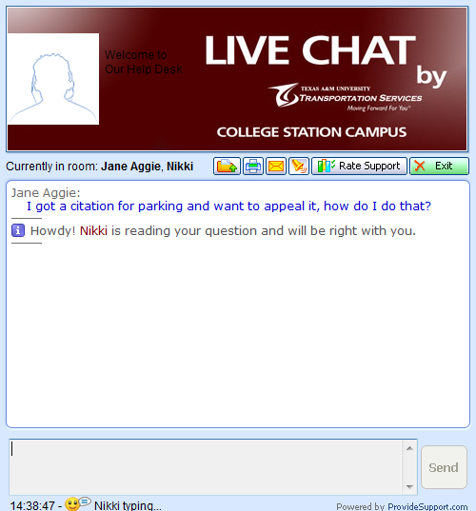
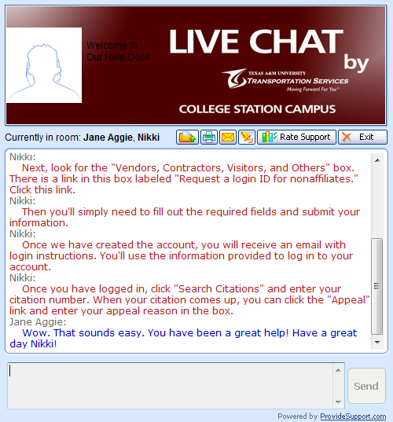
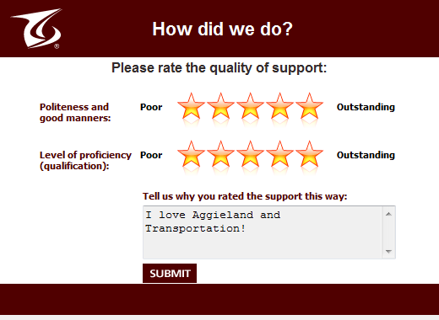
Click to Chat
Notes:
Right now we’re getting 5 – 10 chats daily. We expect a large rise closer to permit registration in April.

Slide 28
Annual Customer Survey
Notes:
Overall satisfaction – Parking & Transit

Slide 29
Annual Customer Survey
Notes:
Overall satisfaction – Parking & Transit

Slide 30
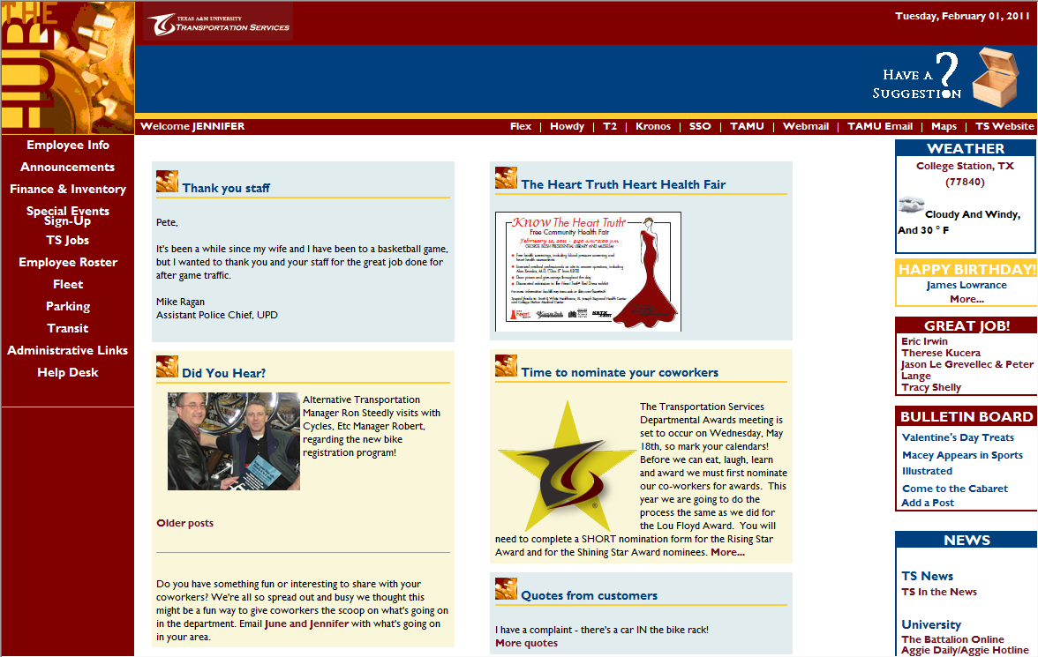
TheHUB Intranet Site
Notes:
Intranet site – don’t forget your employees – keep them aware and engaged and they can help spread the word
Website

Slide 31
Orientation Video
Flash Version (39MB)
http://transport.tamu.edu/about/files/IntroVideo.flv
QuickTime Version (735MB)
http://transport.tamu.edu/about/files/IntroVideo.mov

Slide 32
June Broughton
june@tamu.edu
Jennifer Le Grévellec
jenniferl@tamu.edu
Presentation available online:
http://transport.tamu.edu/presentations

