Slide 1

Big Events
Maximizing Resources, Revenue and Options
Debbie Hoffmann
Associate Director, Texas A&M University

Slide 2
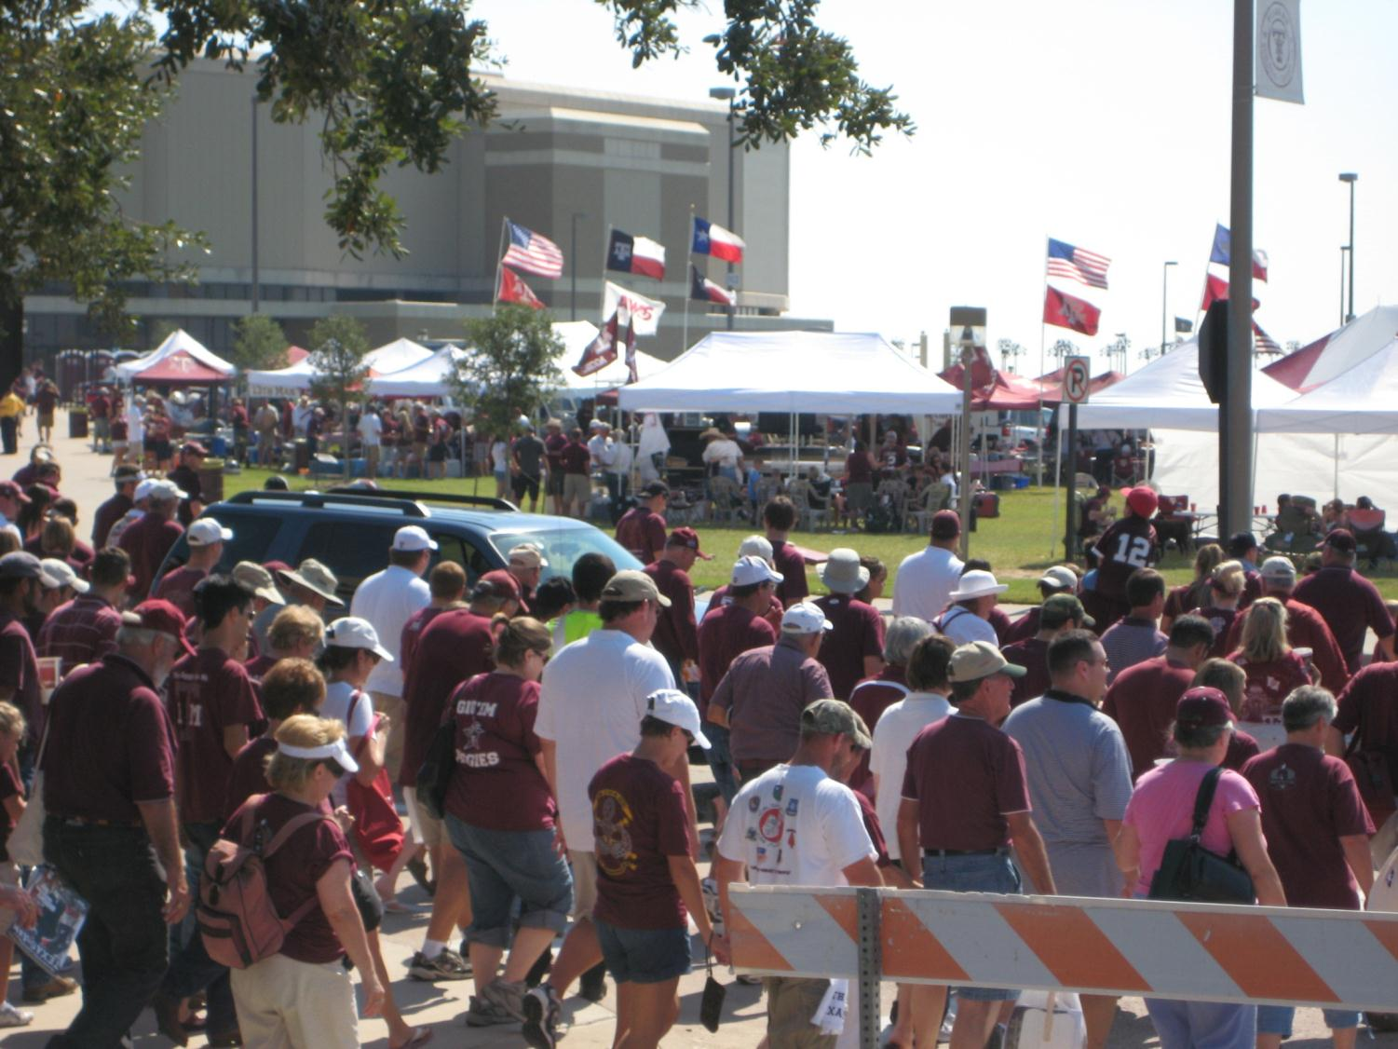

Slide 3
Best Practices
Learn to plan an maximize available resources
Understand how to use pricing strategy to realize revenue growth potential while offsetting costs
Learn to offer a safe venue by planning for traffic, enforcement and pedestrian and vehicular movement

Slide 4

About A&M
Texas’ first public institution of higher learning
Land-Grant, Sea-Grant and Space-Grant university
Seventh-largest university in enrollment
12,000 faculty/staff, 49,800 students
One of largest campuses – 5200 acres
Home to George Bush Presidential Library and Museum

Slide 5
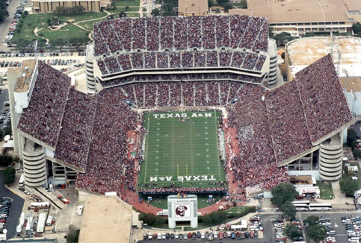
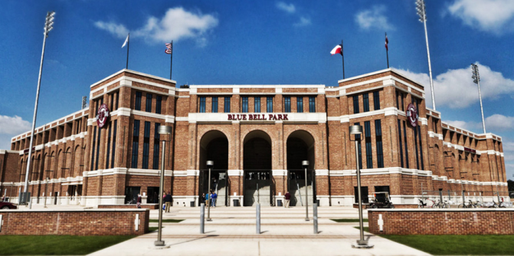
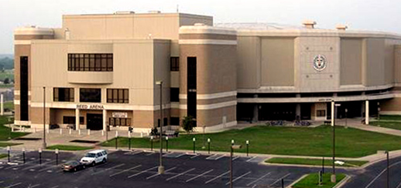
About A&M Venues
Football stadium seats 82,600
Basketball arena seats 12,500
Baseball field seats 6,600
Performing Arts theatre seats 2,500
Notes:
Multi-thousand conferences
NCAA regional playoff events for baseball, basketball, tennis, soccer, track

Slide 6
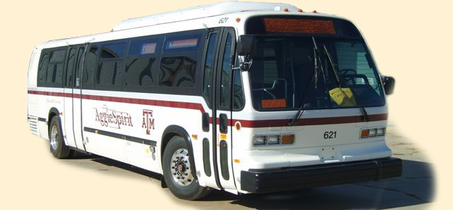
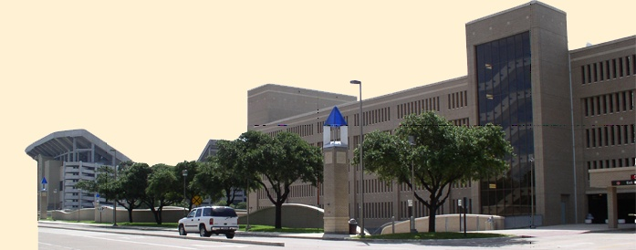
About Transportation Services
36,310 parking spaces
80 buses and 5 paratransit vans operating approximately 117,000 hours each year and 1.4 million service miles
Ridership over 5.1 million/yr
Notes:
Department budget of $26 million
Parking budget of $8 million
Transit budget of $5 million
108 employees

Slide 7
Let’s Talk Events
Video
http://transport.tamu.edu/about/presentations/2012/BigEvents/OpeningSlide7.wmv

Slide 8



Maximize Resources
Cooperation
Comprehensive Plan

Slide 9
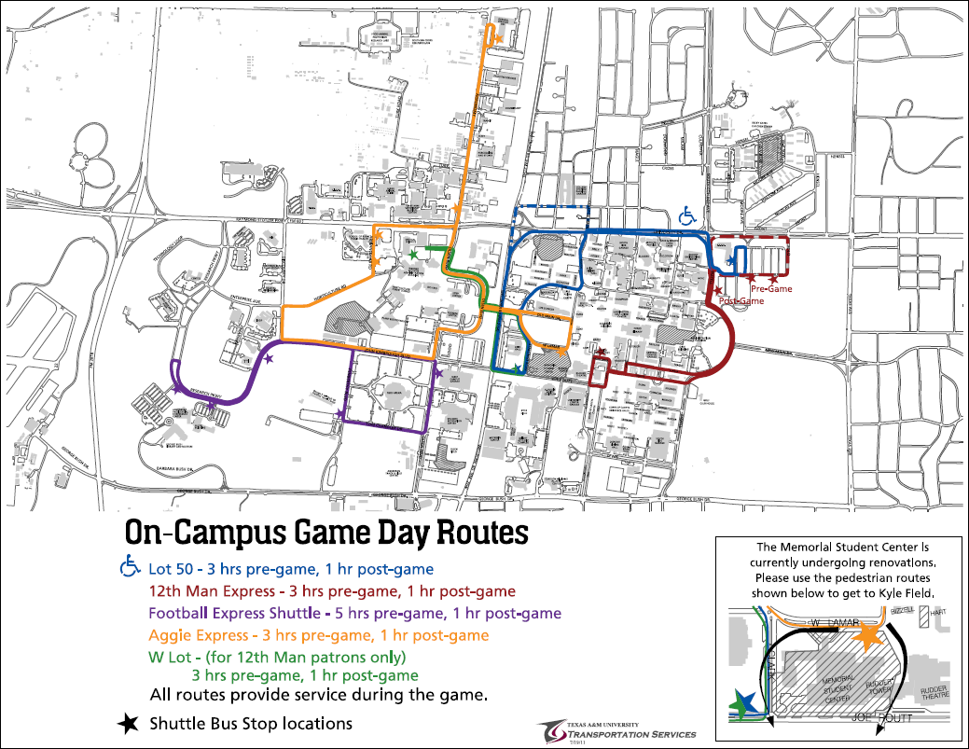
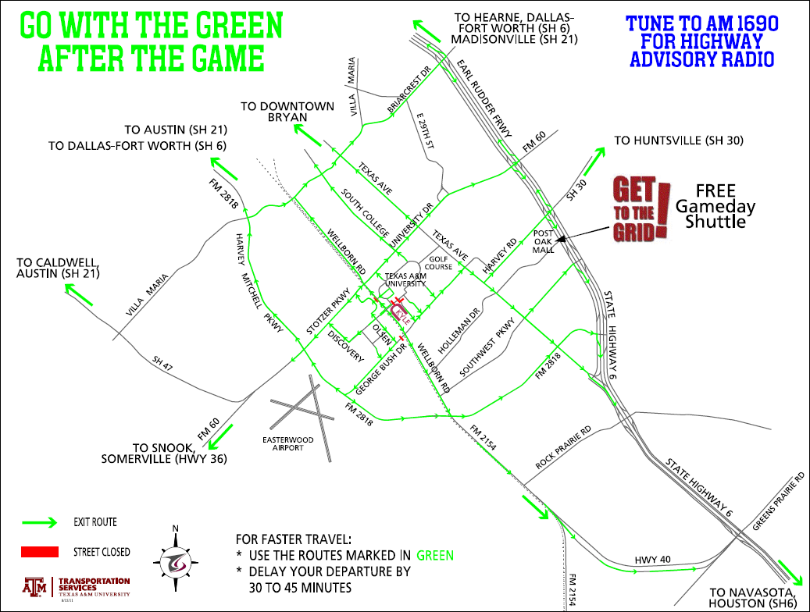
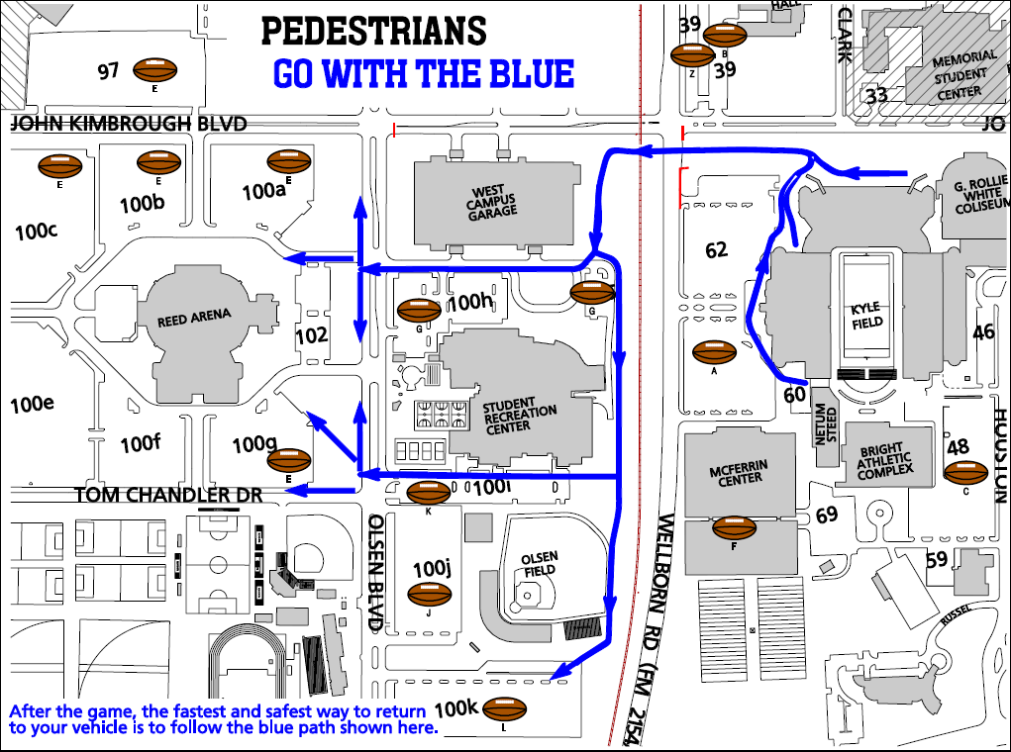
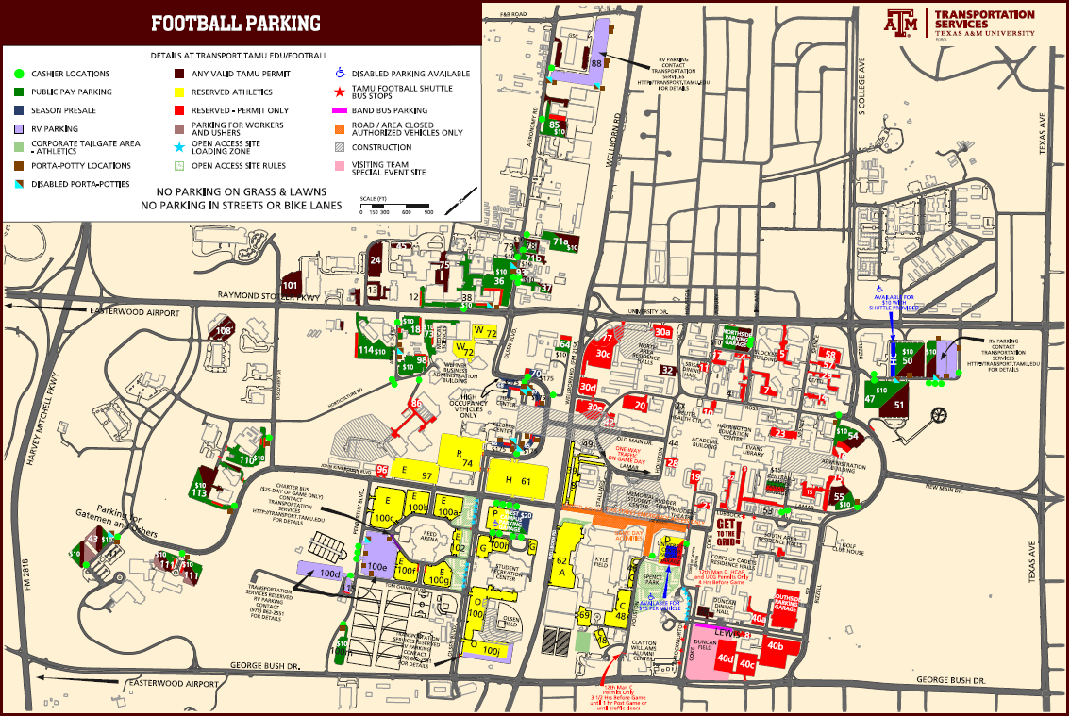
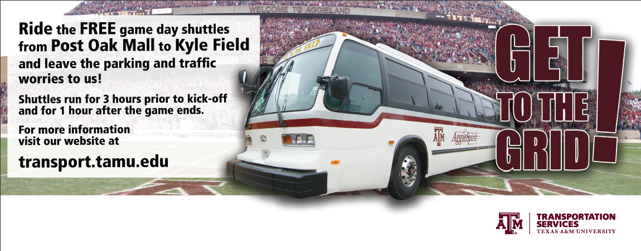
Plan, Plan and Plan
Comprehensive Event Plan
  Get People to the Event
    Consider all customer groups
    Consider multimodal
  Get People Away from the Event
    Traffic Plan
    Pedestrian Plan
Notes:
Regardless of your size, PLANNING for success is critical to success
534 RV spaces with potential this season to top 650

Slide 10
Available Resources
Video
http://transport.tamu.edu/about/presentations/2012/BigEvents/ResourcesSlide10.wmv

Slide 11
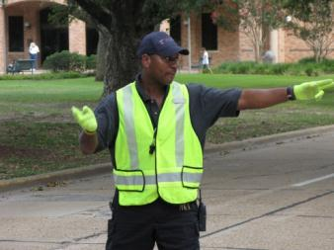
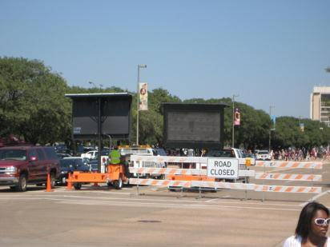
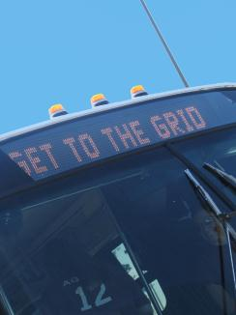
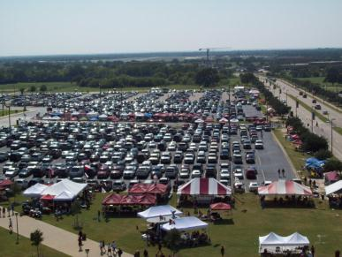
Comprehensive Plan Should Consider...
Staffing
Equipment
Parking
Transit
Getting the Word Out
Notes:
STAFFING:
Administrators – directors, managers, supervisors – have enough eyes on the event (18-20)
Budgeted employees – experienced and knowledgeable about the campus layout (45-50)
Student Workers (60-65)
Temp event staff (30)
EQUIPMENT:
Barricades, signs, ropes, cones, barriers – enough to ensure success
Contract out if not able to handle inhouse
Shirts, vests, food, umbrellas, sunscreen, tents, radios, night lights (blinking), golf carts, porta potties, dump stations, sewer trucks,
PARKING PLAN:
Donor lots, season parking pass areas, disabled parking, employee parking, cash lots, RVs, tailgaters
TRANSIT:
Consider routes away from traffic congestion; hours of operation; getting employees to venue; on-campus; off-campus; disabled; park and ride
GETTING THE WORD OUT:
In advance so customers can plan ahead – helps them and you.
Customers coming to the event
Customers coming to campus but not for the event
Customers displaced because of the event

Slide 12

Ops
FAQs
GAME DAY OPERATIONS
Maps
Lot Instr
Permits
RV
Misc

Slide 13
Ops
Cashiering Tips
Before & During Game
Sdfsdf
Asdf sdf asdf asdf
Asdf asdf a
Asdf asdf
asdf as
Df asdf as
Df asdf
Asdf asdf
asdf
After Game
Sdfsdf
Asdf sdf asdf asdf
Asdf asdf a
Asdf asdf
asdf as
Df asdf as
Df asdf
Asdf asd fsdf sdf asdf sdf
Radio Etiquette
Always dfsdf
Asdf sdf asdf asdf
Asdf asdf a
Asdf asdf
asdf as
Df asdf as
Df asdf
Asdf asdf
asdf asdf asdkfj’asd
Asdlfja;sdlfj
Asdf jasdlkfj fkjdlska f
Sldkjf jsldjf
Lkj; jsdljf
FAQs
Maps
Lot Instr
Permits
RV
Misc

Slide 14
Ops
Frequently Asked Questions
Where is the free vehicle parking?
alskdfj alksjdf laksjdflksjdflskjdf lskdjf lkdjf alksdjf alksjf lksdjf
Where is motorcycle parking and do they pay?
asdlkfj alsdkjf alkdsjf alskdfj a
Where is the RV parking?
alskdfj alksjdf laksjdflksjdflskjdf lskdjf lkdjf alksdjf alksjf lksdjf
Where is bus parking?
asdlkfj alsdkjf alkdsjf alskdfj a
Where is disabled parking?
alskdfj alksjdf laksjdflksjdflskjdf lskdjf lkdjf alksdjf alksjf lksdjf
What do I do if someone drives past me and doesn’t stop?
asdlkfj alsdkjf alkdsjf alskdfj a
What do I do if I need a break?
alskdfj alksjdf laksjdflksjdflskjdf lskdjf lkdjf alksdjf alksjf lksdjf
Are BBQ pits and trailers allowed?
asdlkfj alsdkjf alkdsjf alskdfj a
FAQs
Maps
Lot Instr
Permits
RV
Misc

Slide 15
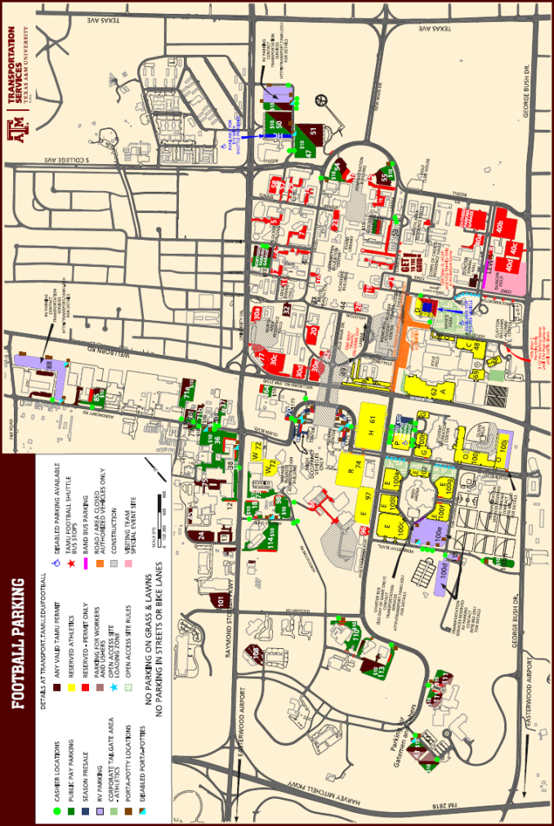
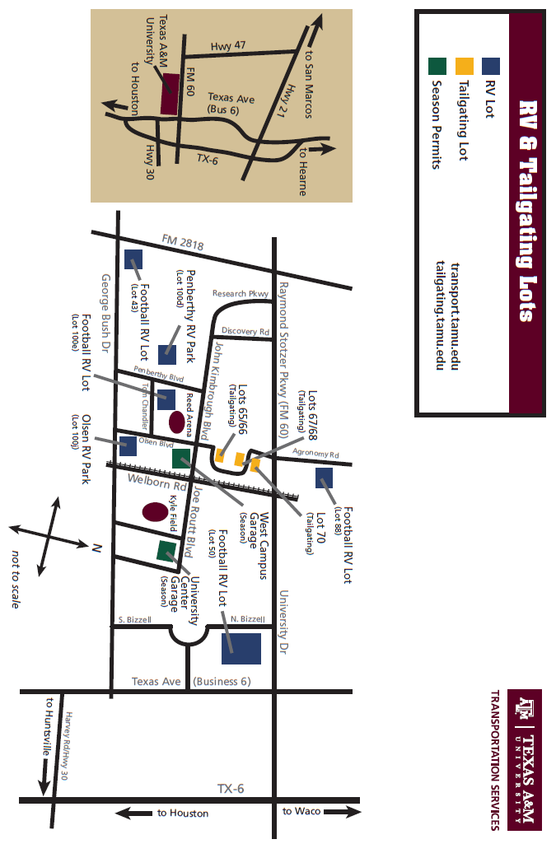
Ops
Frequently Asked Questions
Where is the free vehicle parking?
alskdfj alksjdf laksjdflksjdflskjdf lskdjf lkdjf alksdjf alksjf lksdjf
Where is motorcycle parking and do they pay?
asdlkfj alsdkjf alkdsjf alskdfj a
Where is the free vehicle parking?
alskdfj alksjdf laksjdflksjdflskjdf lskdjf lkdjf alksdjf alksjf lksdjf
Where is motorcycle parking and do they pay?
asdlkfj alsdkjf alkdsjf alskdfj a
Where is the free vehicle parking?
alskdfj alksjdf laksjdflksjdflskjdf lskdjf lkdjf alksdjf alksjf lksdjf
Where is motorcycle parking and do they pay?
asdlkfj alsdkjf alkdsjf alskdfj a
Where is the free vehicle parking?
alskdfj alksjdf laksjdflksjdflskjdf lskdjf lkdjf alksdjf alksjf lksdjf
Where is motorcycle parking and do they pay?
asdlkfj alsdkjf alkdsjf alskdfj a
FAQs
Maps
Lot Instr
Permits
RV
Misc

Slide 16
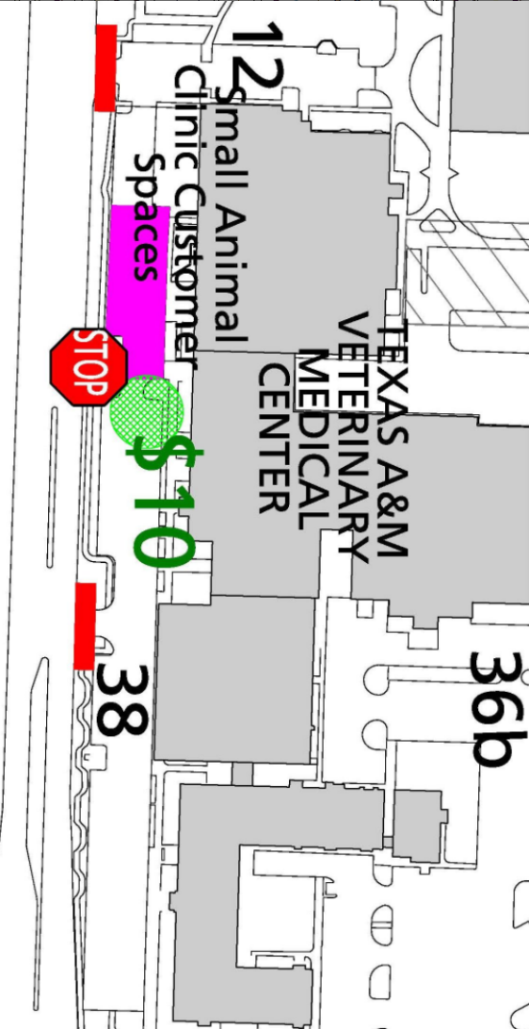
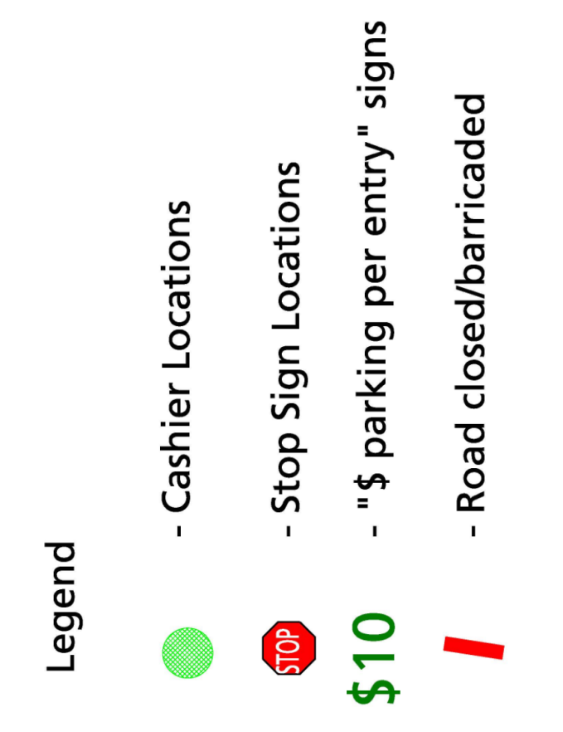
Ops
Frequently Asked Questions
Where is the free vehicle parking?
alskdfj alksjdf laksjdflksjdflskjdf lskdjf lkdjf alksdjf alksjf lksdjf
Where is motorcycle parking and do they pay?
asdlkfj alsdkjf alkdsjf alskdfj a
Where is the free vehicle parking?
alskdfj alksjdf laksjdflksjdflskjdf lskdjf lkdjf alksdjf alksjf lksdjf
Where is motorcycle parking and do they pay?
asdlkfj alsdkjf alkdsjf alskdfj a
Where is the free vehicle parking?
alskdfj alksjdf laksjdflksjdflskjdf lskdjf lkdjf alksdjf alksjf lksdjf
Where is motorcycle parking and do they pay?
asdlkfj alsdkjf alkdsjf alskdfj a
Where is the free vehicle parking?
alskdfj alksjdf laksjdflksjdflskjdf lskdjf lkdjf alksdjf alksjf lksdjf
Where is motorcycle parking and do they pay?
asdlkfj alsdkjf alkdsjf alskdfj a
FAQs
Maps
Lot Instr
Permits
RV
Misc

Slide 17
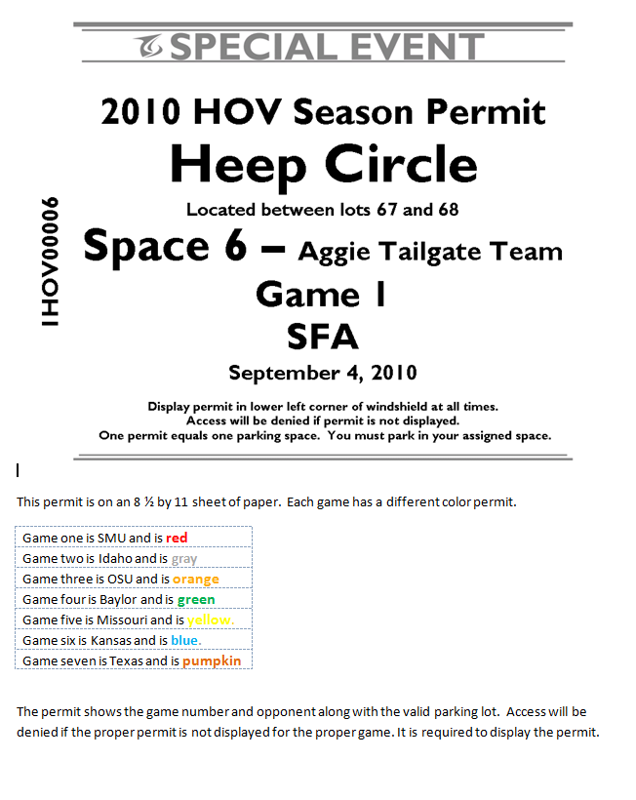
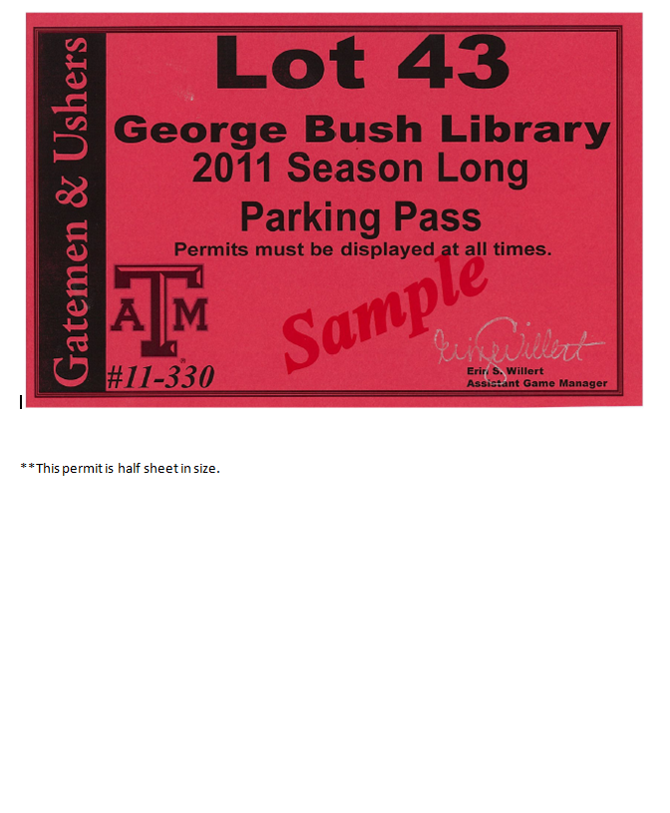
Ops
Frequently Asked Questions
Where is the free vehicle parking?
alskdfj alksjdf laksjdflksjdflskjdf lskdjf lkdjf alksdjf alksjf lksdjf
Where is motorcycle parking and do they pay?
asdlkfj alsdkjf alkdsjf alskdfj a
Where is the free vehicle parking?
alskdfj alksjdf laksjdflksjdflskjdf lskdjf lkdjf alksdjf alksjf lksdjf
Where is motorcycle parking and do they pay?
asdlkfj alsdkjf alkdsjf alskdfj a
Where is the free vehicle parking?
alskdfj alksjdf laksjdflksjdflskjdf lskdjf lkdjf alksdjf alksjf lksdjf
Where is motorcycle parking and do they pay?
asdlkfj alsdkjf alkdsjf alskdfj a
Where is the free vehicle parking?
alskdfj alksjdf laksjdflksjdflskjdf lskdjf lkdjf alksdjf alksjf lksdjf
Where is motorcycle parking and do they pay?
asdlkfj alsdkjf alkdsjf alskdfj a
FAQs
Maps
Lot Instr
Permits
RV
Misc

Slide 18
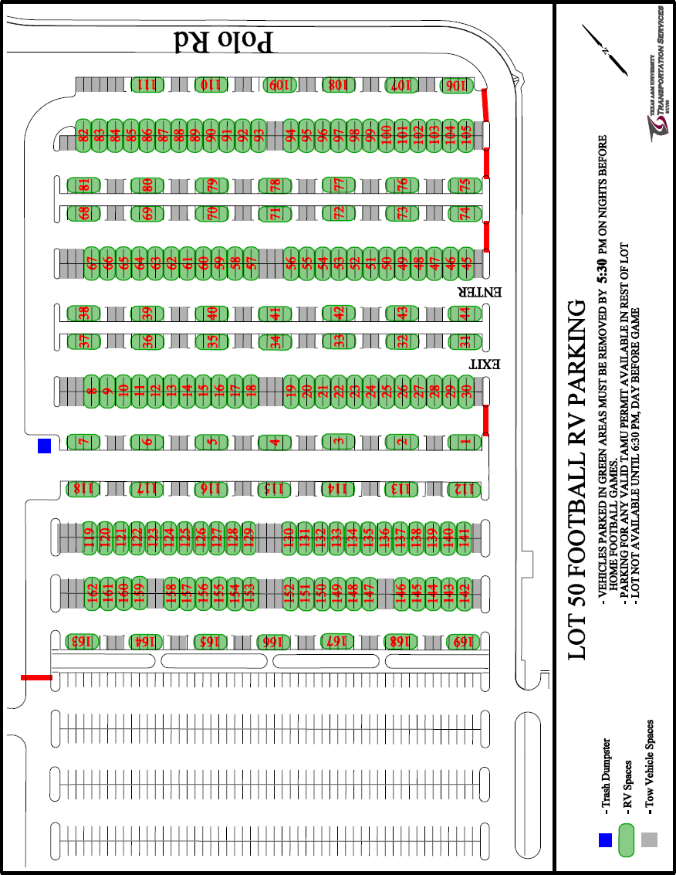
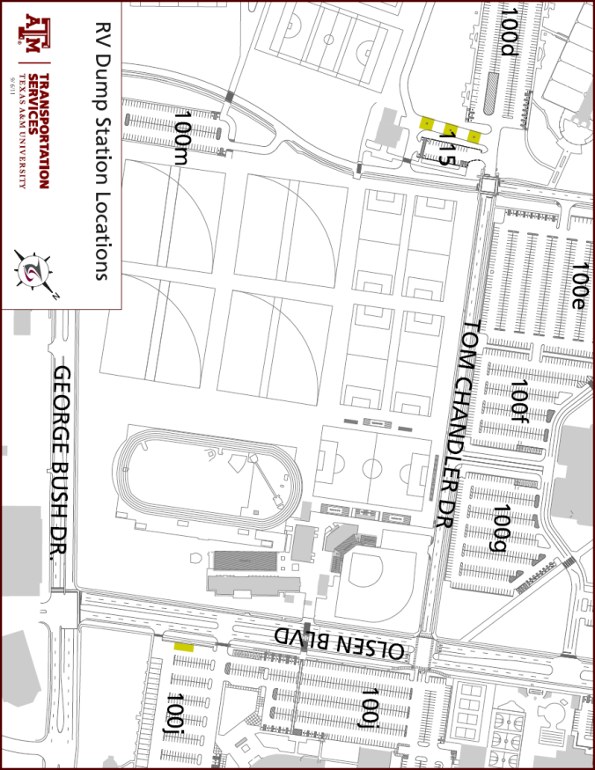
Ops
Frequently Asked Questions
Where is the free vehicle parking?
alskdfj alksjdf laksjdflksjdflskjdf lskdjf lkdjf alksdjf alksjf lksdjf
Where is motorcycle parking and do they pay?
asdlkfj alsdkjf alkdsjf alskdfj a
Where is the free vehicle parking?
alskdfj alksjdf laksjdflksjdflskjdf lskdjf lkdjf alksdjf alksjf lksdjf
Where is motorcycle parking and do they pay?
asdlkfj alsdkjf alkdsjf alskdfj a
Where is the free vehicle parking?
alskdfj alksjdf laksjdflksjdflskjdf lskdjf lkdjf alksdjf alksjf lksdjf
Where is motorcycle parking and do they pay?
asdlkfj alsdkjf alkdsjf alskdfj a
Where is the free vehicle parking?
alskdfj alksjdf laksjdflksjdflskjdf lskdjf lkdjf alksdjf alksjf lksdjf
Where is motorcycle parking and do they pay?
asdlkfj alsdkjf alkdsjf alskdfj a
FAQs
Maps
Lot Instr
Permits
RV
Misc

Slide 19
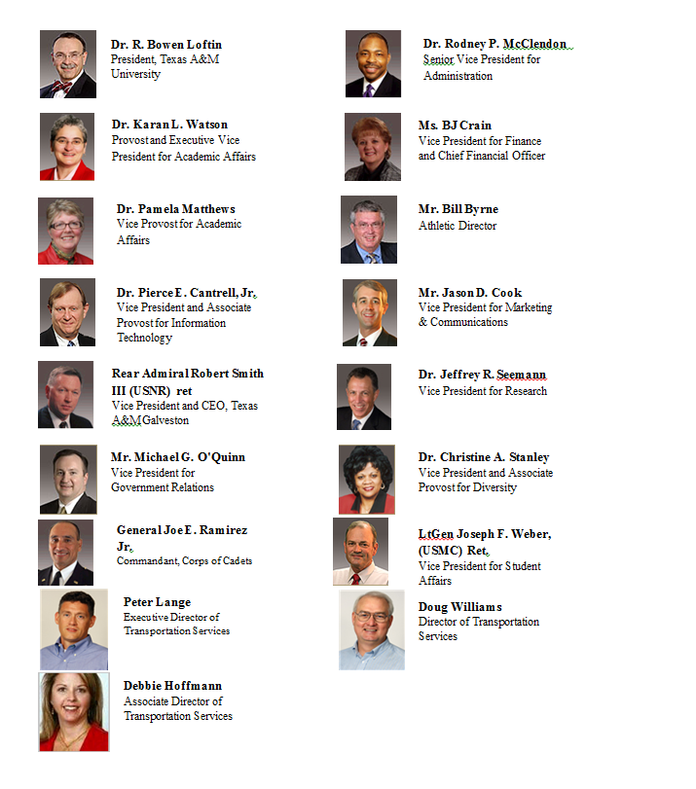
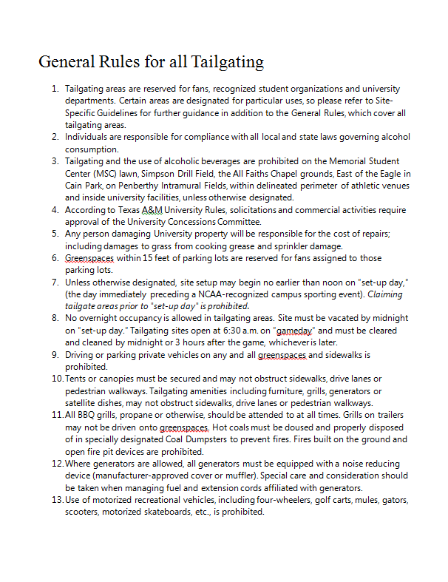
Ops
Frequently Asked Questions
Where is the free vehicle parking?
alskdfj alksjdf laksjdflksjdflskjdf lskdjf lkdjf alksdjf alksjf lksdjf
Where is motorcycle parking and do they pay?
asdlkfj alsdkjf alkdsjf alskdfj a
Where is the free vehicle parking?
alskdfj alksjdf laksjdflksjdflskjdf lskdjf lkdjf alksdjf alksjf lksdjf
Where
Where is the free vehicle parking?
alskdfj alksjdf laksjdflksjdflskjdf lskdjf lkdjf alksdjf alksjf lksdjf
Where is motorcycle parking and do they pay?
asdlkfj alsdkjf alkdsjf alskdfj a
Where is the free vehicle parking?
alskdfj alksjdf laksjdflksjdflskjdf lskdjf lkdjf alksdjf alksjf lksdjf
Where is motorcycle parking and do they pay?
asdlkfj alsdkjf alkdsjf alskdfj a
FAQs
Maps
Lot Instr
Permits
RV
Misc

Slide 20

Communication
Notes:
Internal Communication –
Our units
SPEV
Enforcement
Barricade & Sign Crew
Marketing
Customer Service
Transit
Vehicle Maintenance
University Units
Athletics
UPD
EHS
Facilities Services
Waste Management
Landscape Management – turn off sprinkler systems
Student Affairs – manage student groups involved
Administrators
Event Coordinators – help limit conflicts
Community units
City Police
County Law Enforcement
Media
Department of Transportation

Slide 21
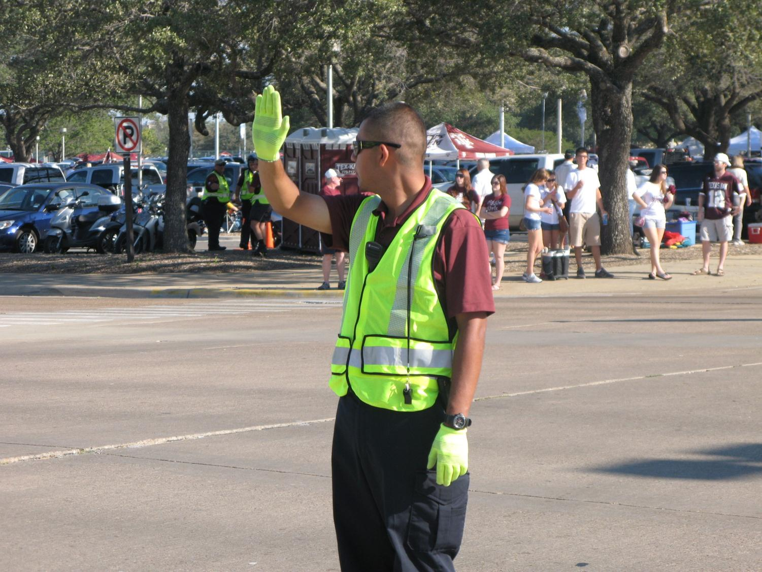

Slide 22
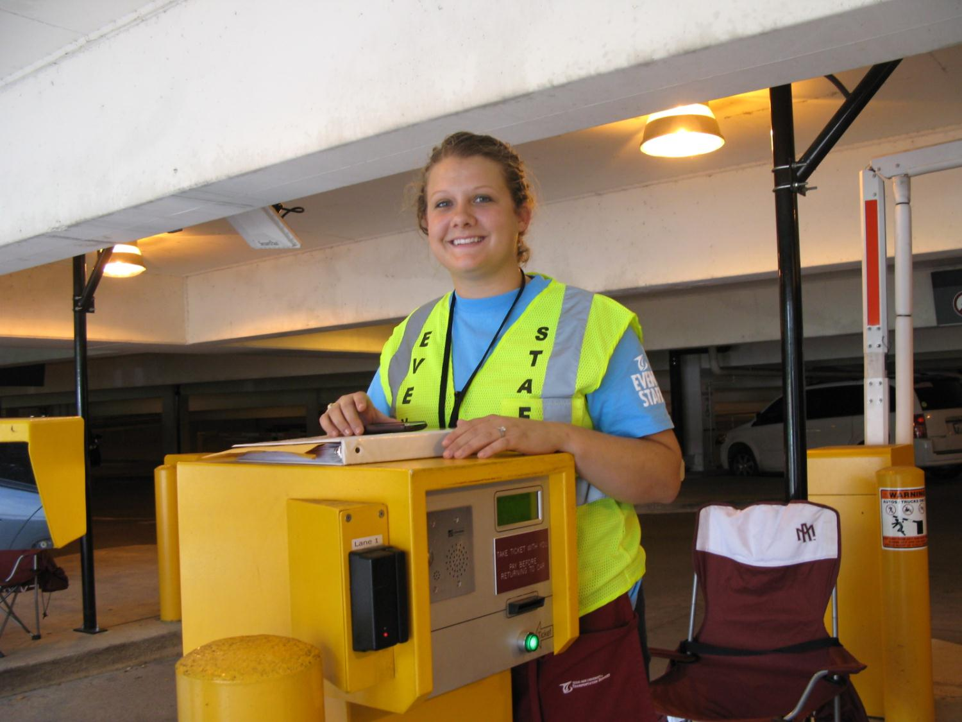

Slide 23
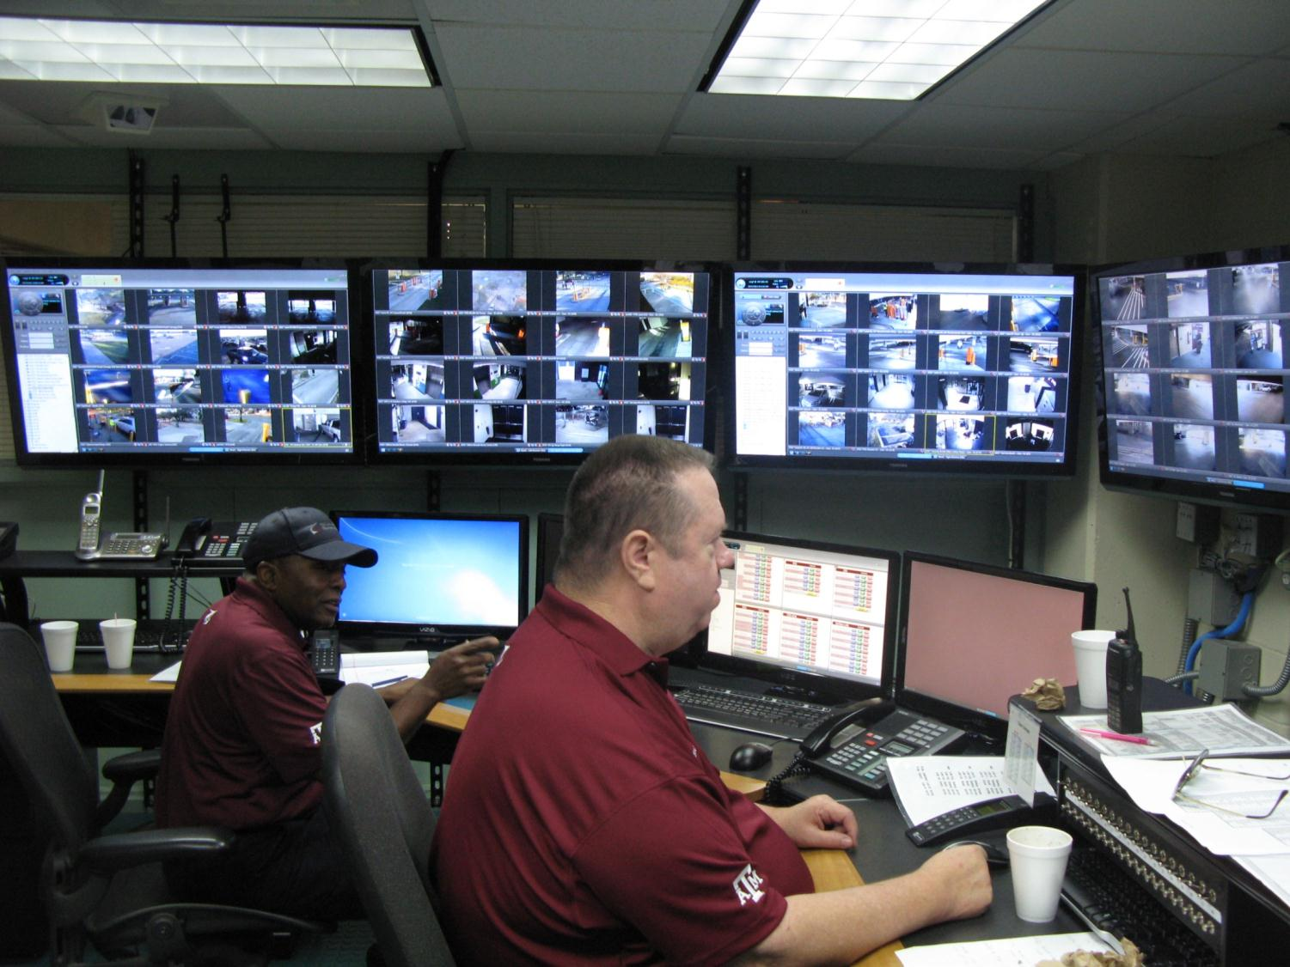

Slide 24
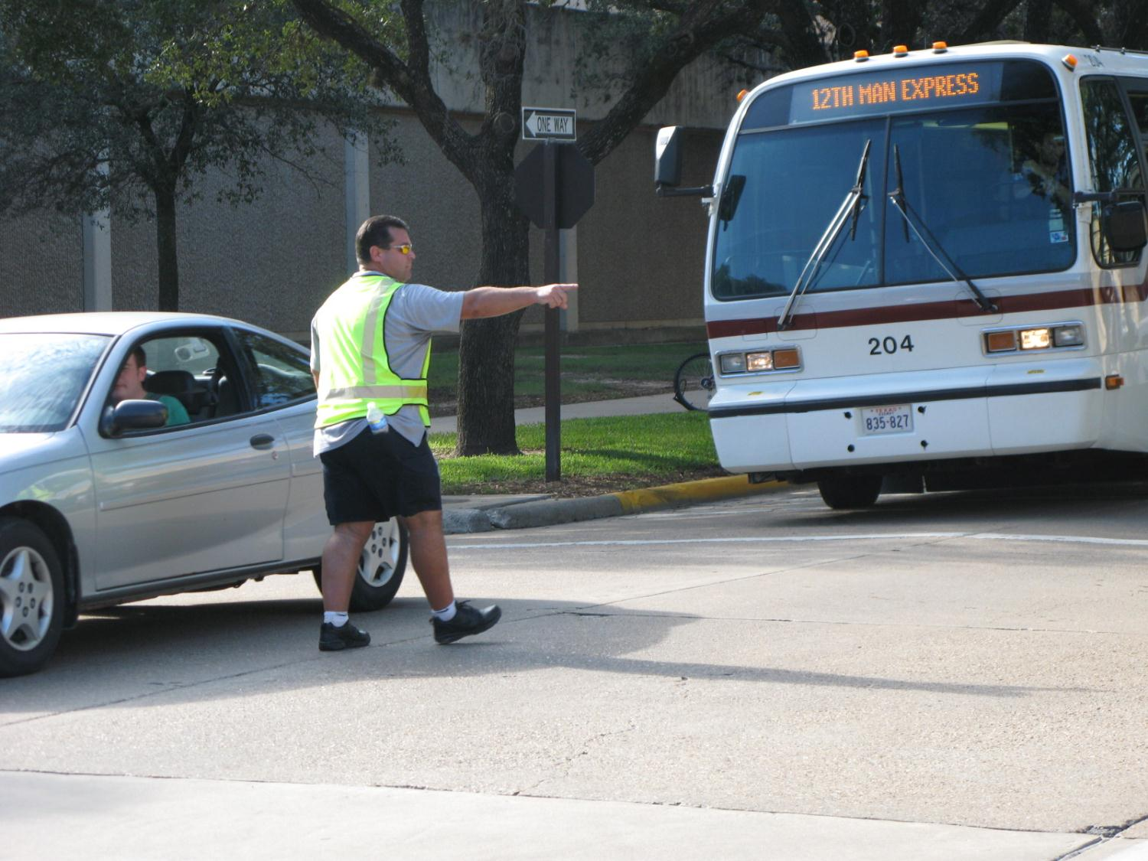

Slide 25
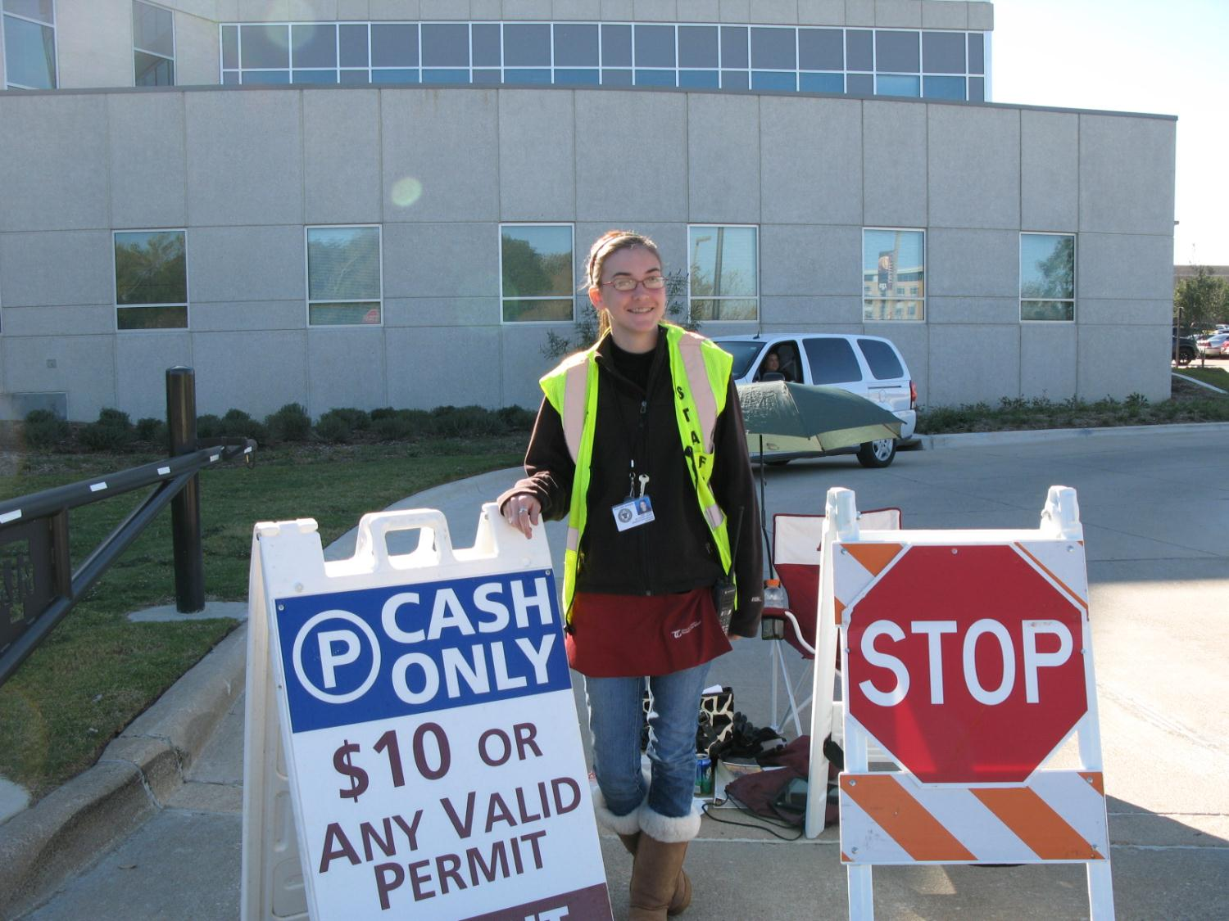

Slide 26
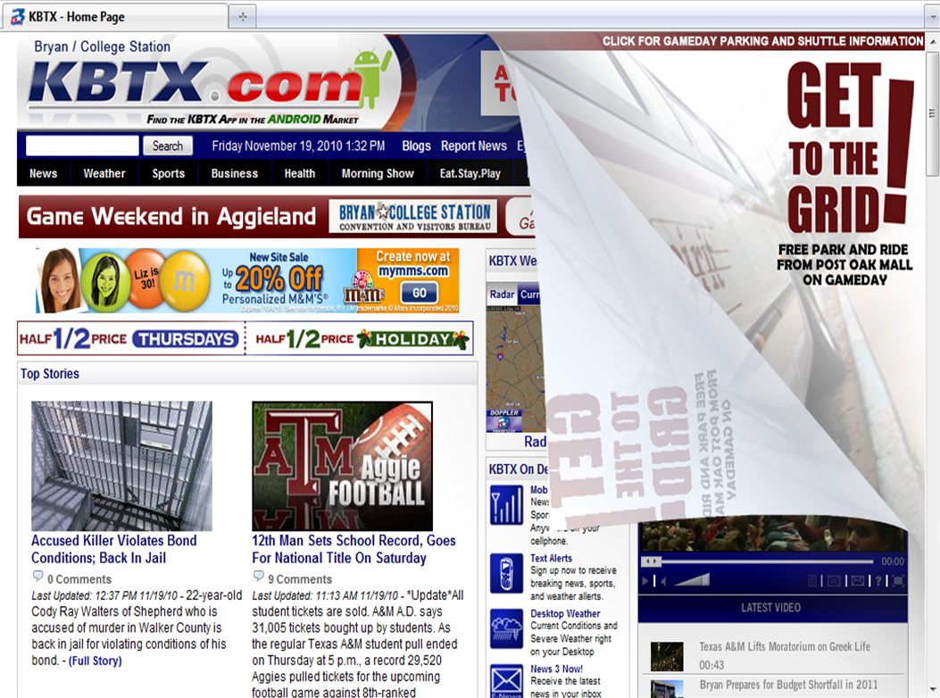
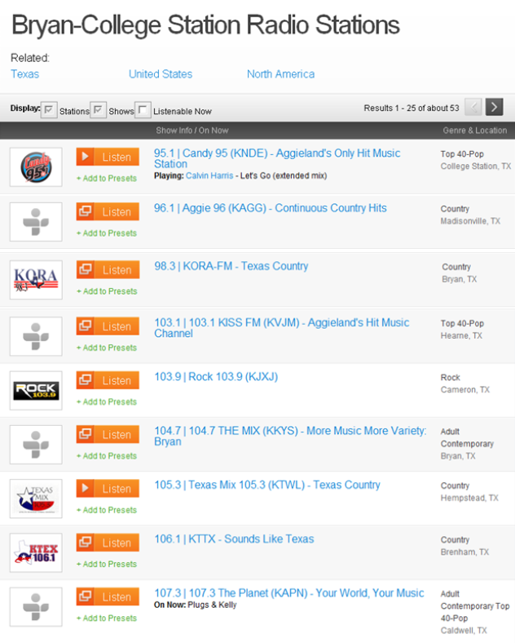
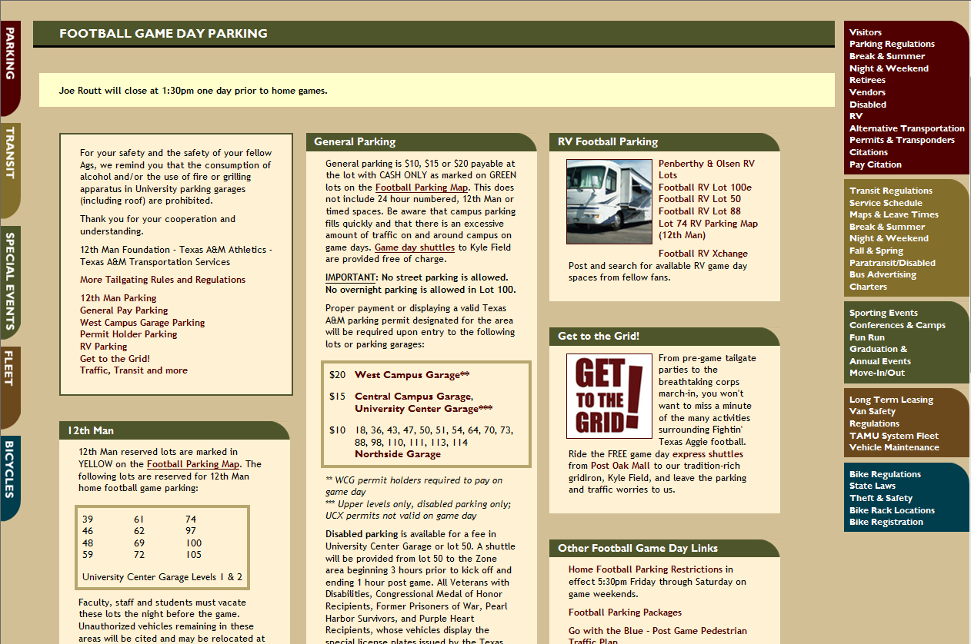
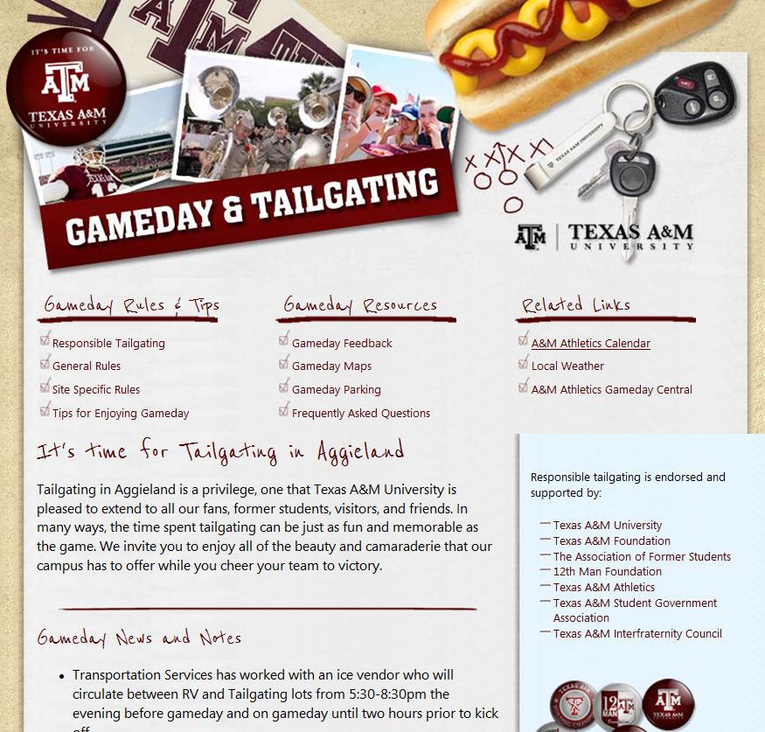

Communication
Notes:
External Communication
Corner Peel - $400 per game (Friday and game day); 250,000 hits per game

Slide 27
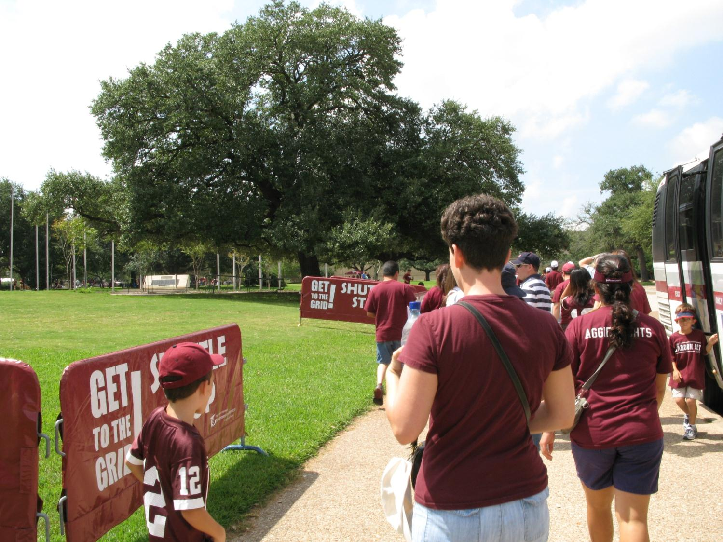

Slide 28
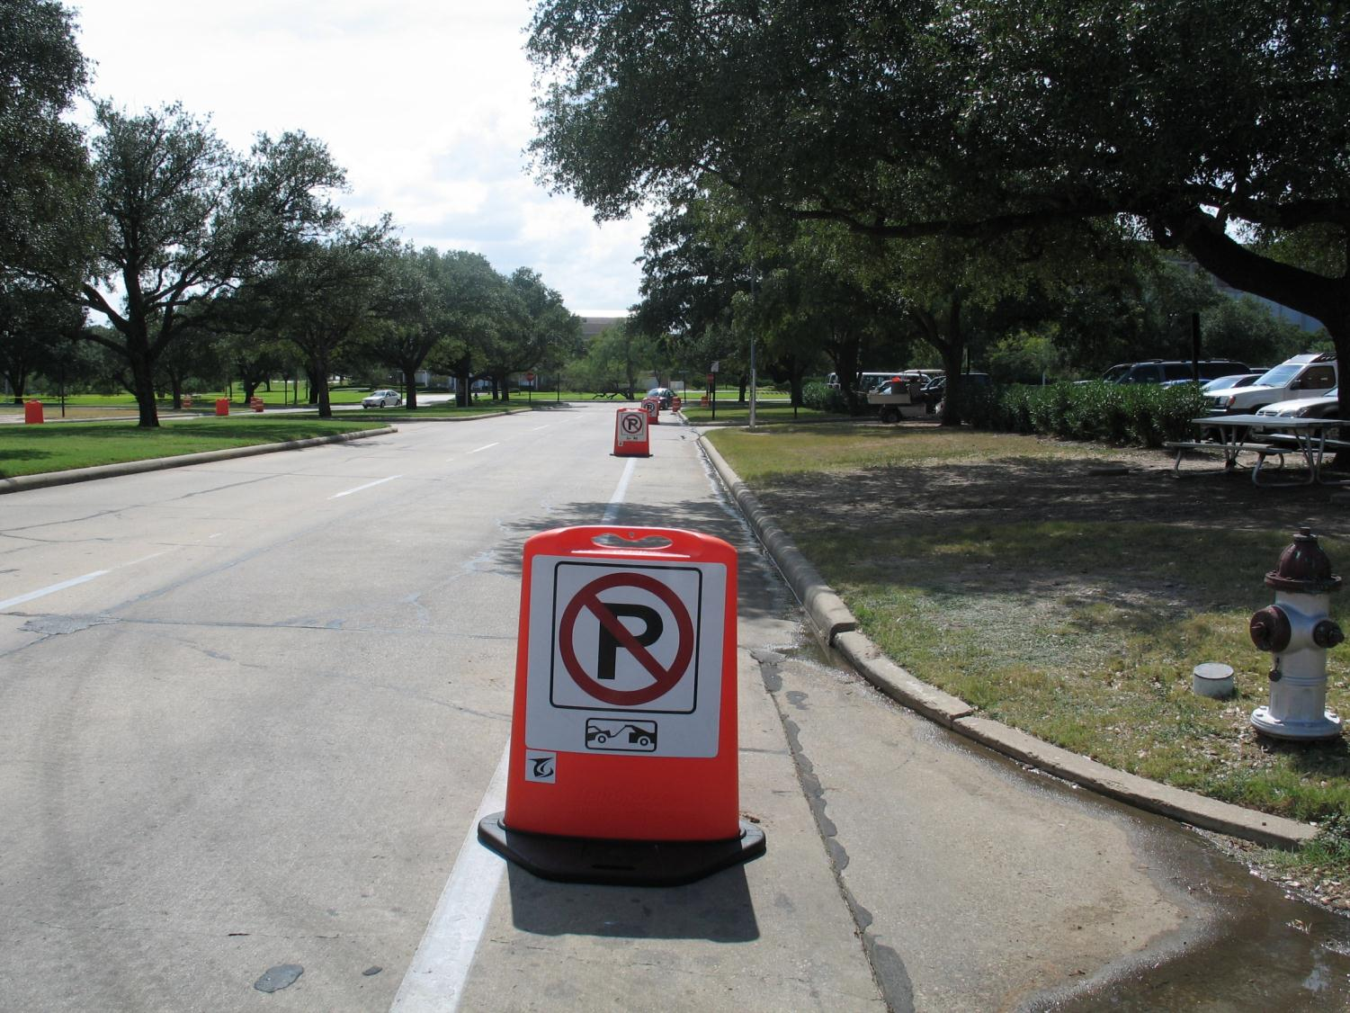

Slide 29
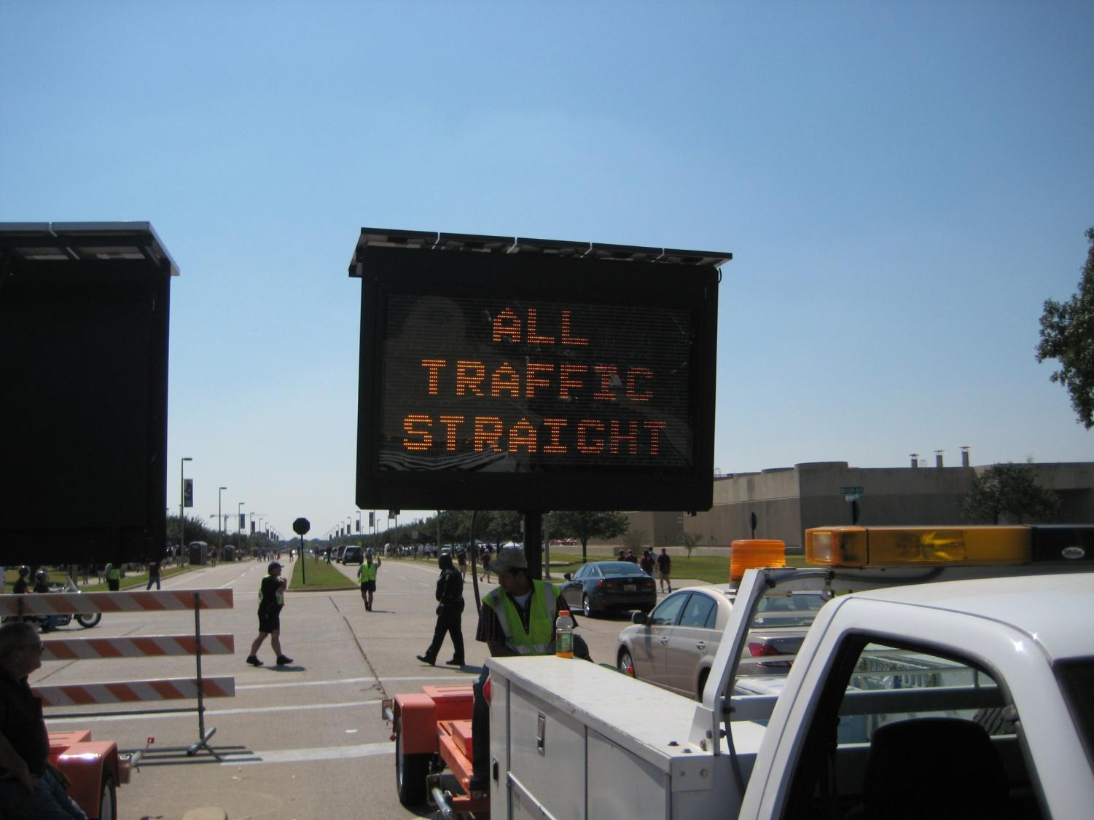

Slide 30
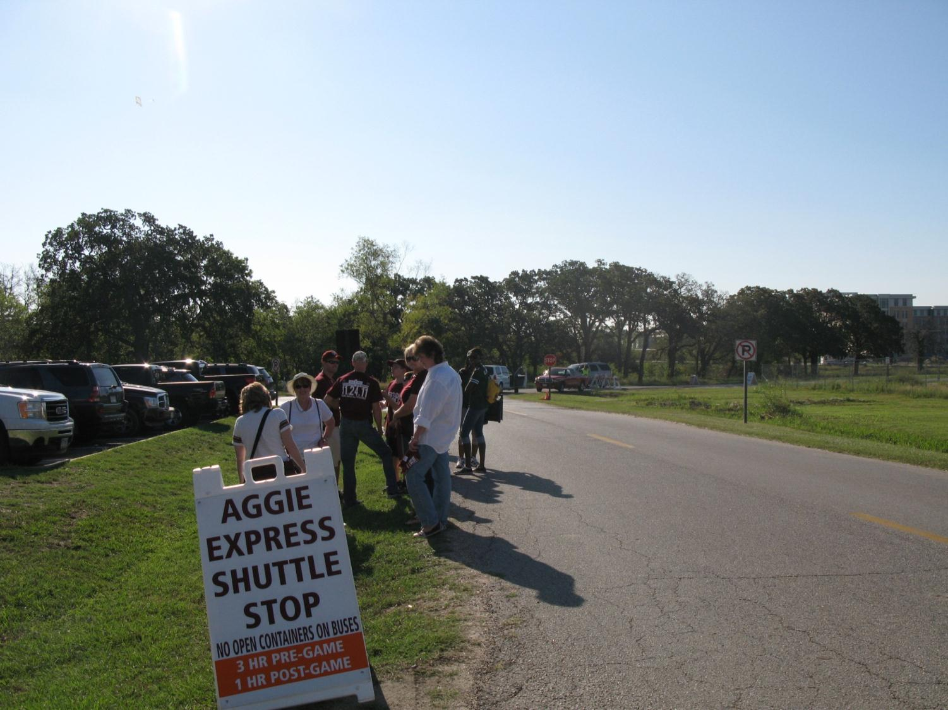

Slide 31
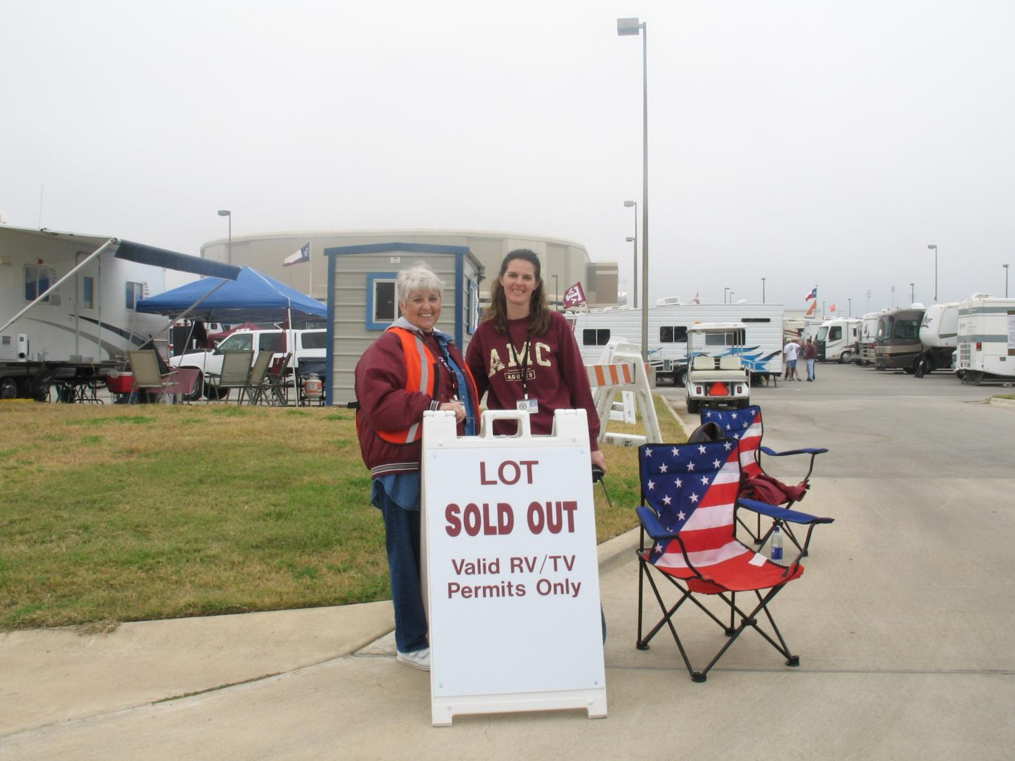

Slide 32
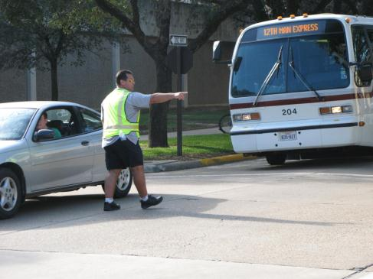





Remember These Guys?
Notes:
The members of your internal groups are also talking to and directing IE communicating with your external customers, too.

Slide 33
Cooperation
Vehicle Maintenance
University Police
Special Event Team
Enforcement
Environmental Health and Safety
Athletics
Barricade & Sign Crew
Facilities Services
Customer Service
Waste Management
Marketing
Transit
Department of Transportation
Campus Event Coordinators
Campus Administrators
Student Affairs
City Police
County Law Enforcement
Landscape Management
Media

Slide 34
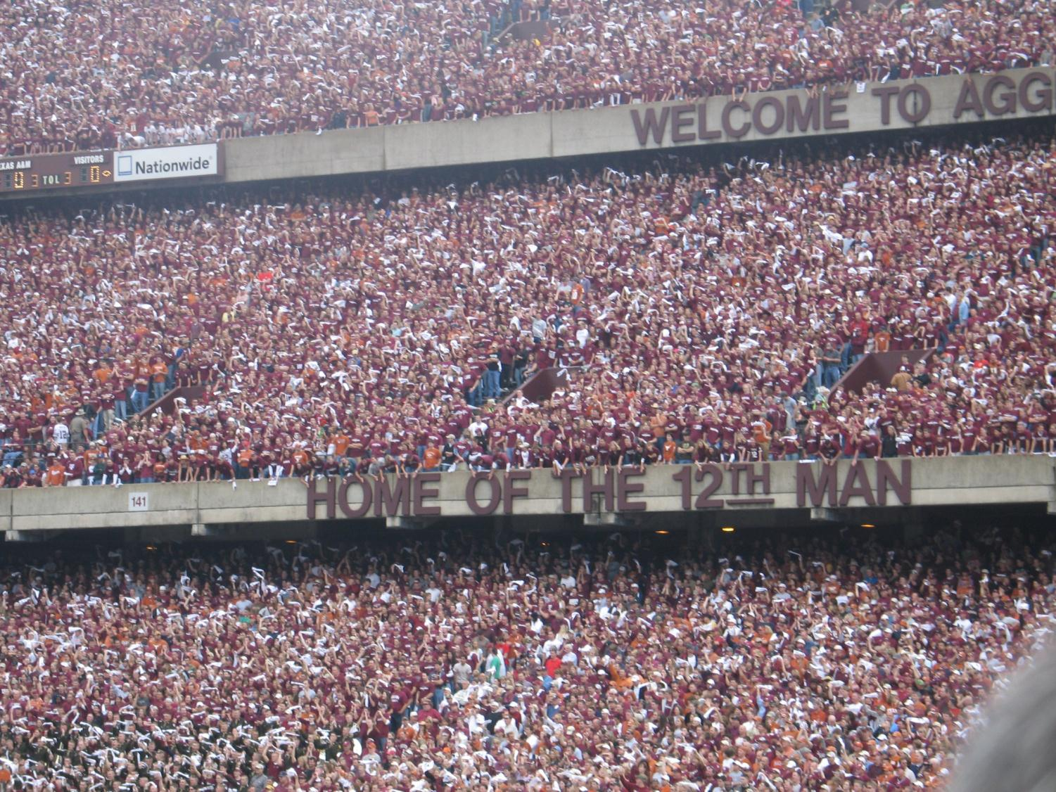
Notes:
Not only did we have to help get these 90,000 fans to the game, now we need to help get them away safely and effiently.

Slide 35
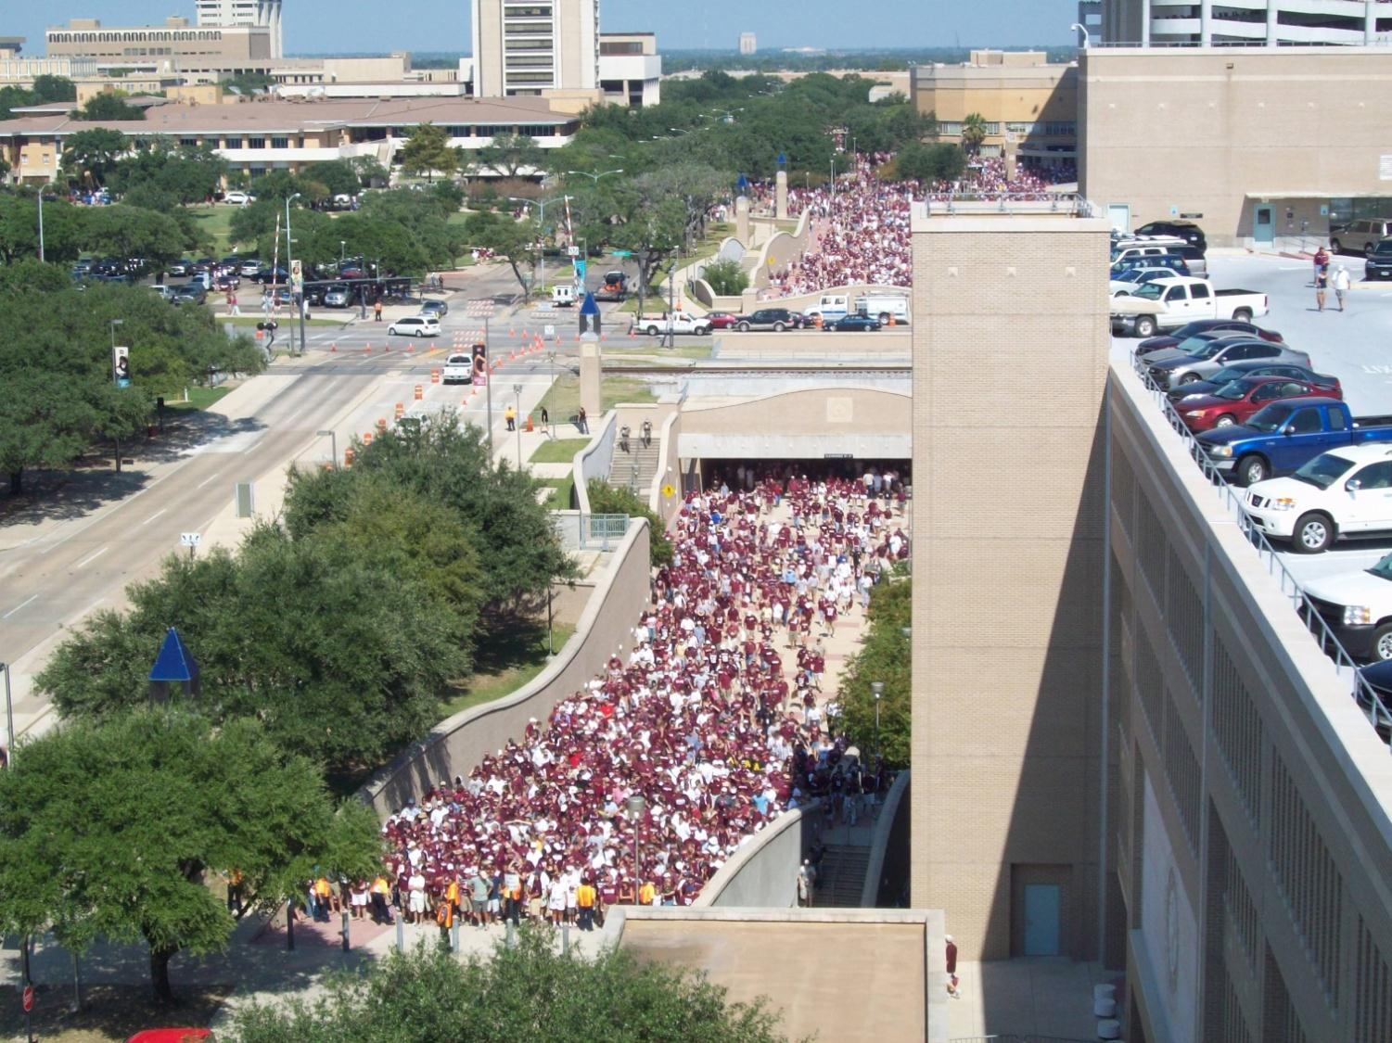

Slide 36
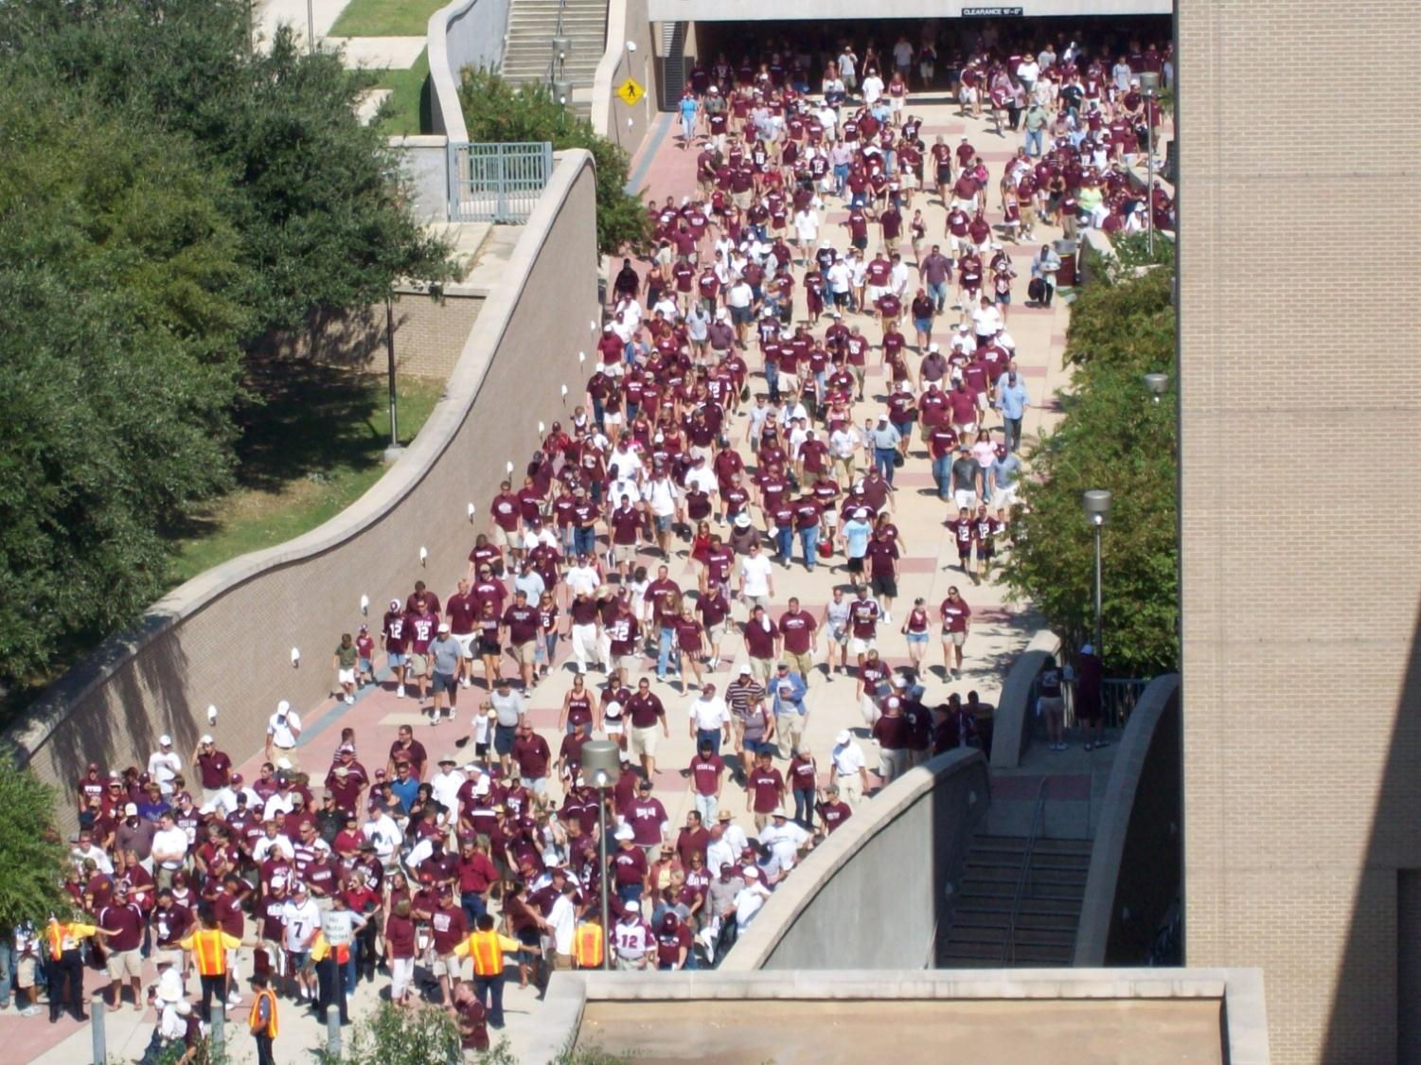

Slide 37
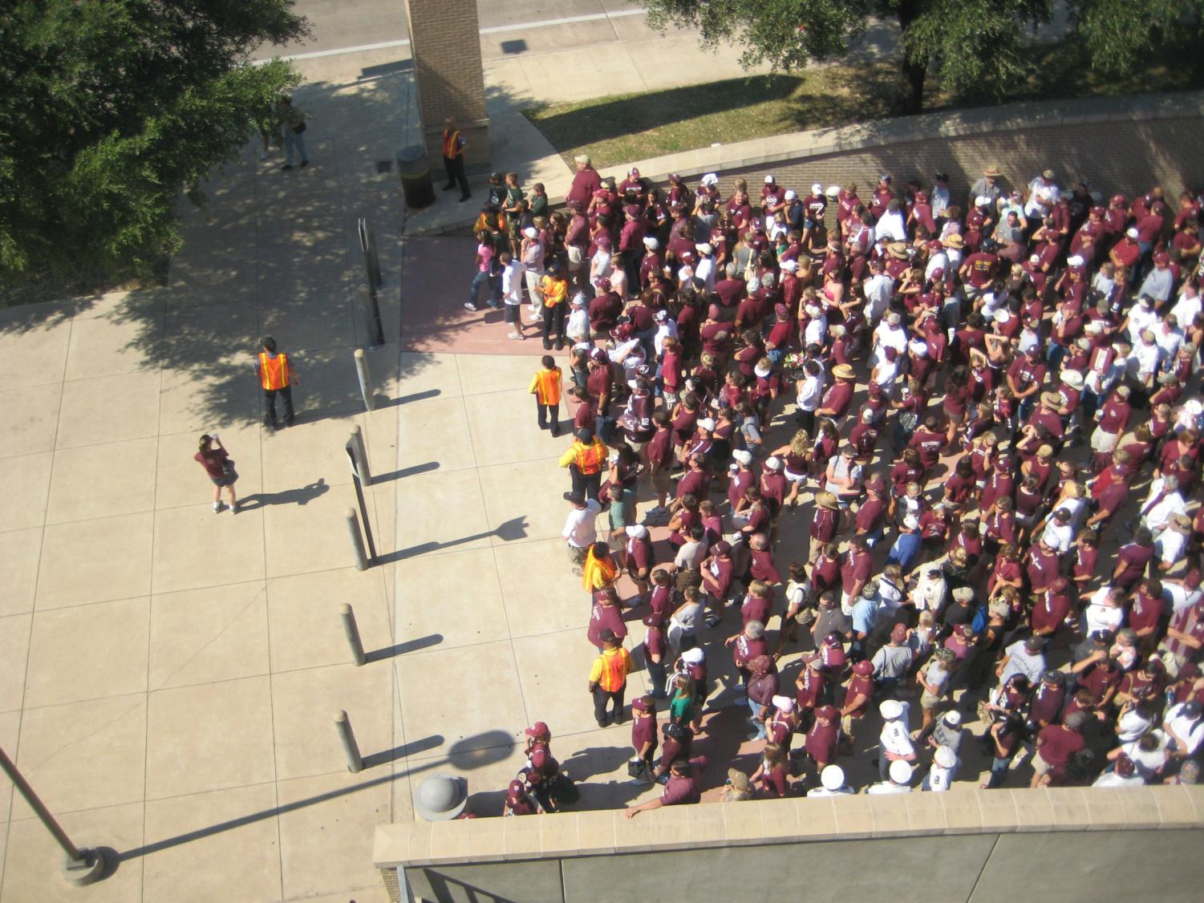

Slide 38
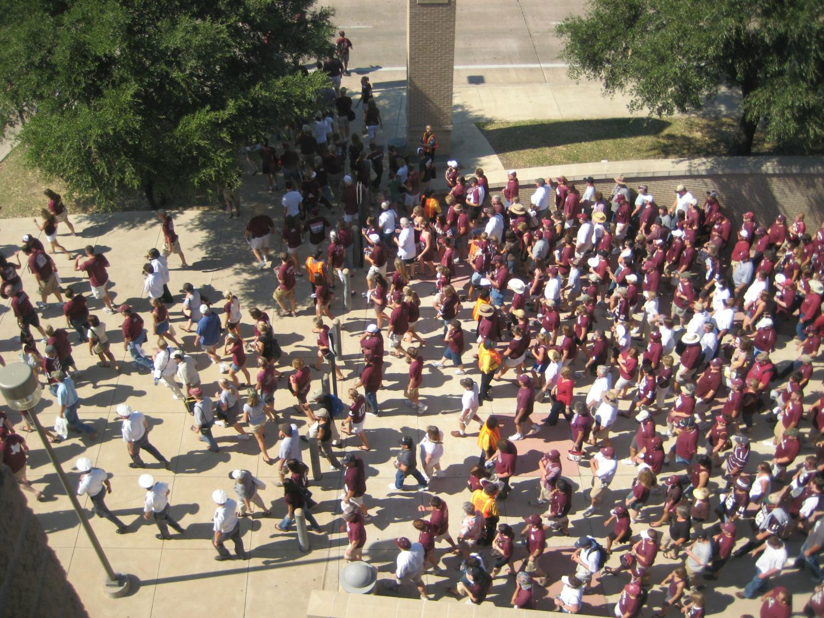

Slide 39
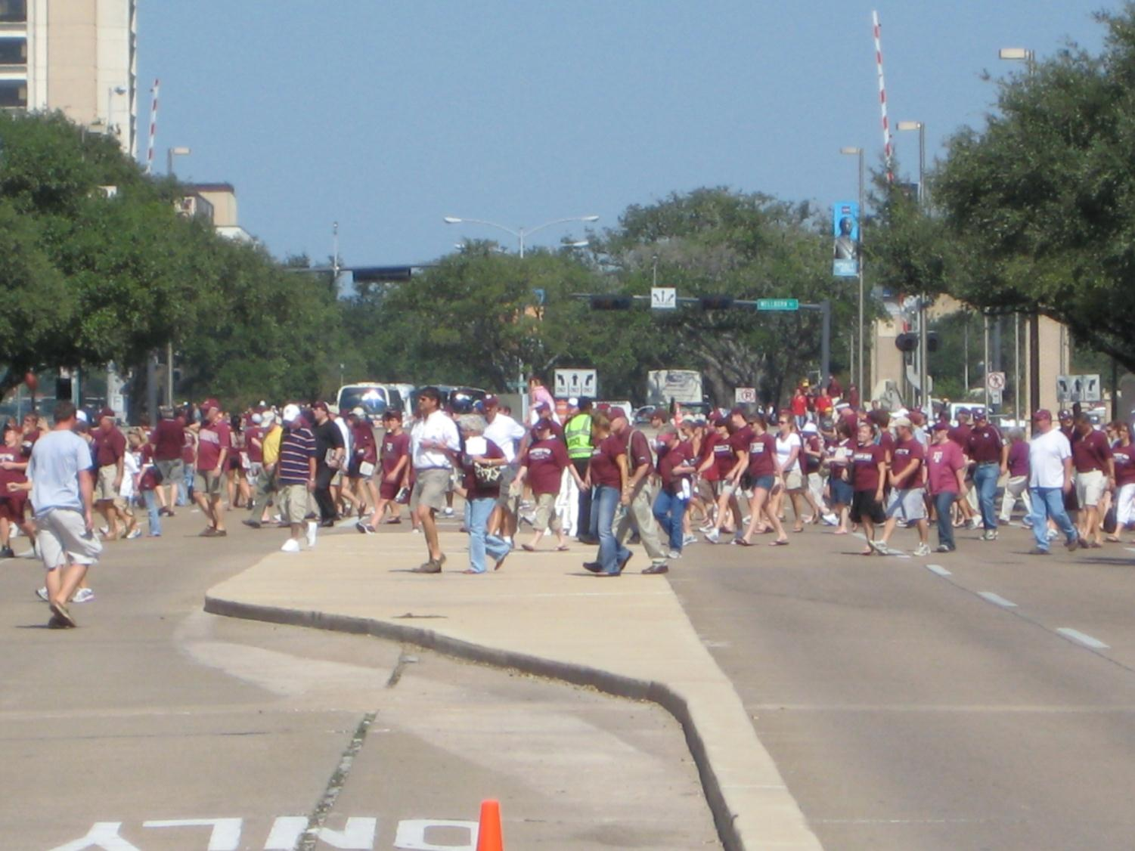

Slide 40
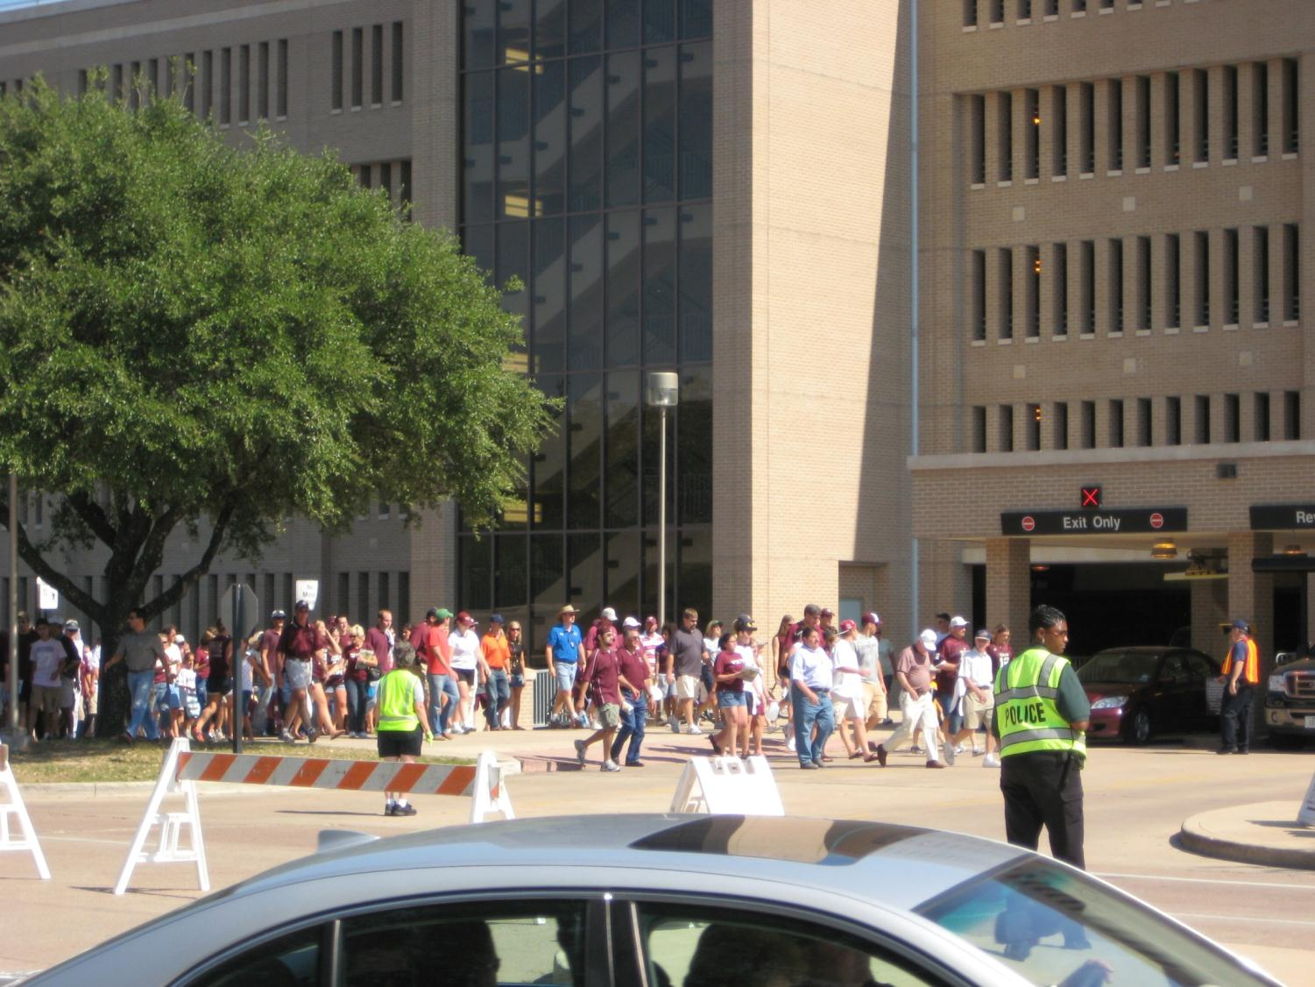

Slide 41
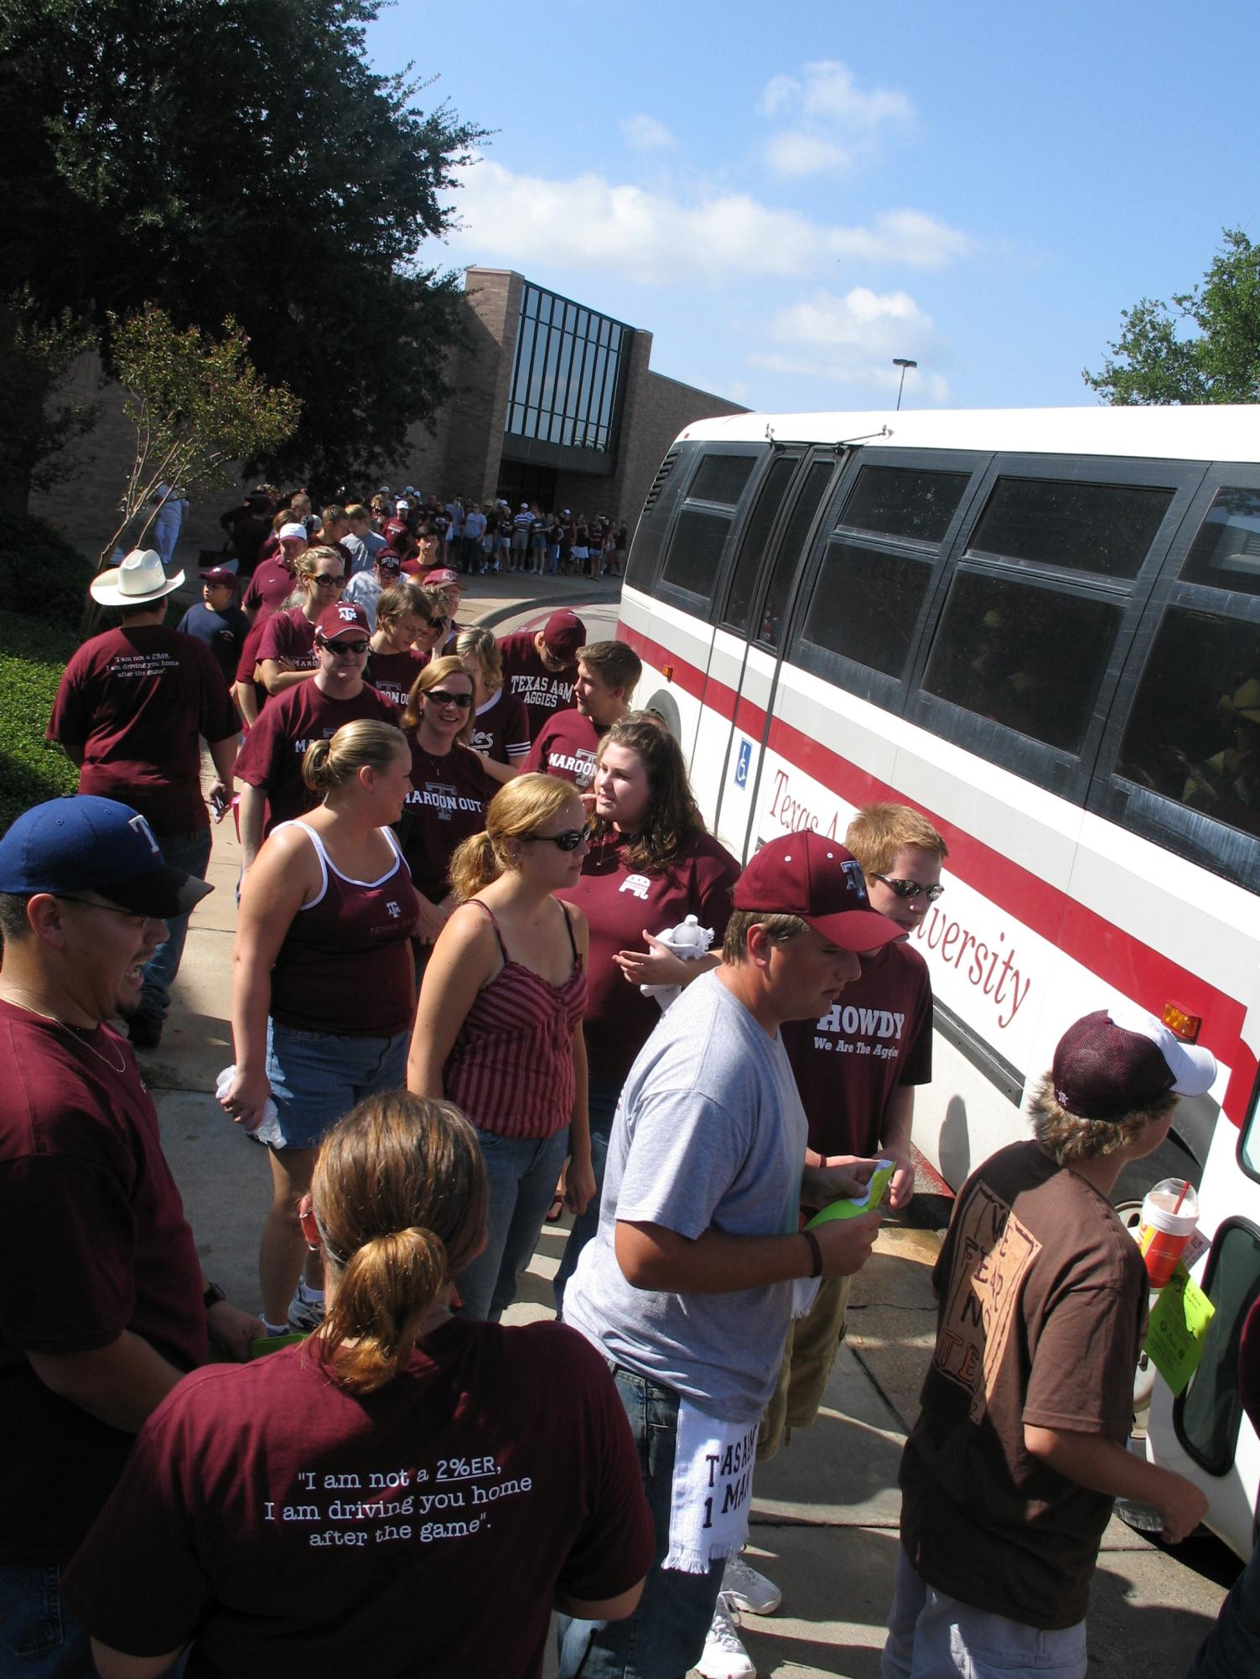

Slide 42
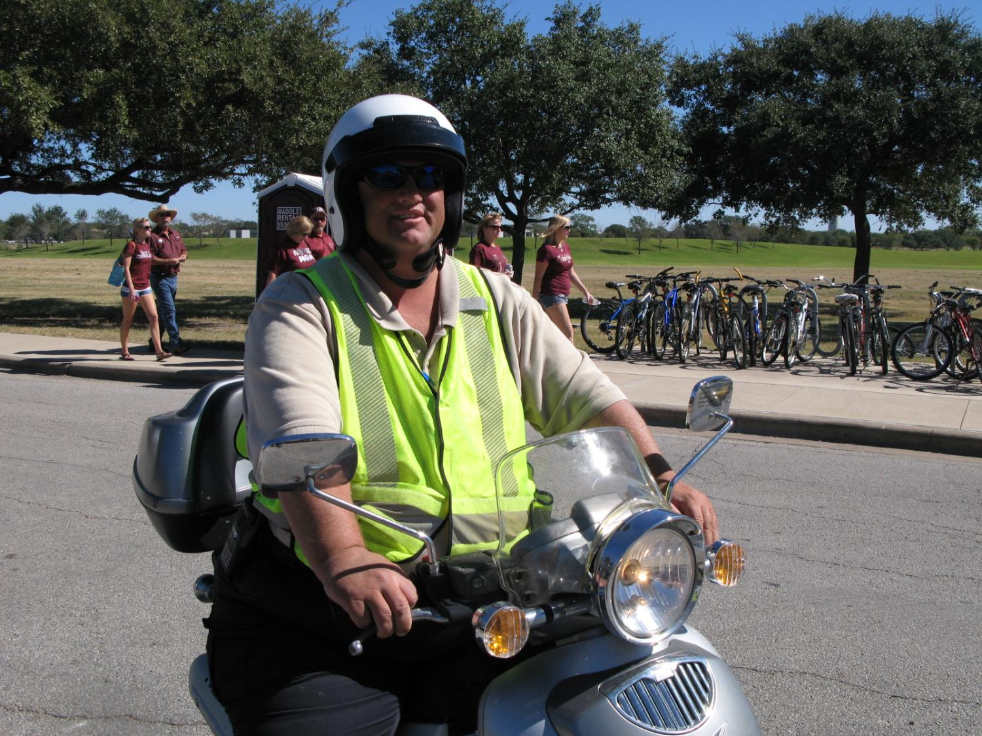

Slide 43
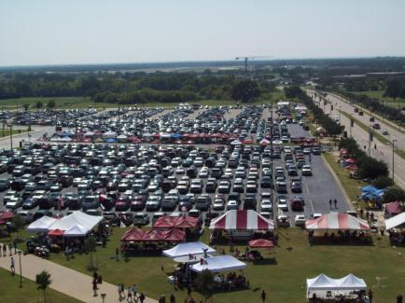


Pricing Strategy
Effective Strategies
  Donor Parking
  Season Passes
  Specialty Areas
    Tailgating
    Vehicles with trailers
    RV’s
    Party Buses
  Presold Parking
  Pay Upon Arrival
Proximity Pricing
Notes:
Understand how to use pricing strategy to realize revenue growth potential while offsetting costs

Slide 44
Safety
Video
http://transport.tamu.edu/about/presentations/2012/BigEvents/SafetySlide44.wmv

Slide 45


Safety
Community Traffic
On-Campus Vehicular Movement
Pedestrians
Enforcement
  Keep vehicles out of unwanted areas
  Maintain areas for designated patrons
Response Teams and Equipment
Seasonal Issues
Notes:
Learn to offer a safe venue by planning for traffic, enforcement and pedestrian and vehicular movement

Slide 46
Review and Revise
Video
http://transport.tamu.edu/about/presentations/2012/BigEvents/ReviewReviseSlide46.wmv

Slide 47

After Action Review

Slide 48



They Just Want to Have FUN!
Notes:
So don’t lose sight of providing great service and limiting restrictions to what is necessary. Make them feel welcome and special.

Slide 49
Wrap Up
Video
http://transport.tamu.edu/about/presentations/2012/BigEvents/WrapUpSlide49.wmv

Slide 50
Questions?
Debbie Hoffmann dhoffmann@tamu.edu
Presentation available online:
http://transport.tamu.edu/presentations

Slide 51
THANK YOU FOR ATTENDING
We hope you have enjoyed this presentation. If you’d like to get a copy of the audio of this session or any sessions this week, stop by SHOPIPI.com near the registration counters to place your order.

