Slide 1
@AggieParking #TAMU
2014 MSTPA Spring Conference
March 3-5, 2014

Slide 2
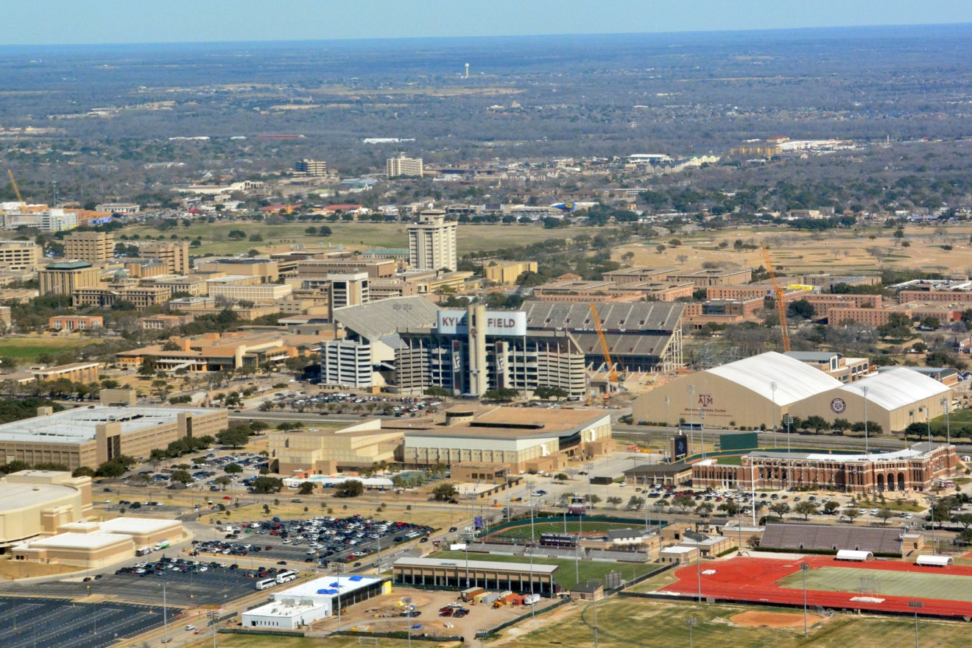

Slide 3
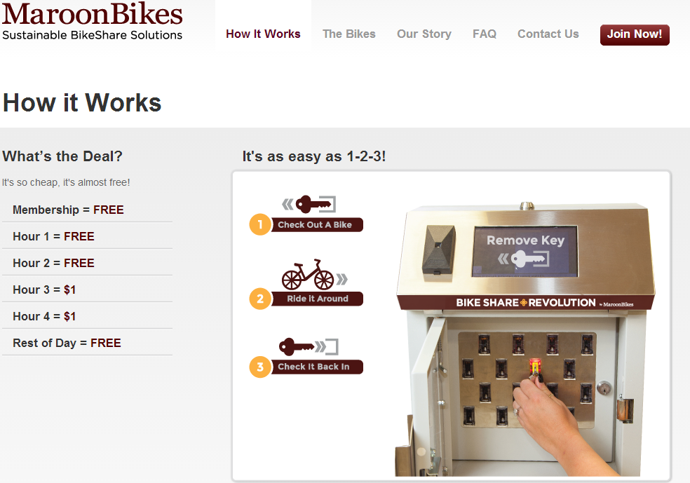
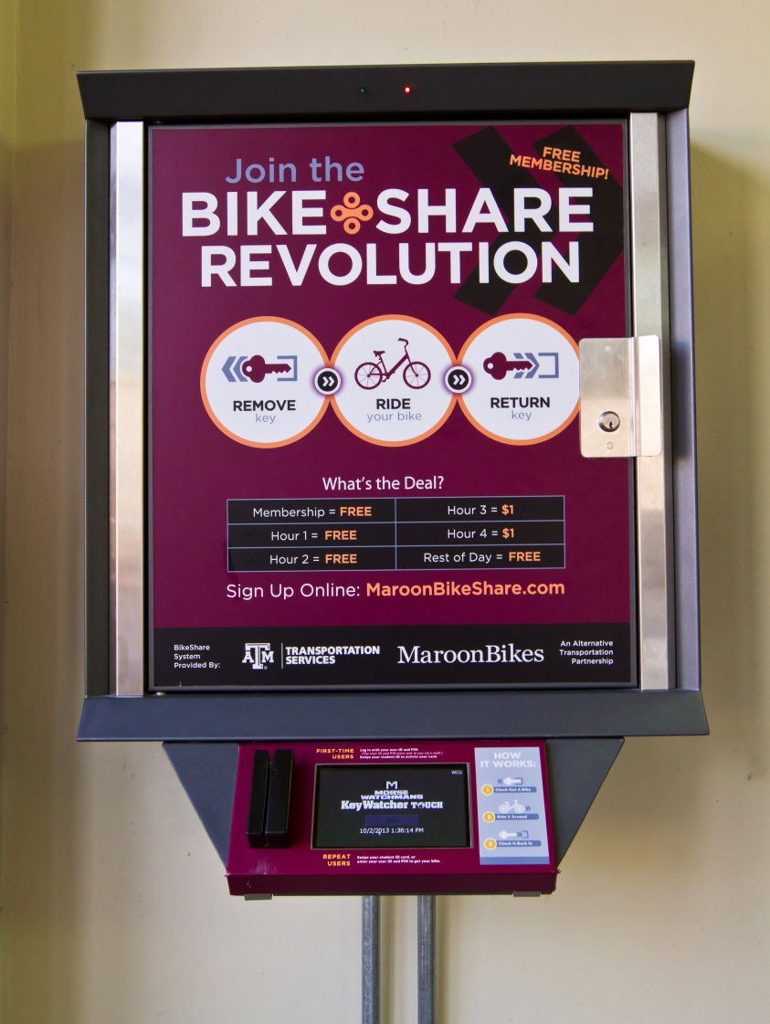
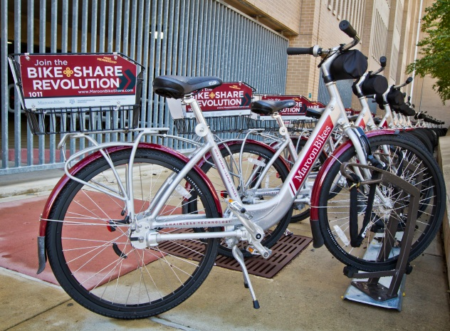
Bike Share

Slide 4
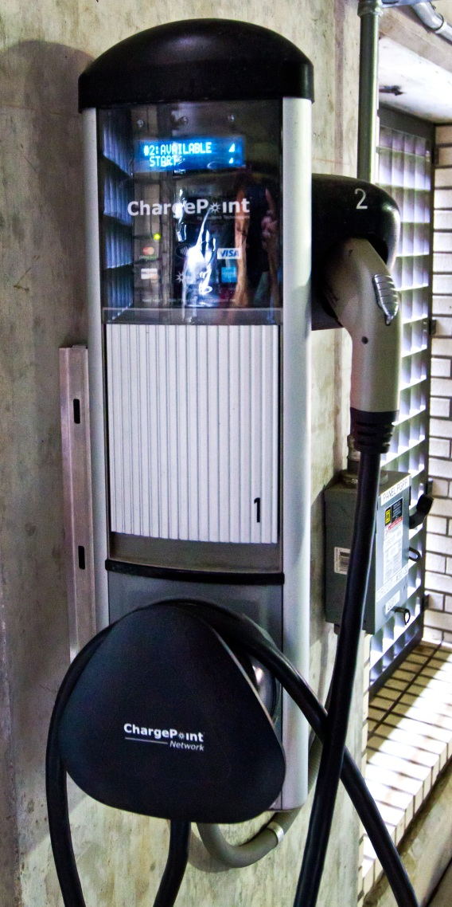
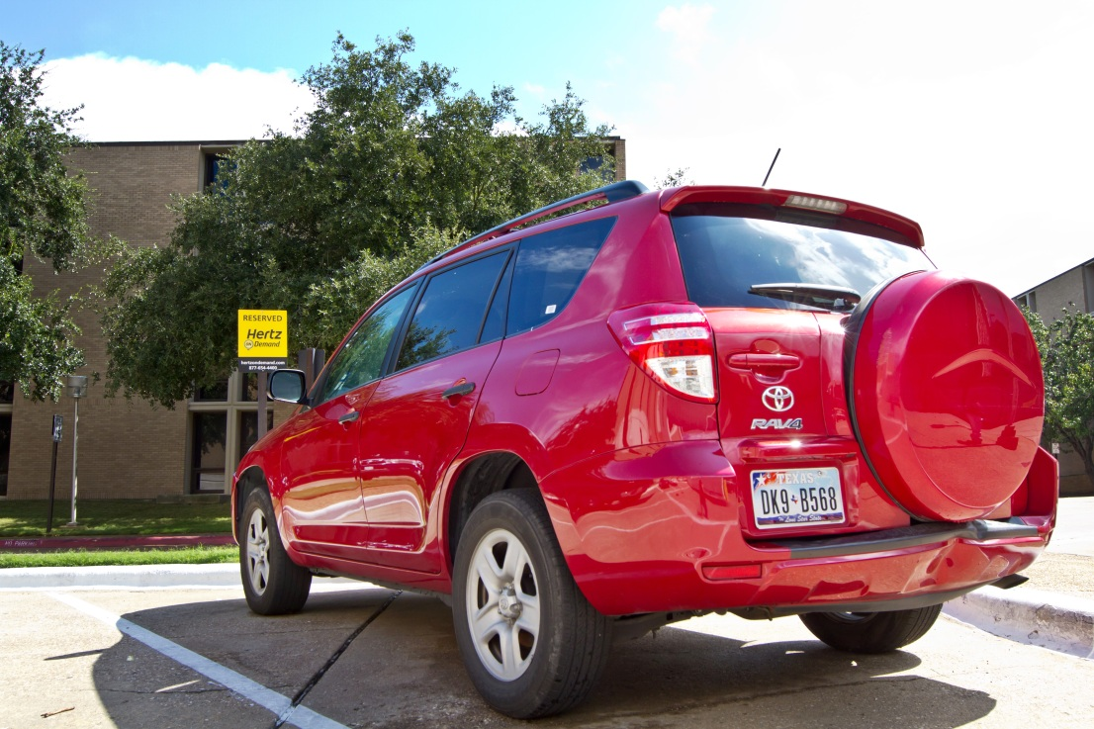

Alternative Transportation

Slide 5
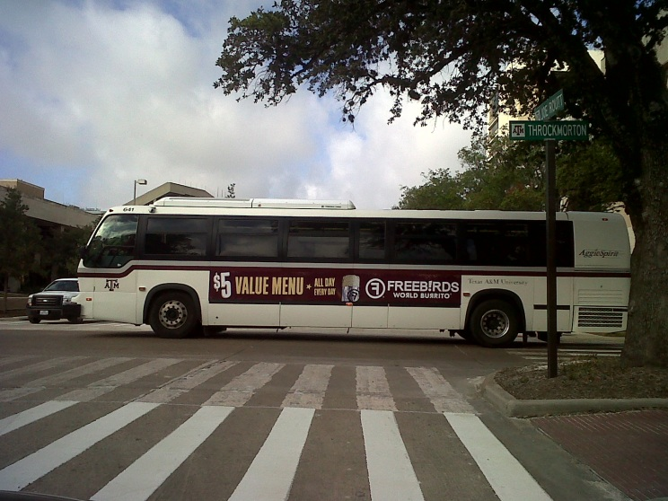
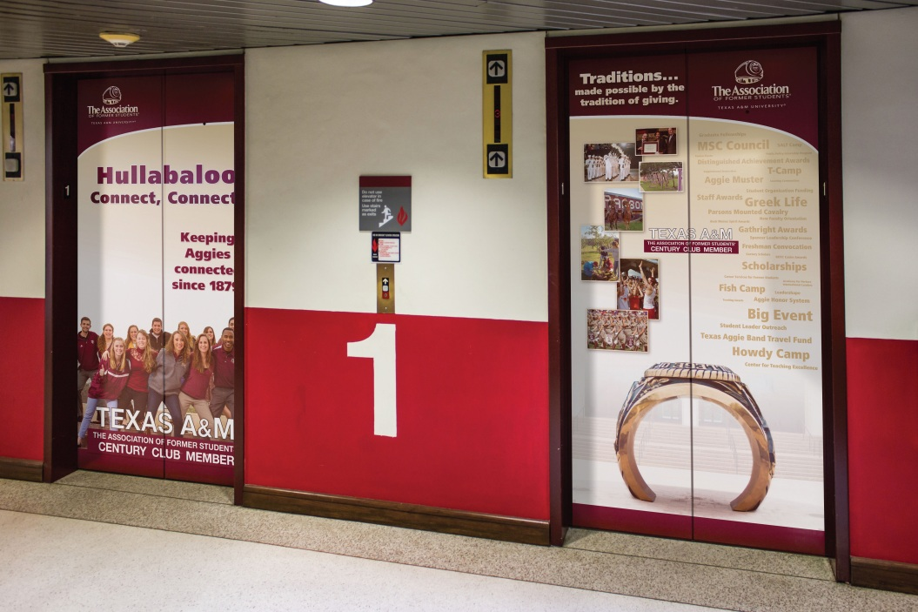
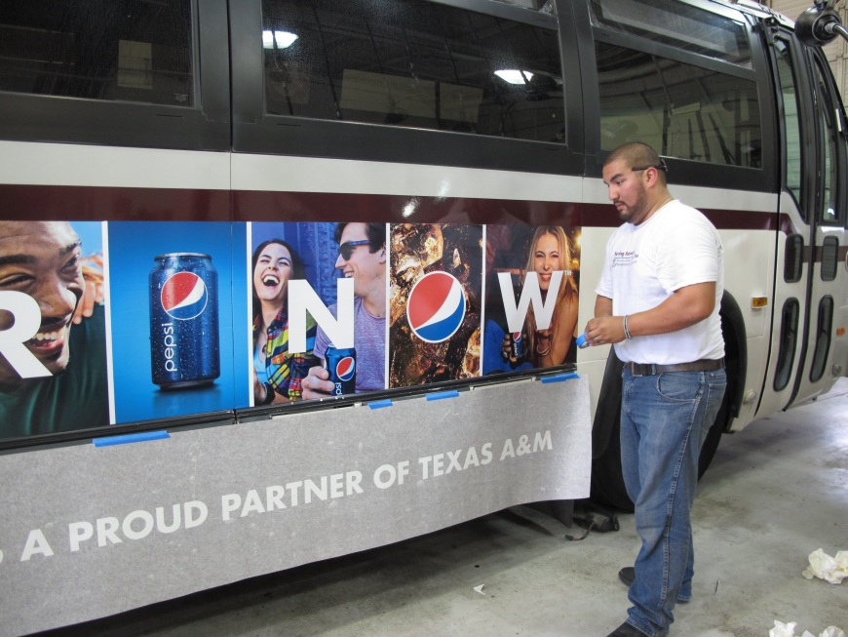
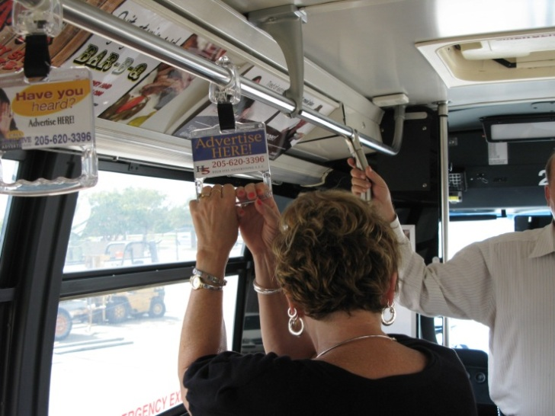
Advertising

Slide 6

Notes:
Advertisers

Slide 7
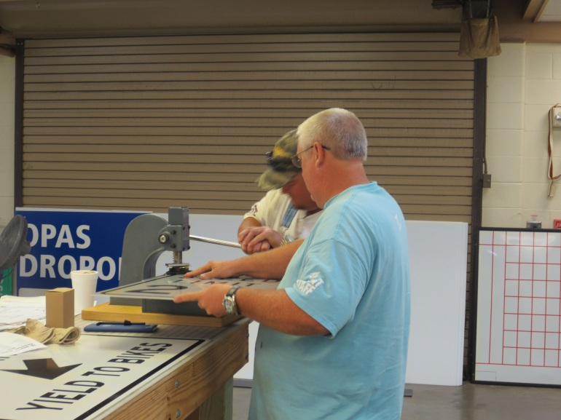
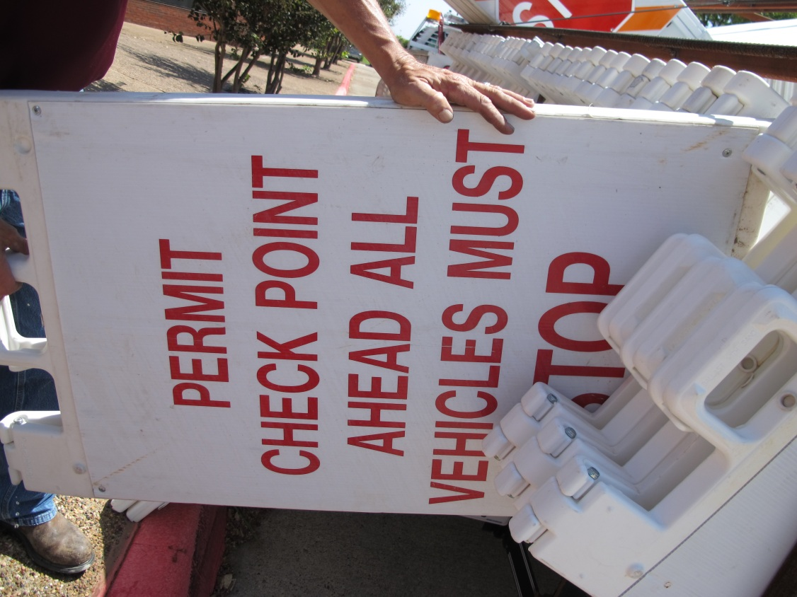
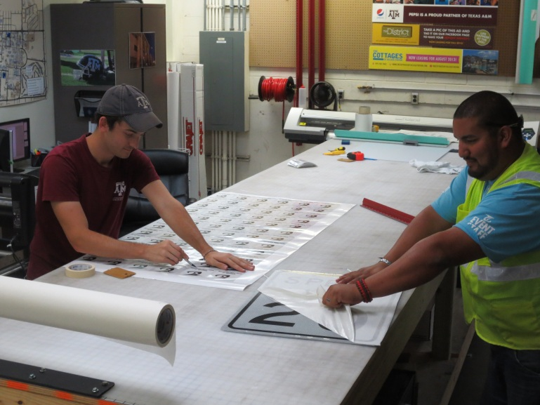
Sign Shop

Slide 8
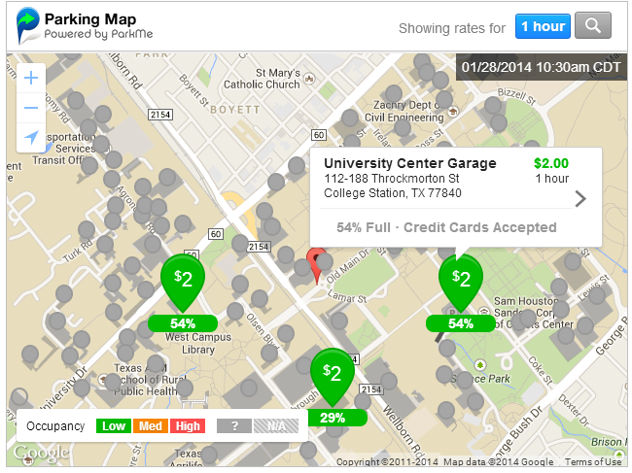
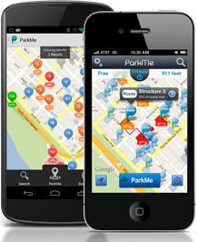
ParkMe

Slide 9
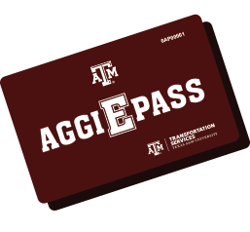
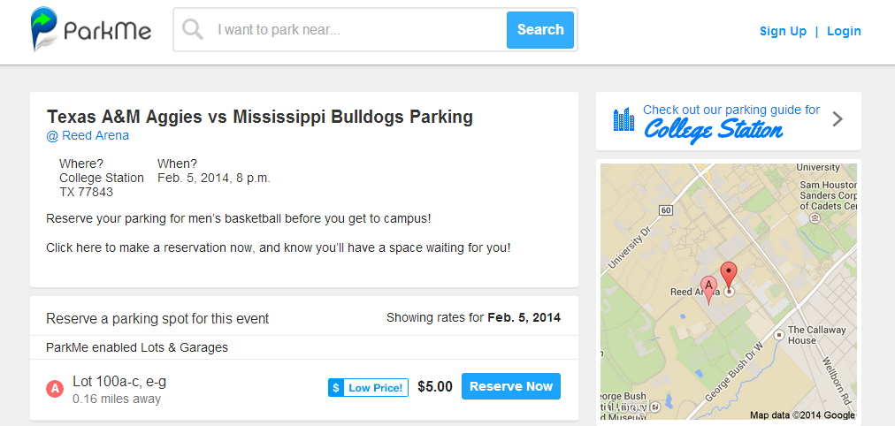
Prepay Options

Slide 10
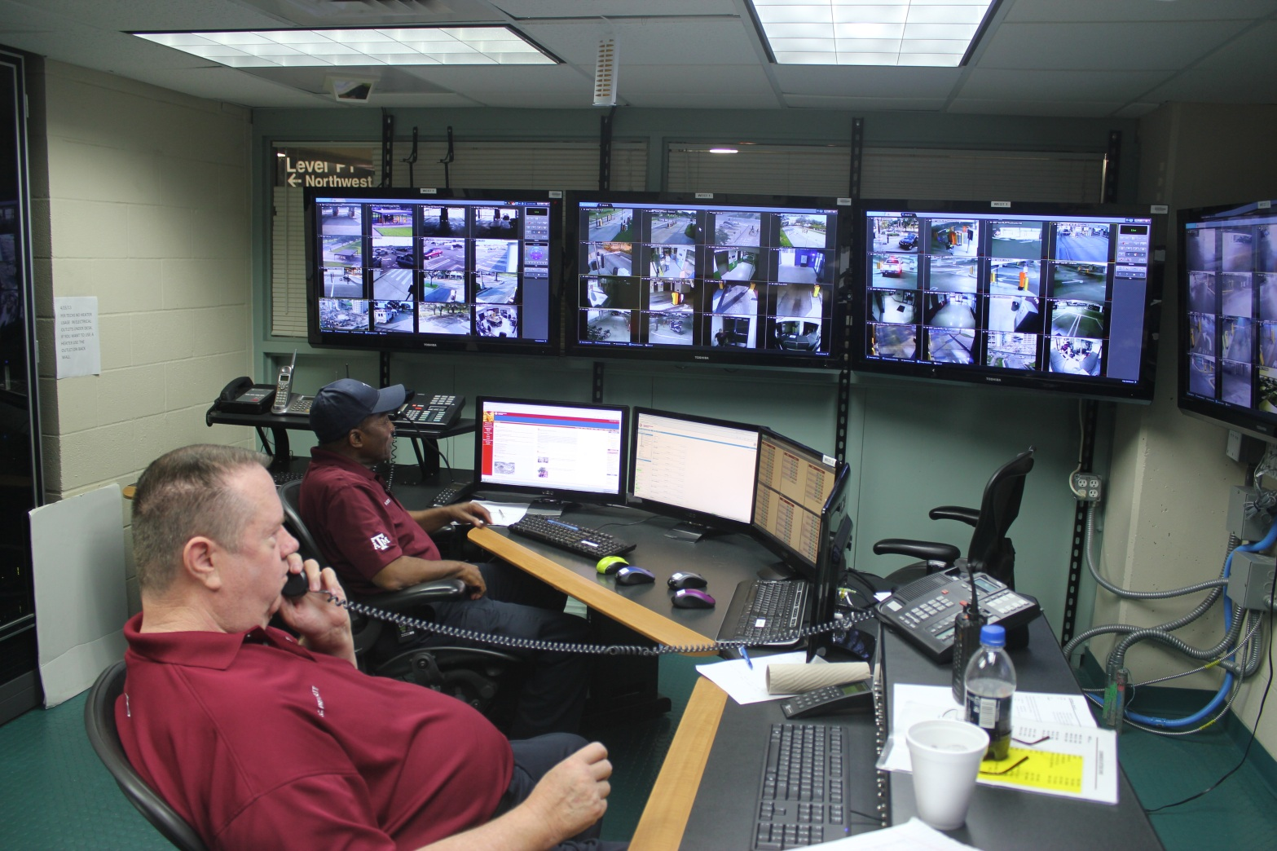
Notes:
Talk about support staff for all of our systems

Slide 11
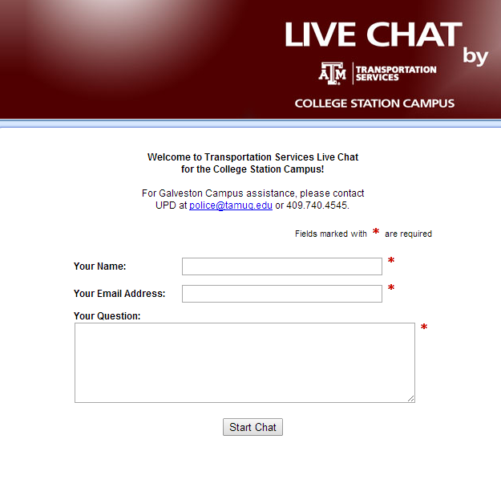
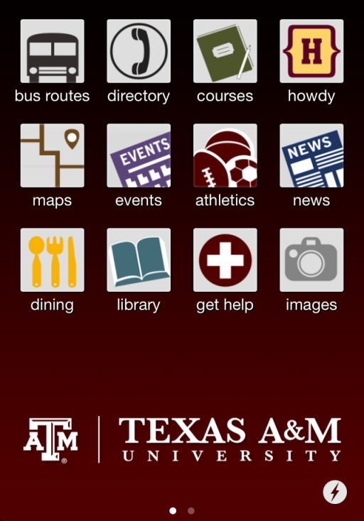
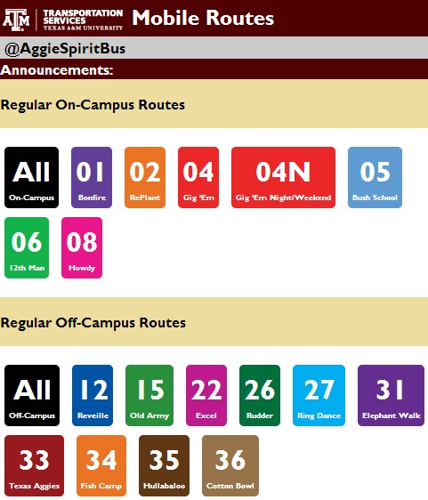
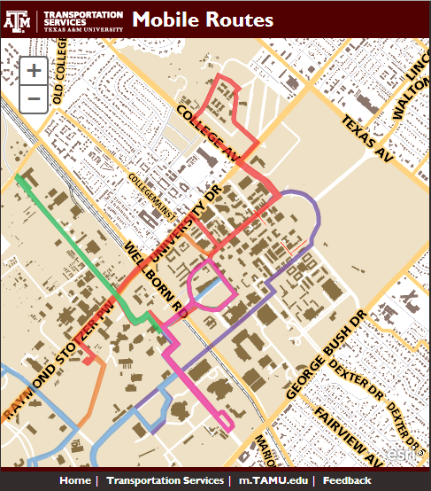



Staying updated
Notes:
Pop up Click To Chat

Slide 12
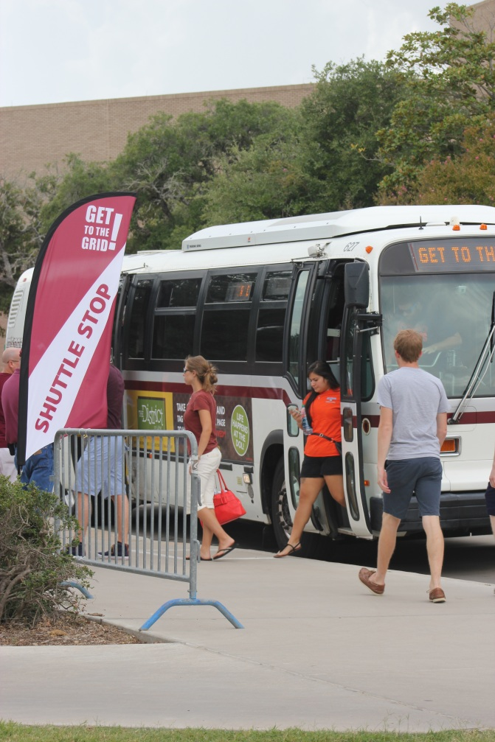
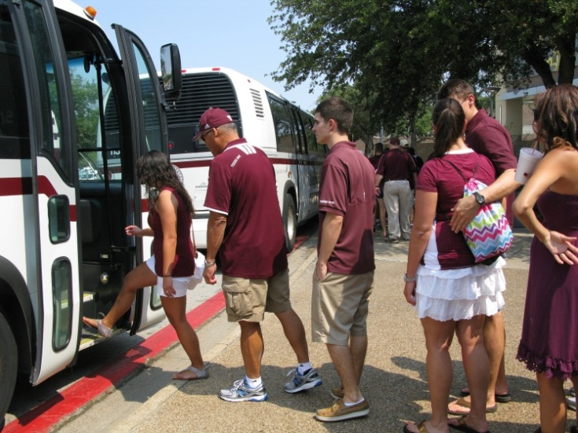
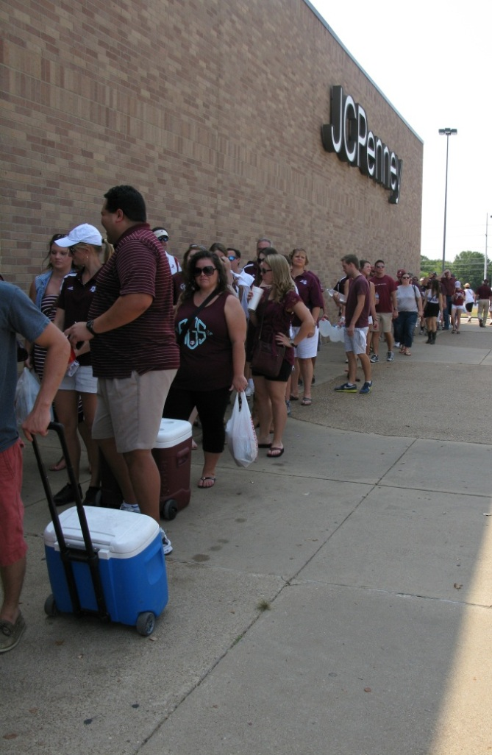
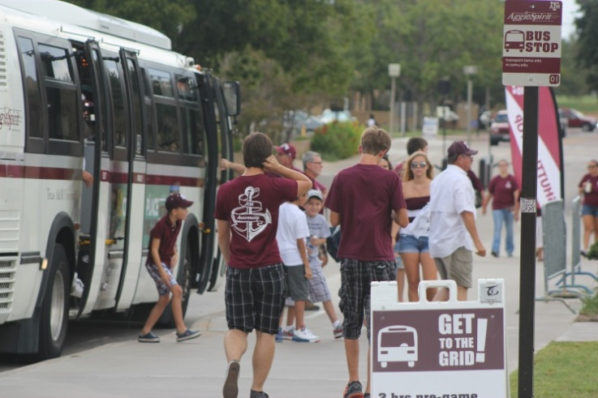
Get to the Grid!

Slide 13
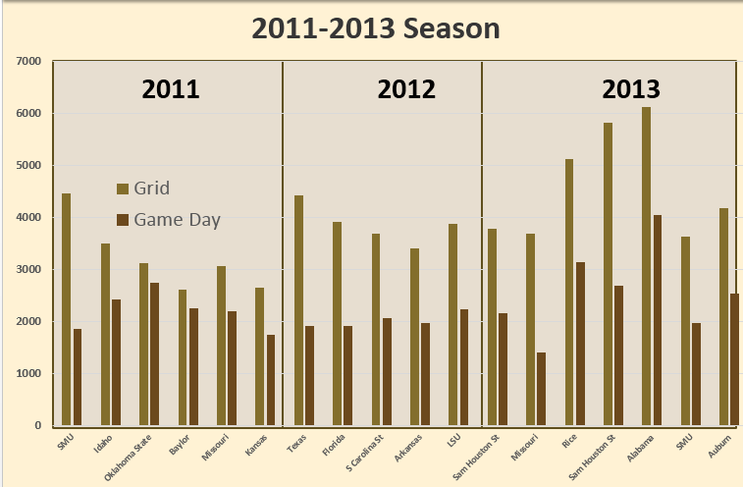
Grid

Slide 14
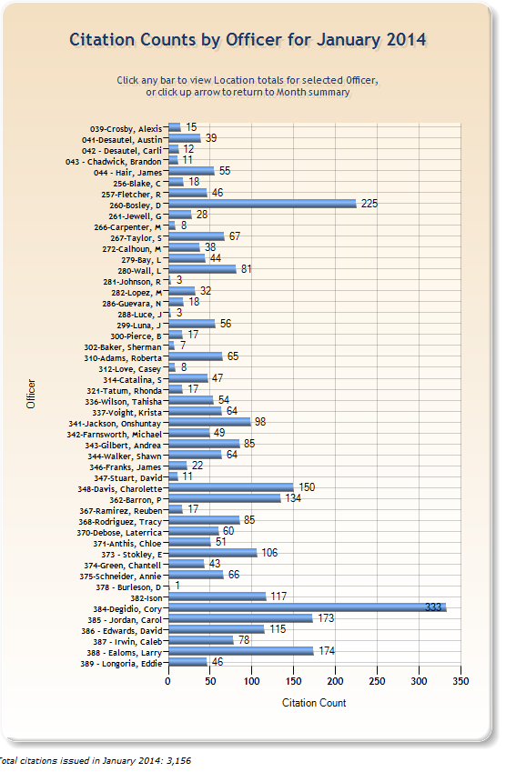
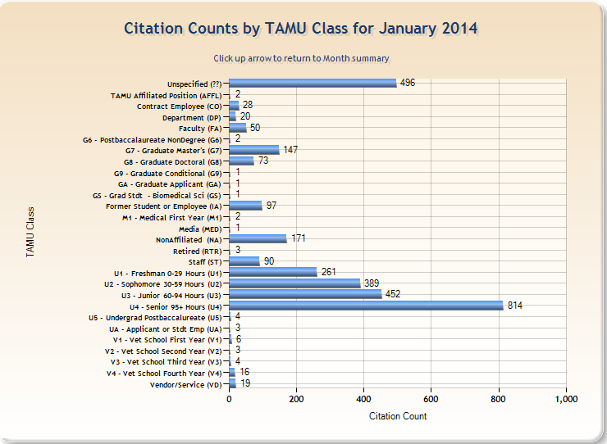
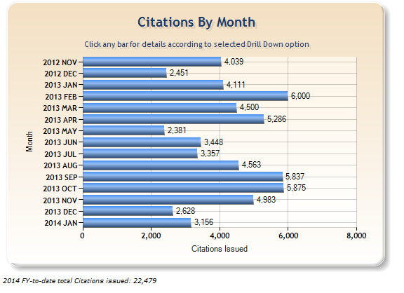
Citation Dashboards

Slide 15

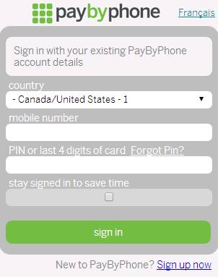
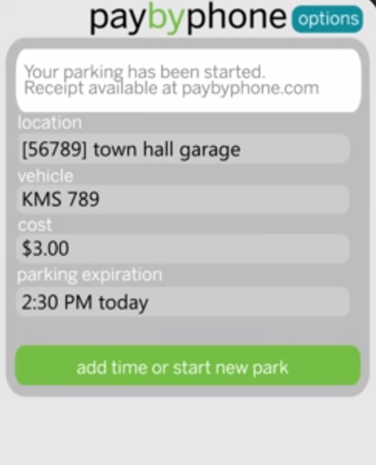


Slide 16
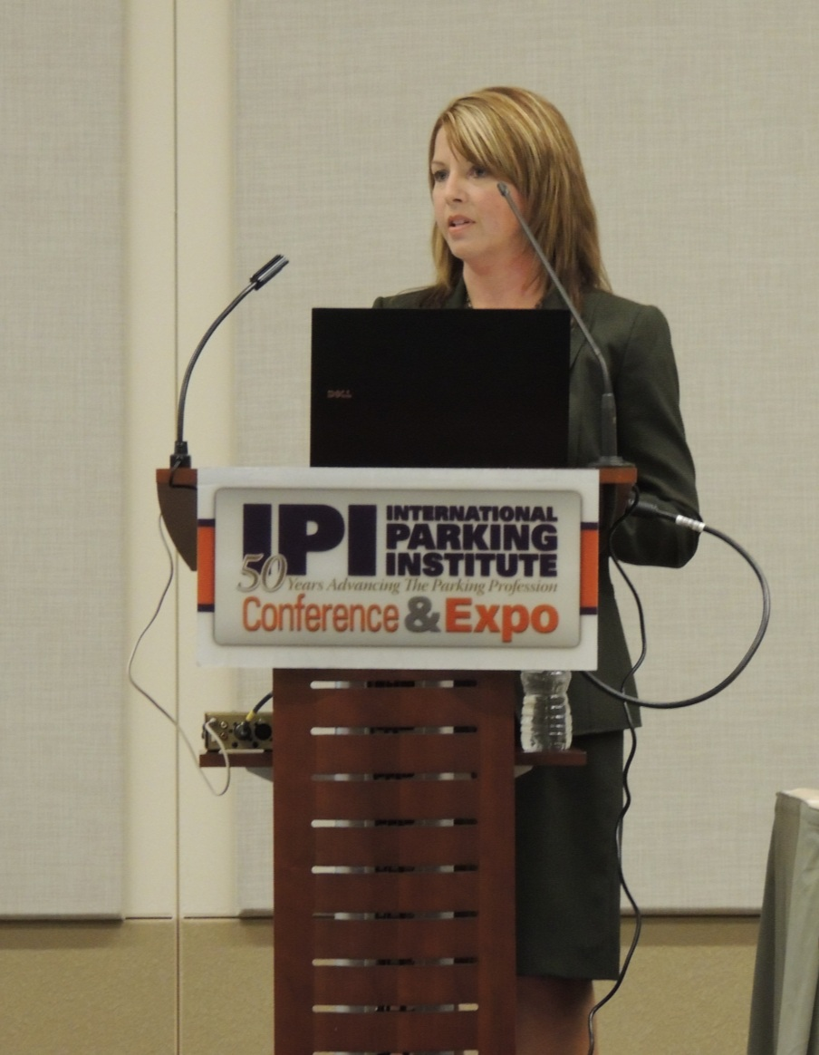
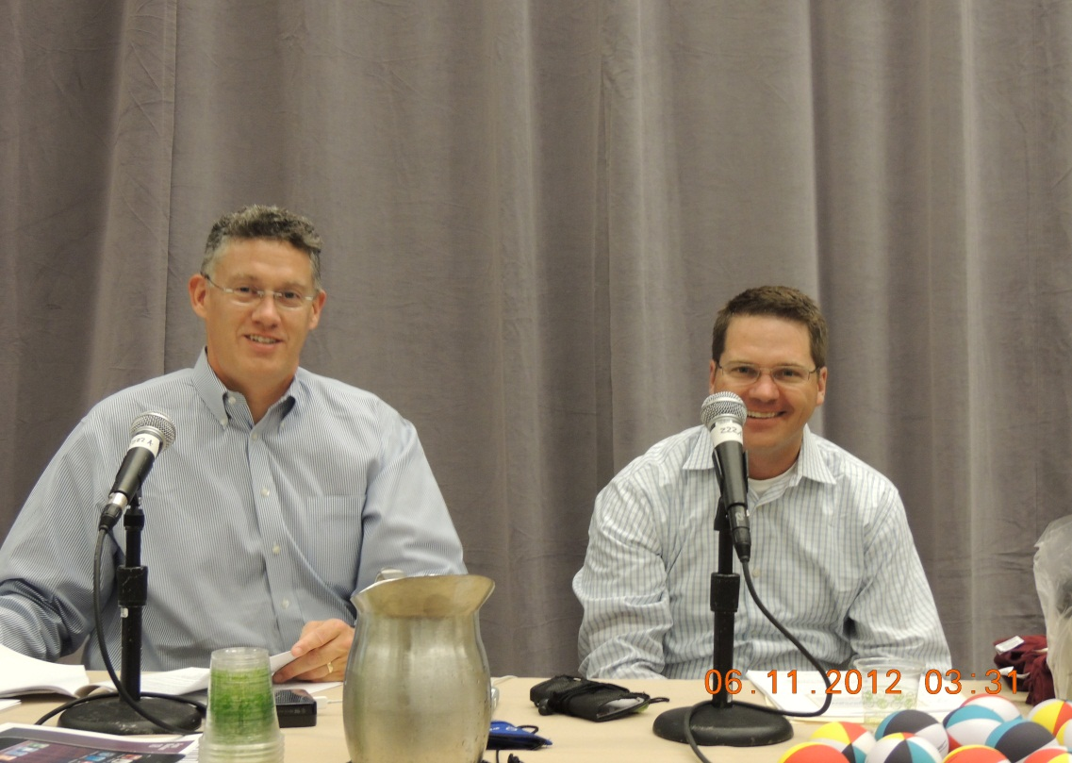








Slide 17
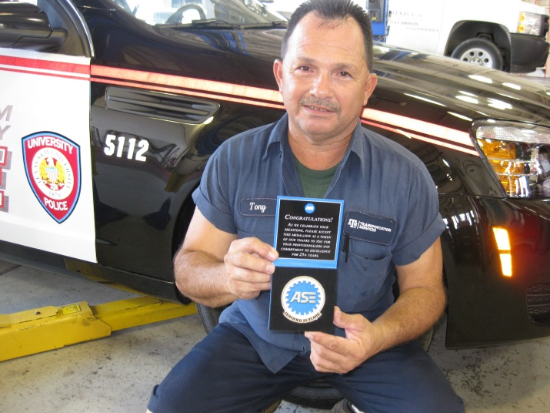
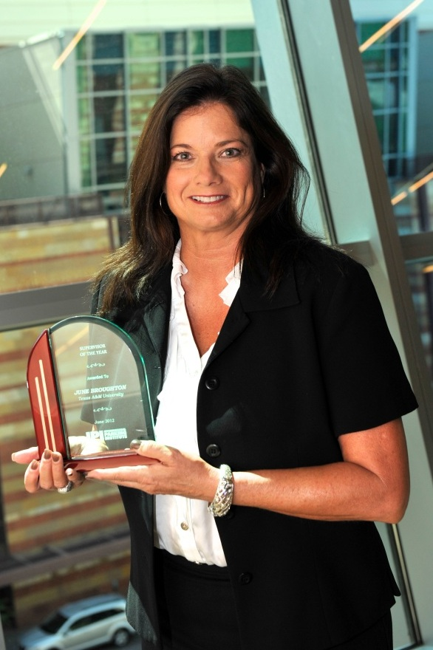
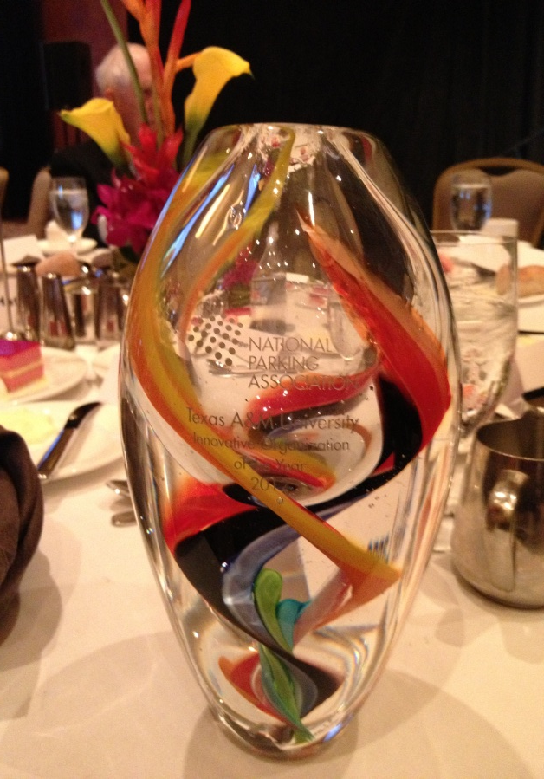
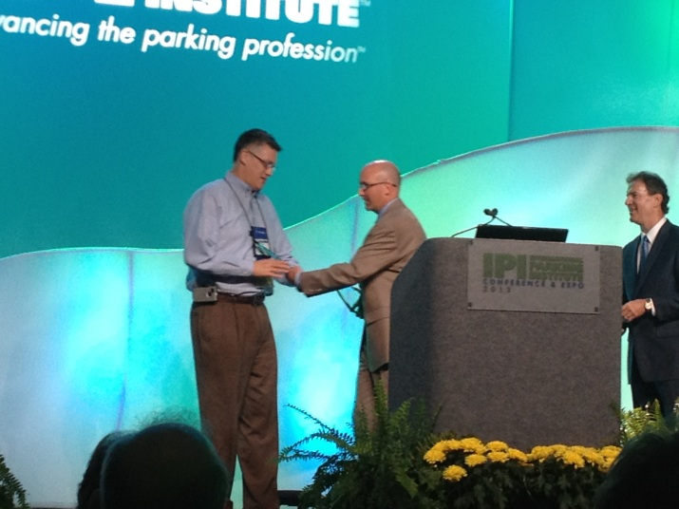
Employee Recognition

Slide 18
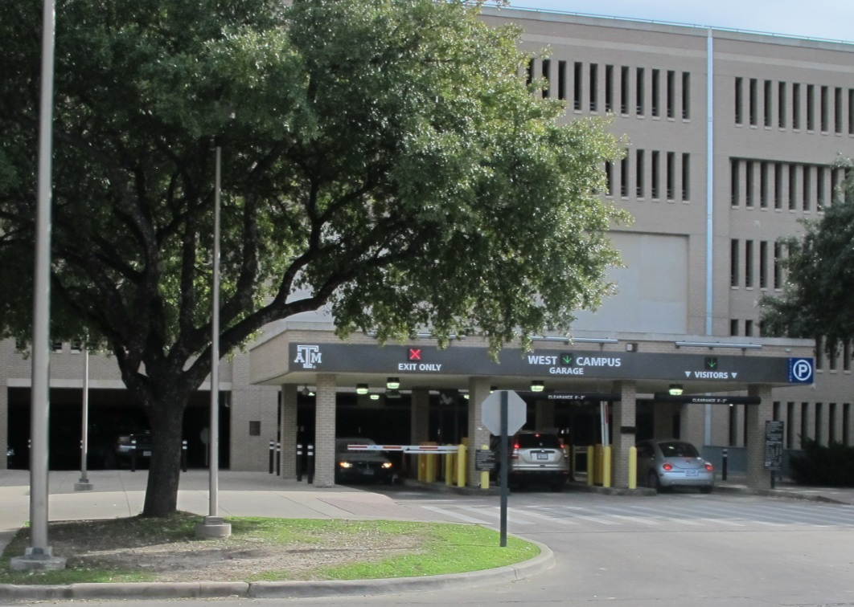
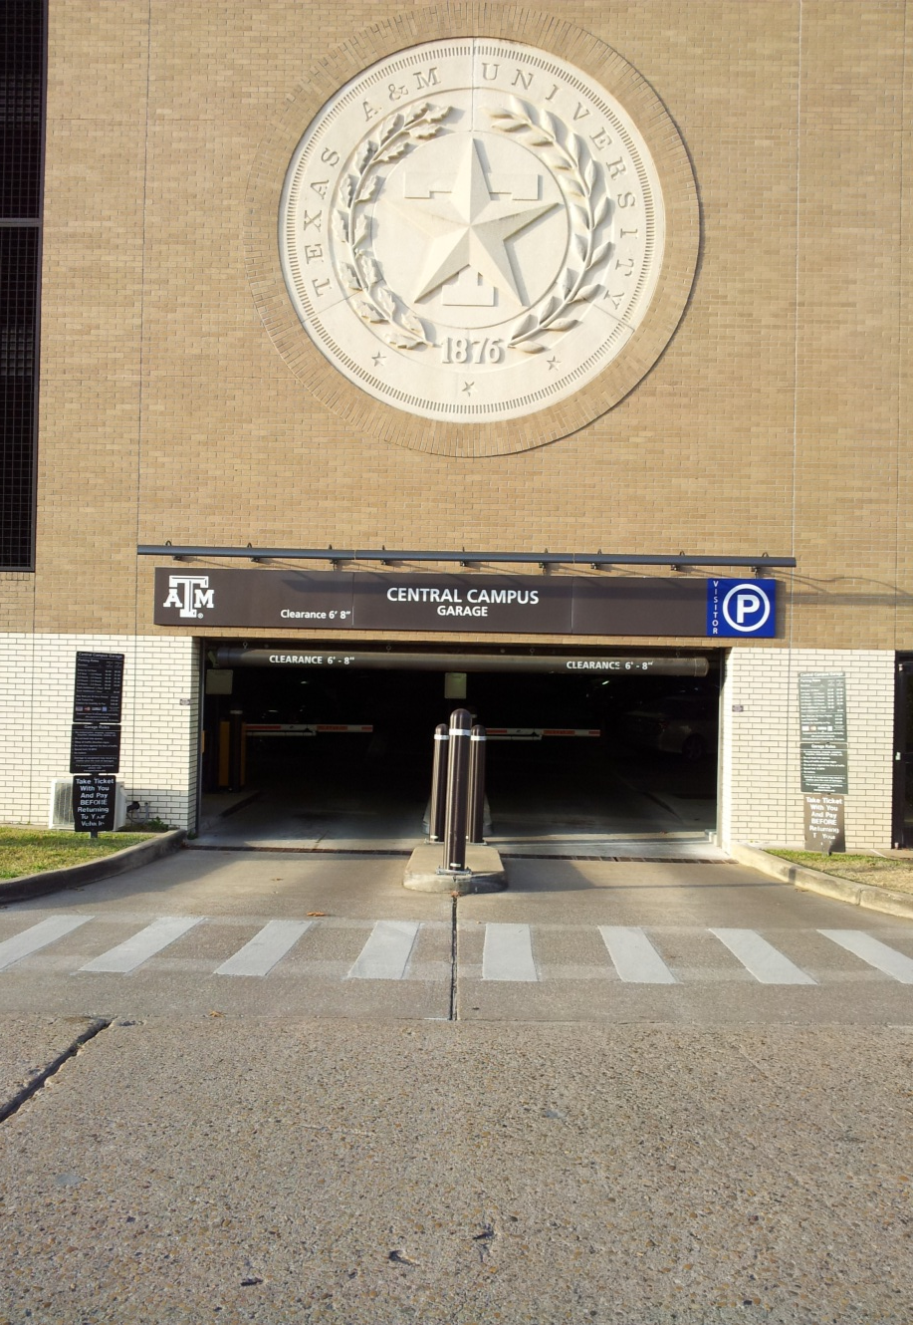
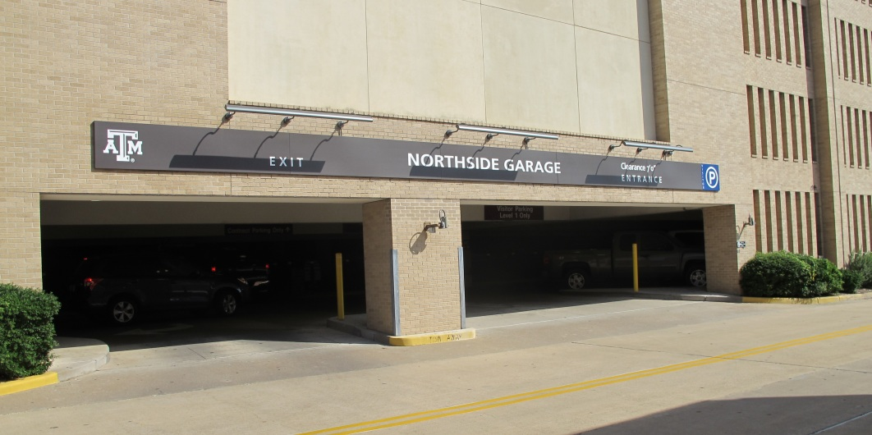

Slide 19
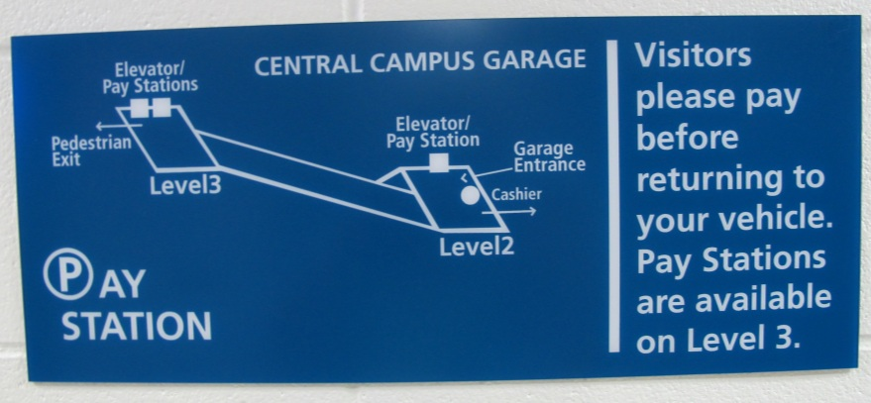
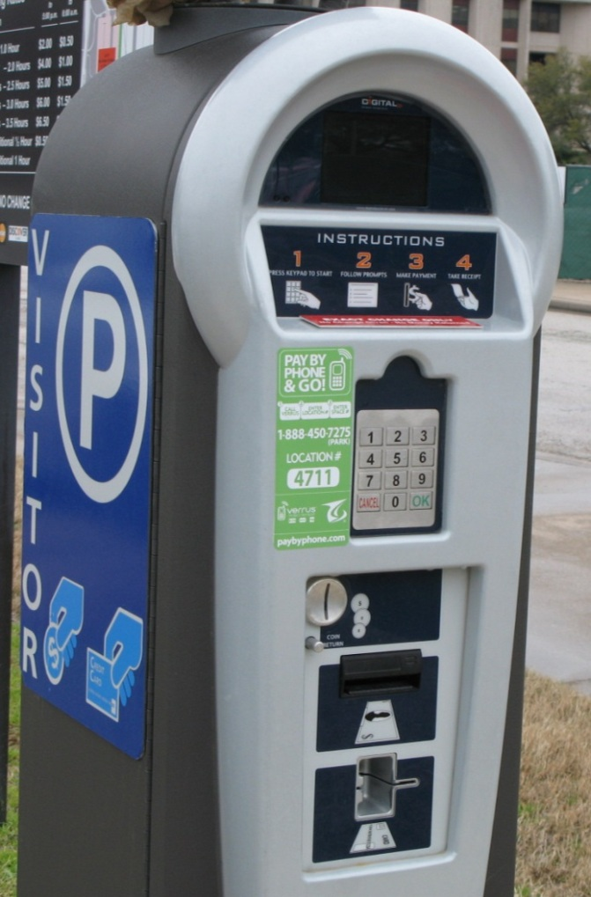
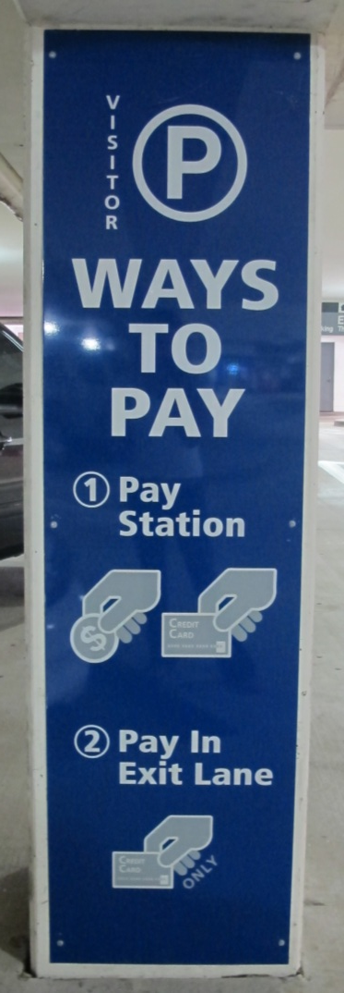
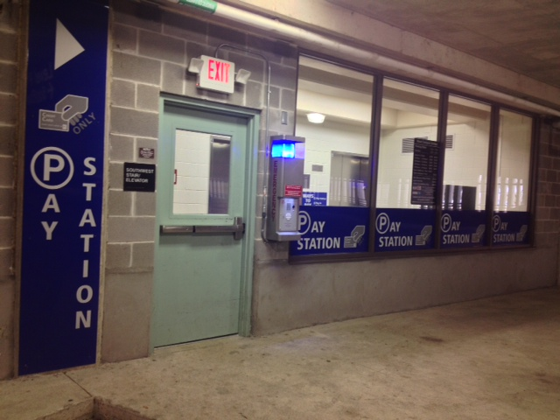
New Visitor Signage

Slide 20
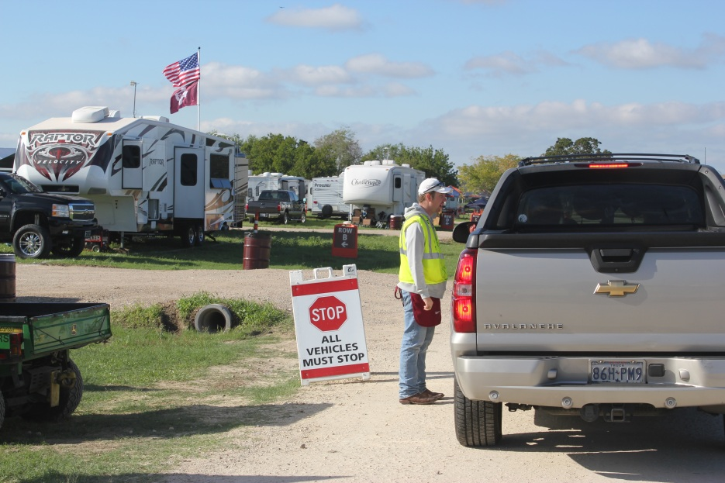
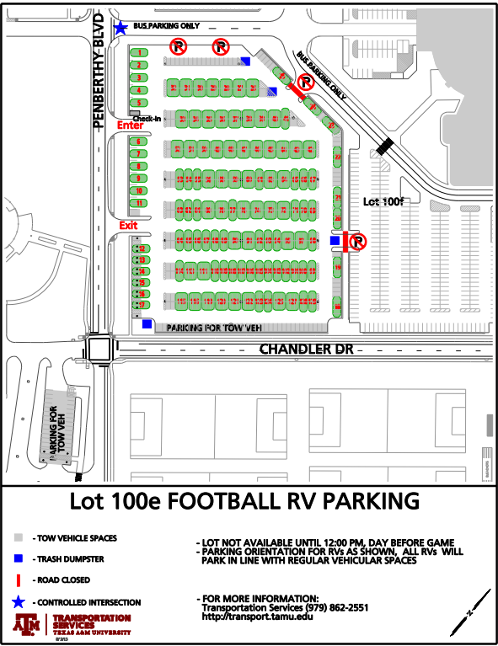
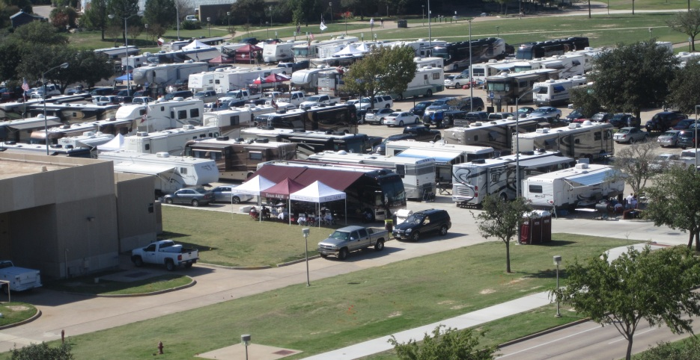
Gameday RV

Slide 21
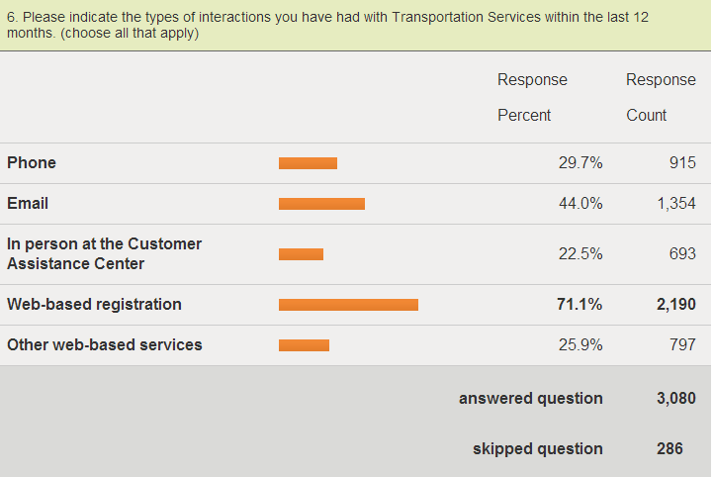
Annual Customer Survey

Slide 22
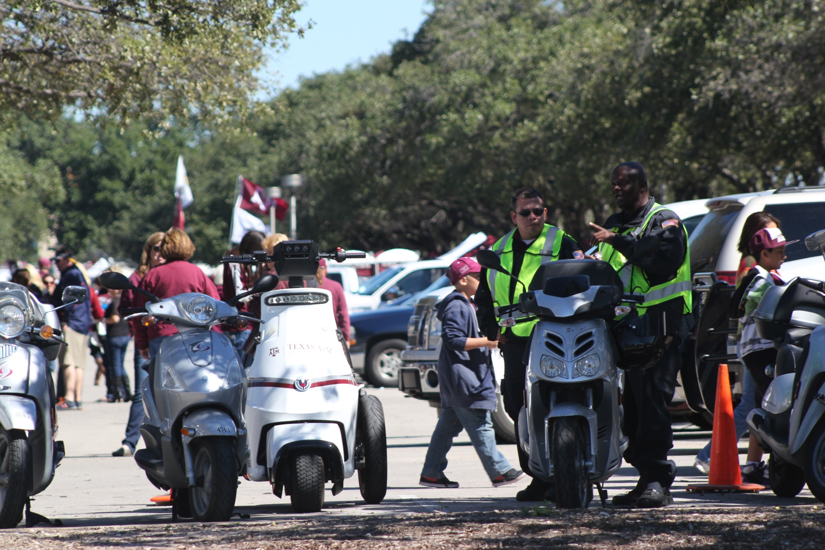
Parking Officer Equipment

Slide 23


Time Clocks

Slide 24


Lot Renovation

Slide 25



Slide 26



Garage Maintenance

Slide 27


Event Wayfinding

Slide 28



Dispatch App/Tracking of Bus Units

Slide 29


Transit Software/Equipment – A&M
Ranger-on board computer terminal
APC-Automated Passenger Counters

Slide 30

Cameras

Slide 31




Bus wash/Fueling

Slide 32



Media

Slide 33


















Site Visits

Slide 34


Bike Registration
Notes:
Add bike with permit or photoshop

Slide 35


Slide 36




Bikes

Slide 37


Marketing/Communications

Slide 38


Slide 39

Credit Card Missing Report

Slide 40

Online Revenue

Slide 41


Slide 42

Fixed LPR

Slide 43


Lot Counts

Slide 44


Gameday Operations

Slide 45

GIS

Slide 46



Access
Notes:
Take pic of peters car

Slide 47




Real Time Handheld

Slide 48
Citations breakdown
Notes:
Tell story about 100m

Slide 49


Slide 50


Slide 51


Slide 52

Annual Price Survey

Slide 53


Recognition

Slide 54




Motor Assistance

Slide 55



Braille stops

Slide 56



Portable Message Board
Notes:
hide

Slide 57




Access Technology

Slide 58

Responsive Design
Notes:
Desktop, Tablet, phone

Slide 59



Virtual Services

Slide 60


Ross St. Before and After

Slide 61








Site Visits

Slide 62


Slide 63








