Slide 1
Credit Card Reconciliation
Jessica Sands – Senior Consultant

Slide 2
Objectives
Data sets should have a common value
Pull data from both systems
Input data in Excel
Compare totals
Compare individual records
Use filters
Handle exceptions
Keep notes for auditors

Slide 3
Reconciliation Tools
Texas A&M University
Therese Kucera & Pam Horner

Slide 4
Data Warehouse – Epay

Slide 5
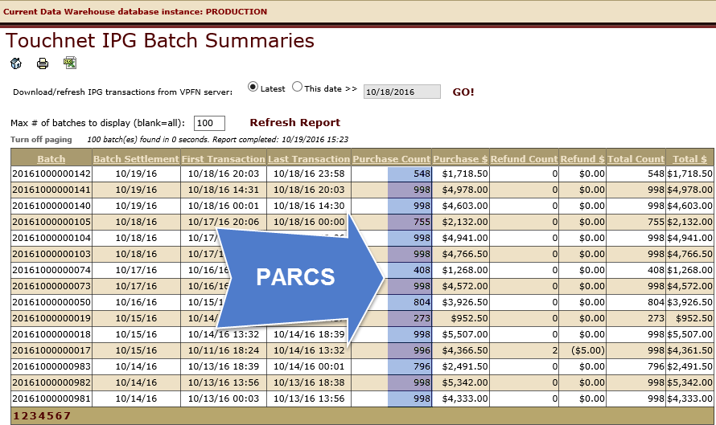
Data Warehouse Epay – PARCS Summary

Slide 6
Touchnet Interface vs Flex Report
7 Missing transactions – and $22 short in FLEX.

Slide 7
Data Warehouse Epay

Slide 8
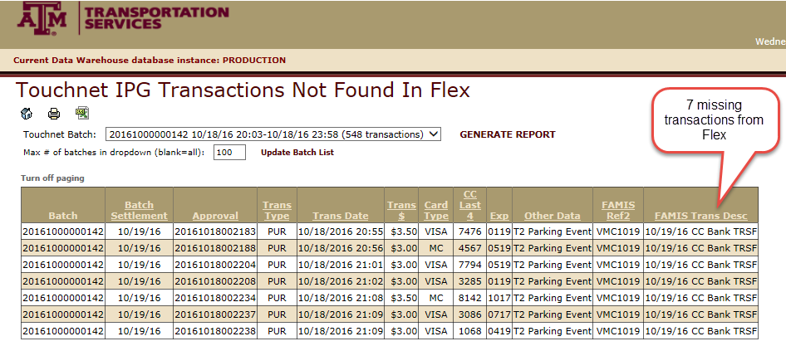
Data Warehouse Epay – Discrepancies
7 Missing transactions – and $22 not recorded in FLEX.

Slide 9
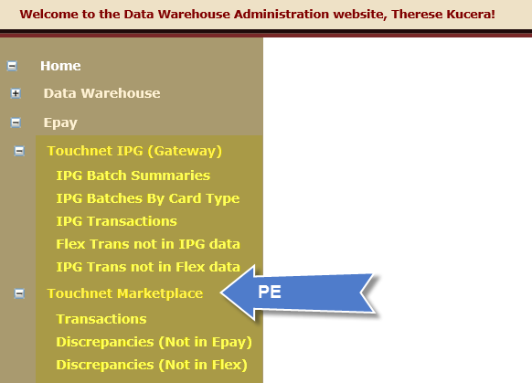
Data Warehouse – Epay

Slide 10
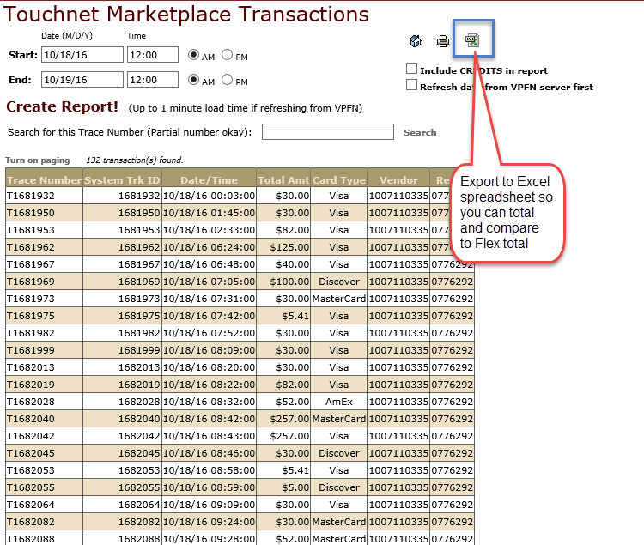
Data Warehouse – Export to Excel

Slide 11
Data Warehouse – Epay

Slide 12
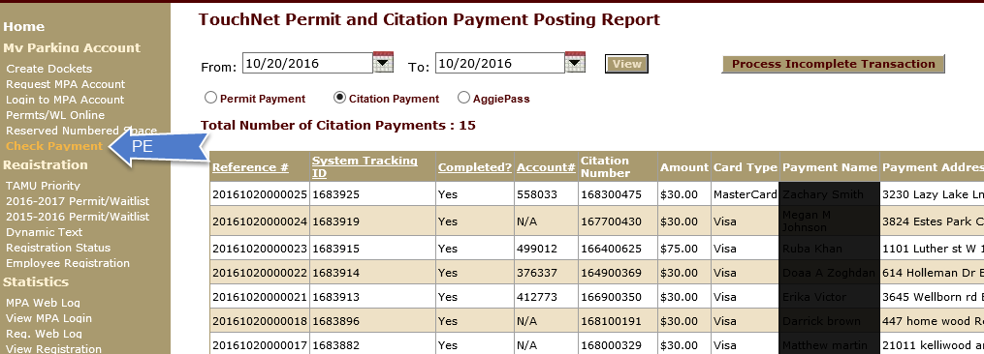
MarketPlace – Check Payments

Slide 13
Check Payments – Incompletes

Slide 14
Check Payments – Refunded

Slide 15
Questions?
Pam Horner – pwh@tamu.edu
Therese Kucera – tkucera@tamu.edu

