Slide 1
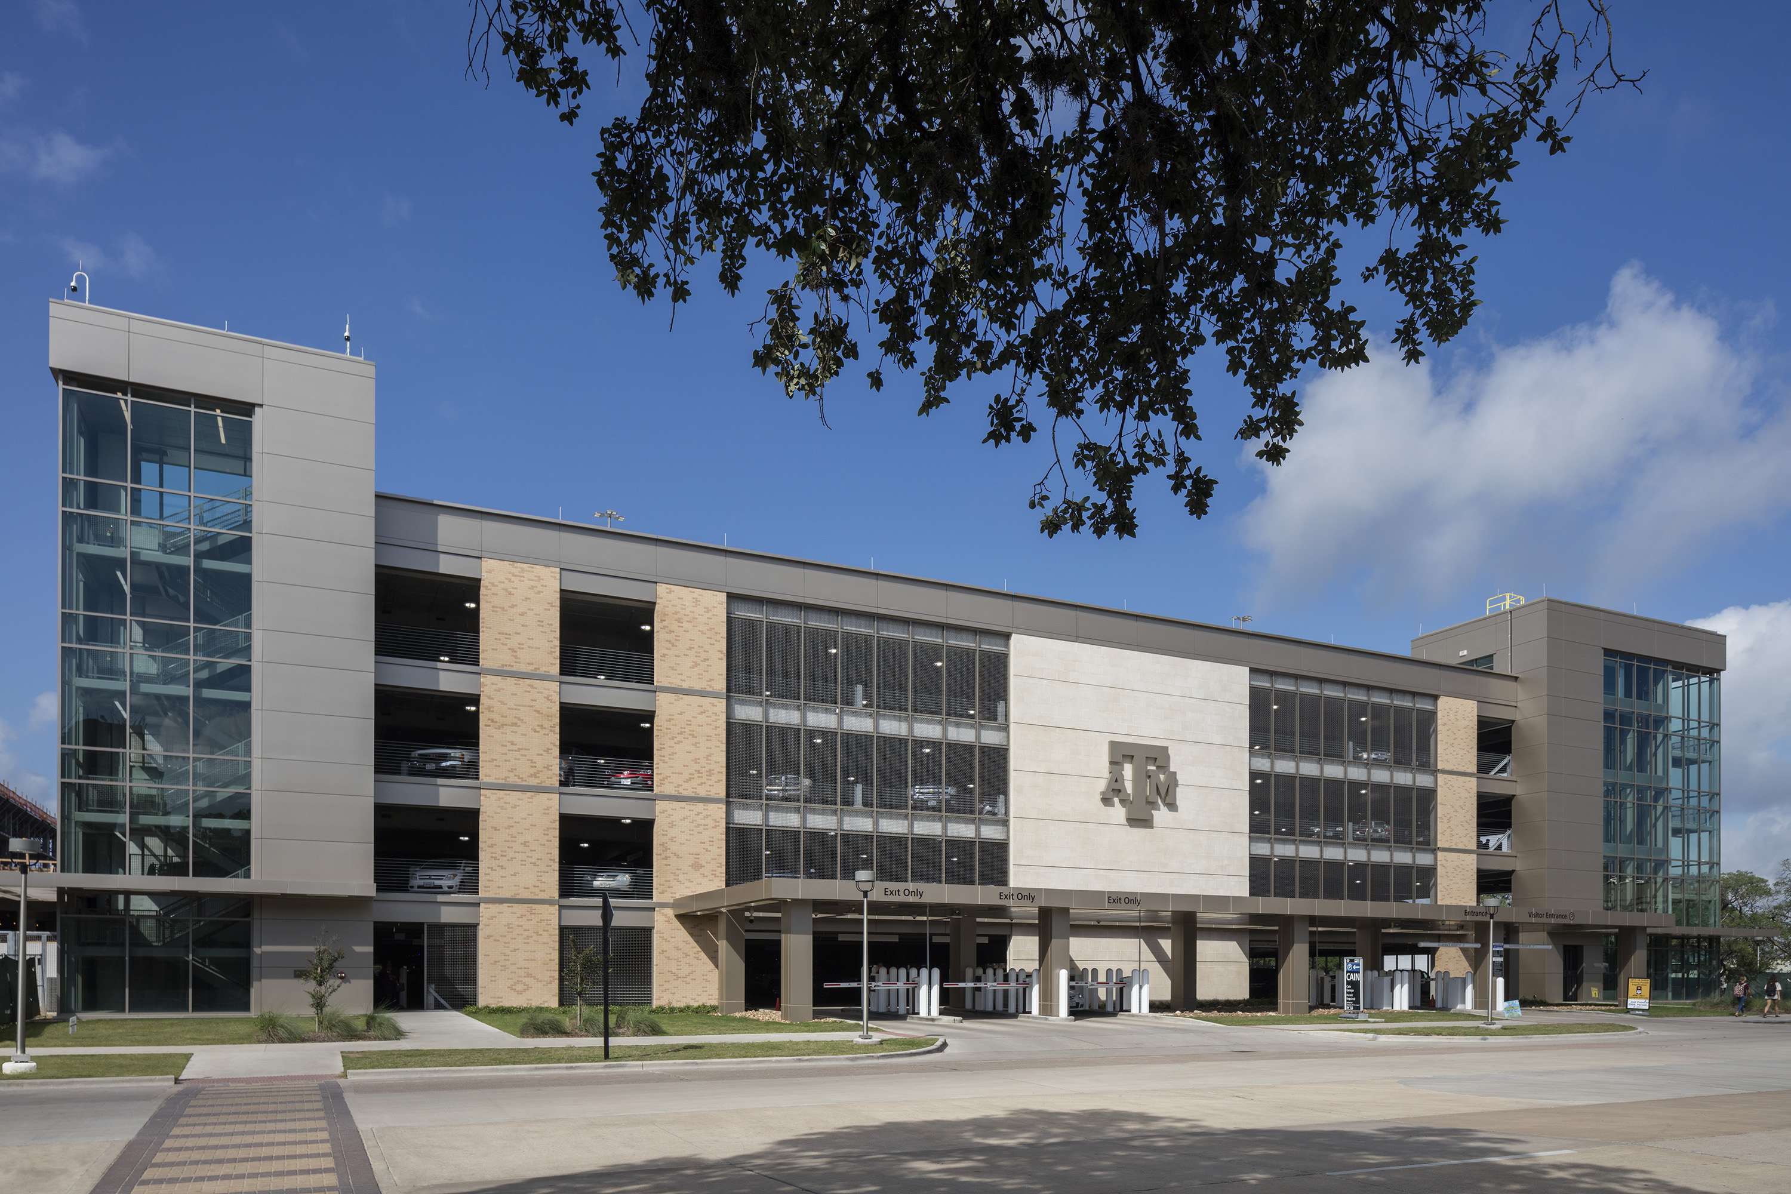
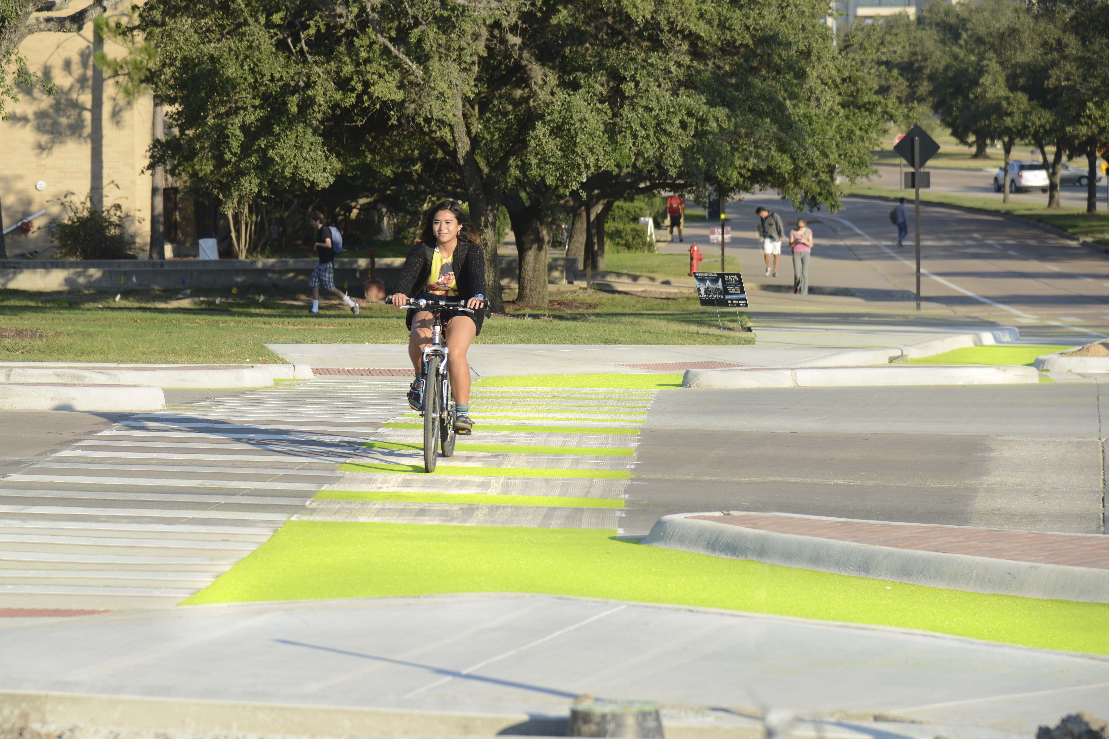
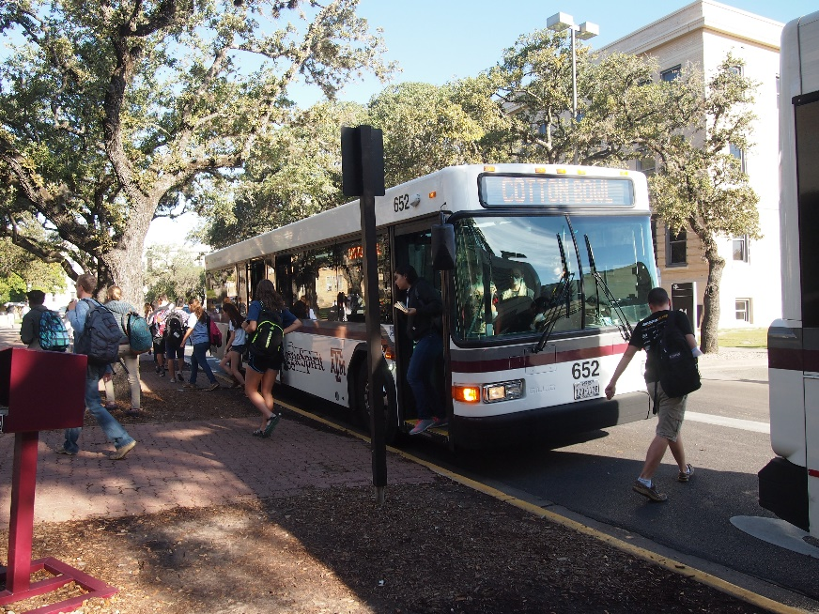
TDM at Texas A&M University
Transportation Demand Management Summit
Debbie Hoffmann, M.S, CAPP
Associate Director
Texas A&M University, Transportation Services

Slide 2
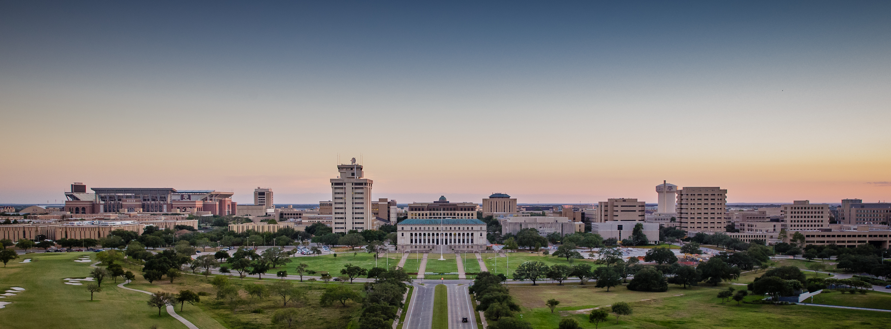
About Texas A&M
Located in College Station, Texas
Fourth-largest U.S. university – 5,200 acres
12,000 faculty/staff, 63,000 students
35,091 parking spaces; 6 garages; 2/3 space in surface lots

Slide 3
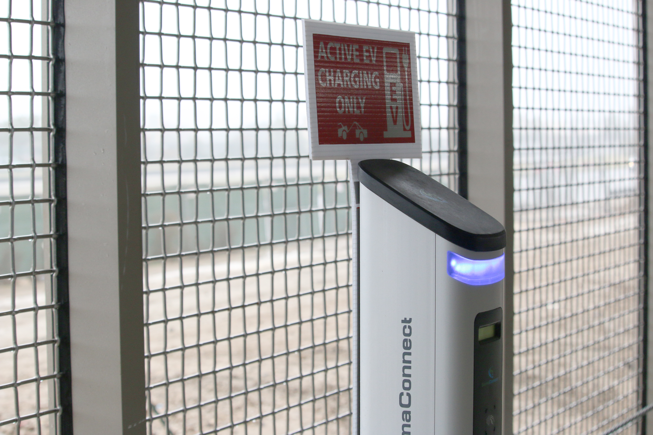
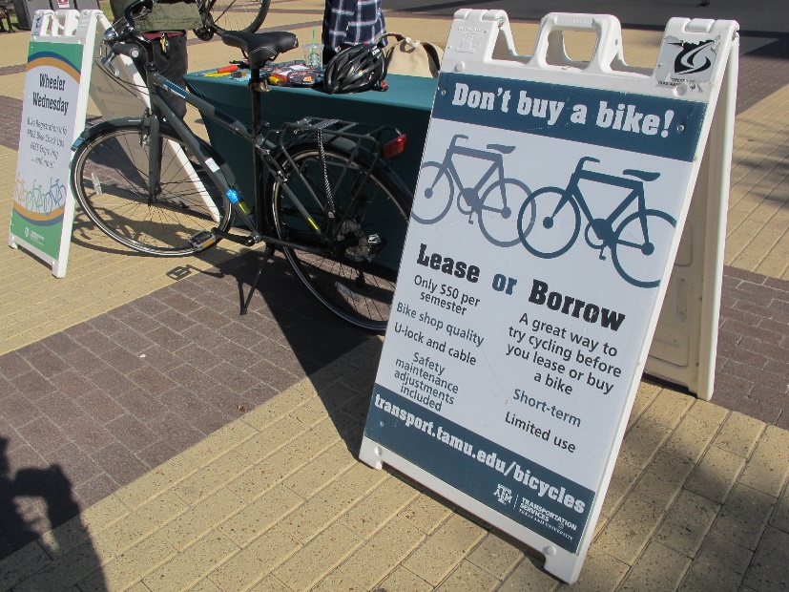
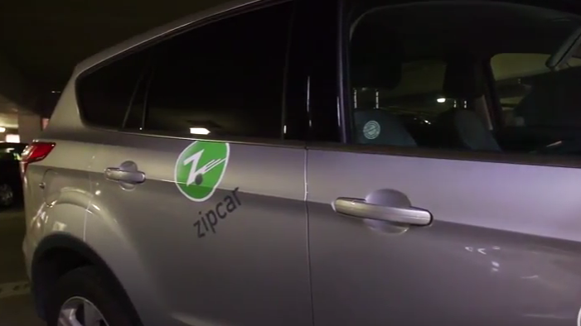
TDM at Texas A&M
11,000 bikes; 15,000 bike parking spaces
95 bikes in bike lease fleet
75 bikes in bike share fleet
10 vehicles in car share fleet; 15-33% utilization
Ride share; 2,513 posts in last 90 days
Break/Weekend shuttles
Electric vehicle charging
Park and Ride
Exploring Vanpool

Slide 4
What drives choosing TDM at Texas A&M?
At or nearing capacity of transit
7.75 million rides per year
10 off-campus routes; 8 on-campus routes
Limited city transit service
Finally…… parking!
Inconvenience of available spaces

Slide 5
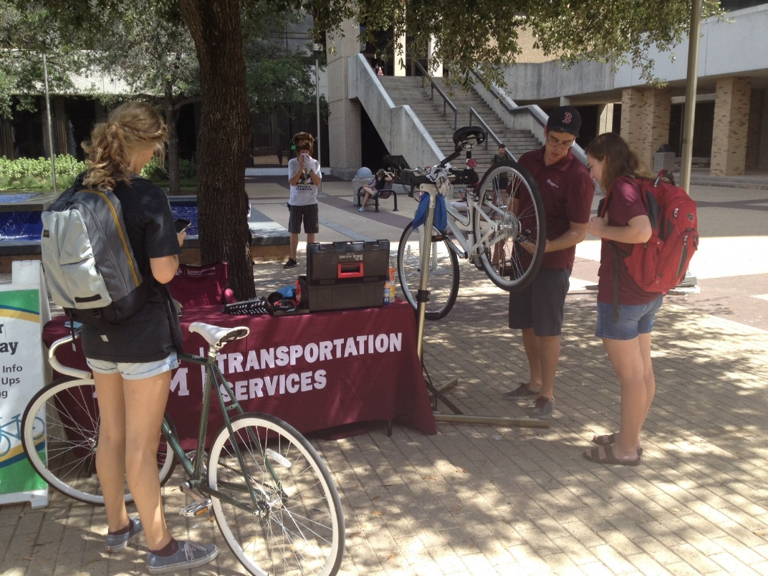
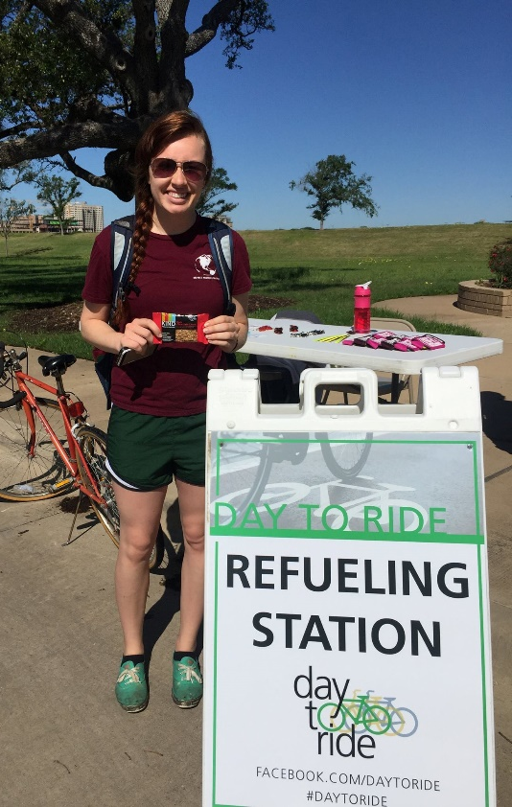
TDM Challenges
Customer demand levels
Lack of community services/partners
Funding sources
Notes:
We are not in a downtown environment where we may have collaborations and partnerships with the city to offer subsidized transit passes or city offered services to supplement what we offer. This puts all of the onus on us to implement and fund options. Because alternatives are not necessary, and there are no mandates to offer them, so it is us pushing to offer them.
Still, we have some great success stories… 40% of our

Slide 6
Despite Challenges, Successes
Provide 7.75 million bus rides per year
40% of resident students do not own permits
Car share rides warrant increasing fleet size
Bike share has 164 active members; 4667 trips in first 9 months
Ride share has 1,100 new users and 2,513 new posts in last 90 days
Texas A&M Aggie Green Fund Advisory Committee awards nearly annual small grants to alternative transportation initiatives
Notes:
We are not in a downtown environment where we may have collaborations and partnerships with the city to offer subsidized transit passes or city offered services to supplement what we offer. This puts all of the onus on us to implement and fund options. Because alternatives are not necessary, and there are no mandates to offer them, so it is us pushing to offer them.
Still, we have some great success stories… 40% of our

Slide 7
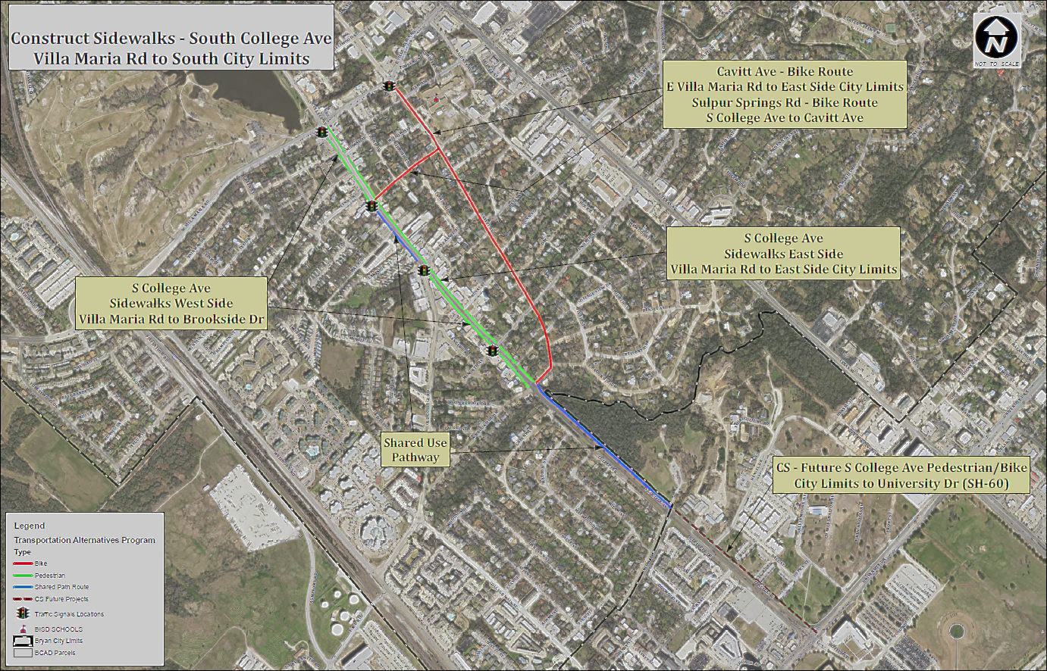
Recent TDM Wins - Community
Involvement on regional Active Transportation Advisory Panel allows great input and impact on new bike/ped project connecting campus to downtown

Slide 8
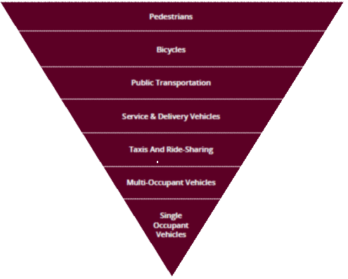
Recent TDM Wins – Campus Master Plan
Pedestrians
Bicycles
Public Transportation
Service & Delivery Vehicles
Mobility Hierarchy
Most Environmental Impact Least Environmental Impact
Taxis & Ride Sharing
Multi-occupant vehicles
Single
Occupant
vehicles
Partnering with campus architect while creating updated Campus Master Plan results in heightened focus on access for pedestrians and alternative transportation.

Slide 9
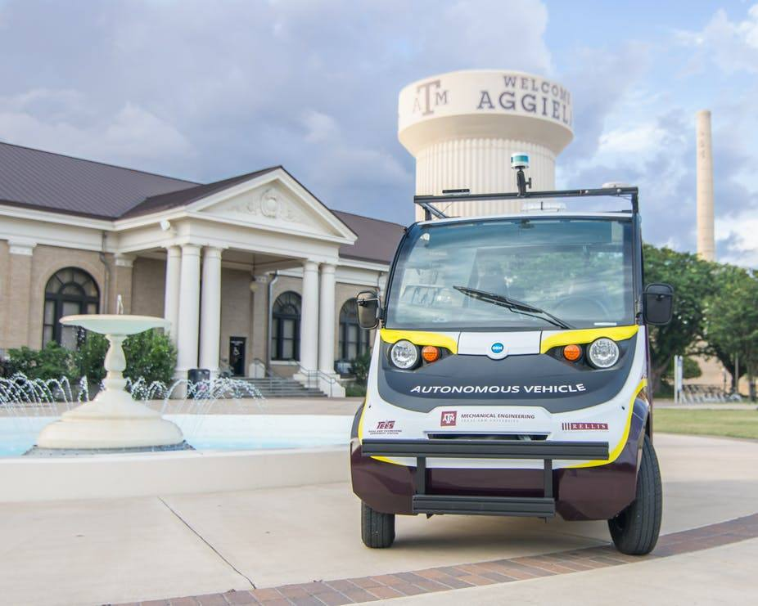
Recent TDM Wins – Transformational Mobility
Campus Transformational Mobility Plan
Focused on transforming the university into a
greener, more people-centric campus by focusing on
pedestrian and bicycle connections,
enhanced transit options,
shared transportation services,
innovative technologies
and autonomous vehicles.
Notes:
Stakeholders Meetings

Slide 10
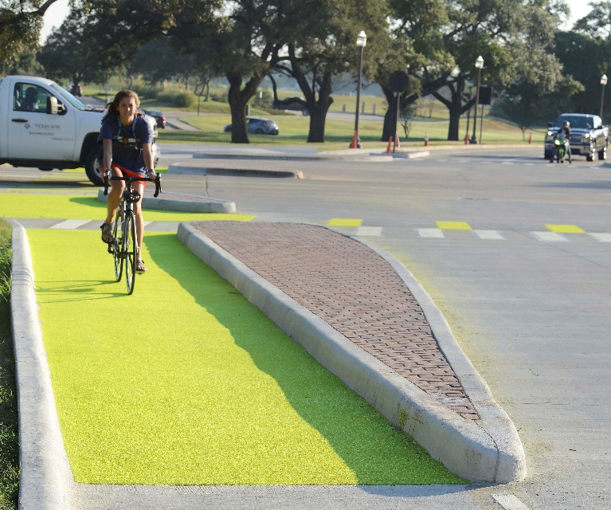
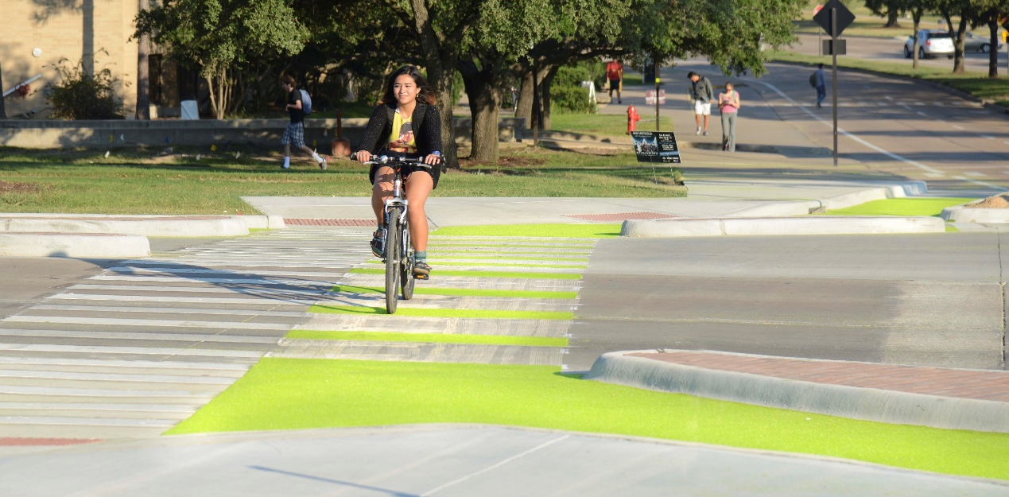
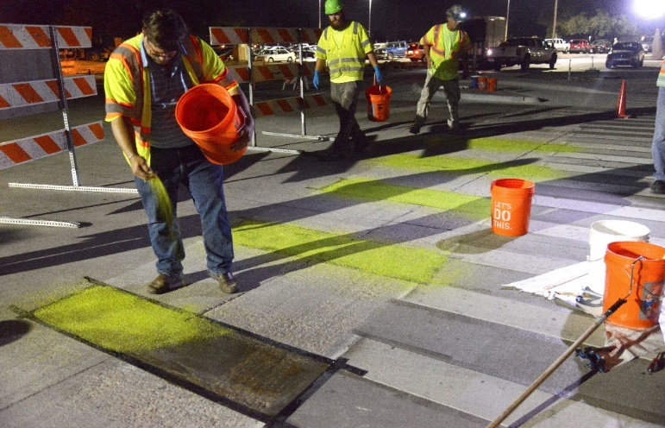
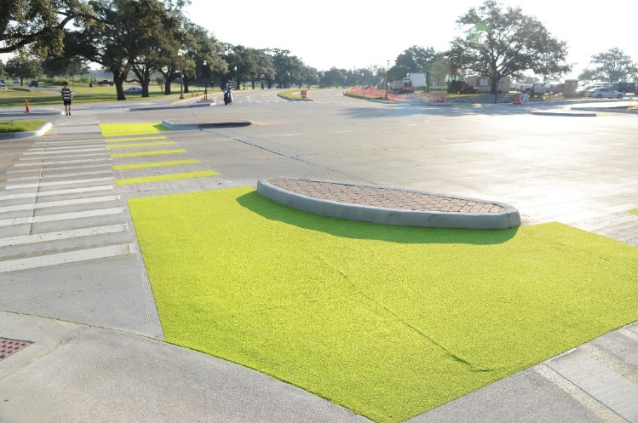
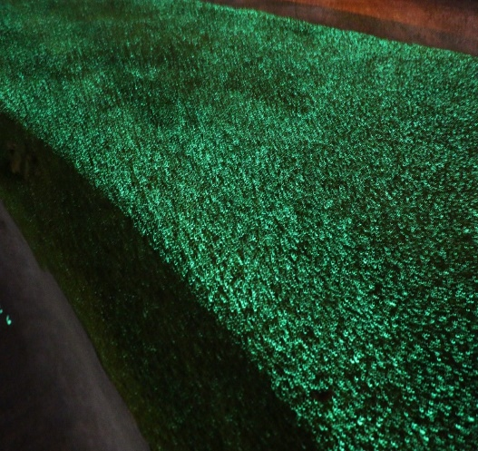
Recent TDM Wins - Dutch Junction

Slide 11
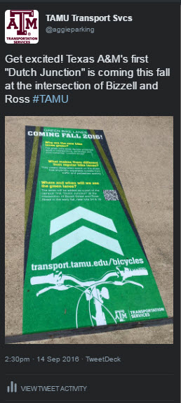
Campaign Success—What worked?
Communications Plan that informed and sparked interest in the project and offered opportunities for research—“Living
Laboratory”
Media release (joint)
Social Media Strategy
Spokespersons (partnerships)
Creativity in design
“#1 Most Read Story at
Texas A&M for 2016!”
Notes:
-Media outreach: focused on elements of innovation (urban design, smart cities, cool factor) to draw in audience.
-Social Media: Received 24,000+ page views when first published and 6,900 shares to Facebook from the Texas A&M Today site alone.
-Spokesperson: Utilized partnership resources to maximize outreach efforts when telling our story.
There were over 60+ mentions in print and online news outlets when first published.
It went international! Netherlands Reddit forum and national/international metro transportation blogs covered story.

Slide 12
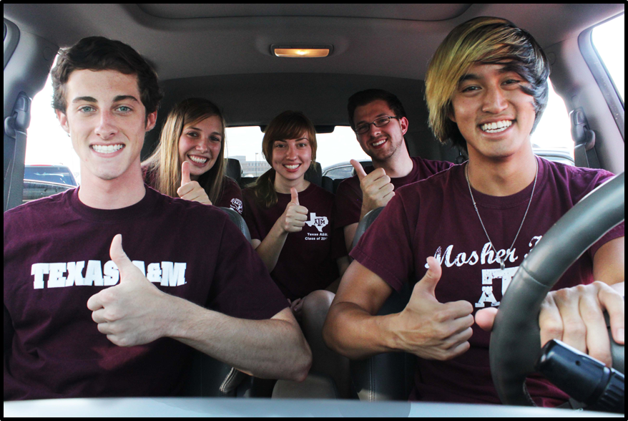
Debbie Hoffmann
dhoffmann@tamu.edu

