Slide 1
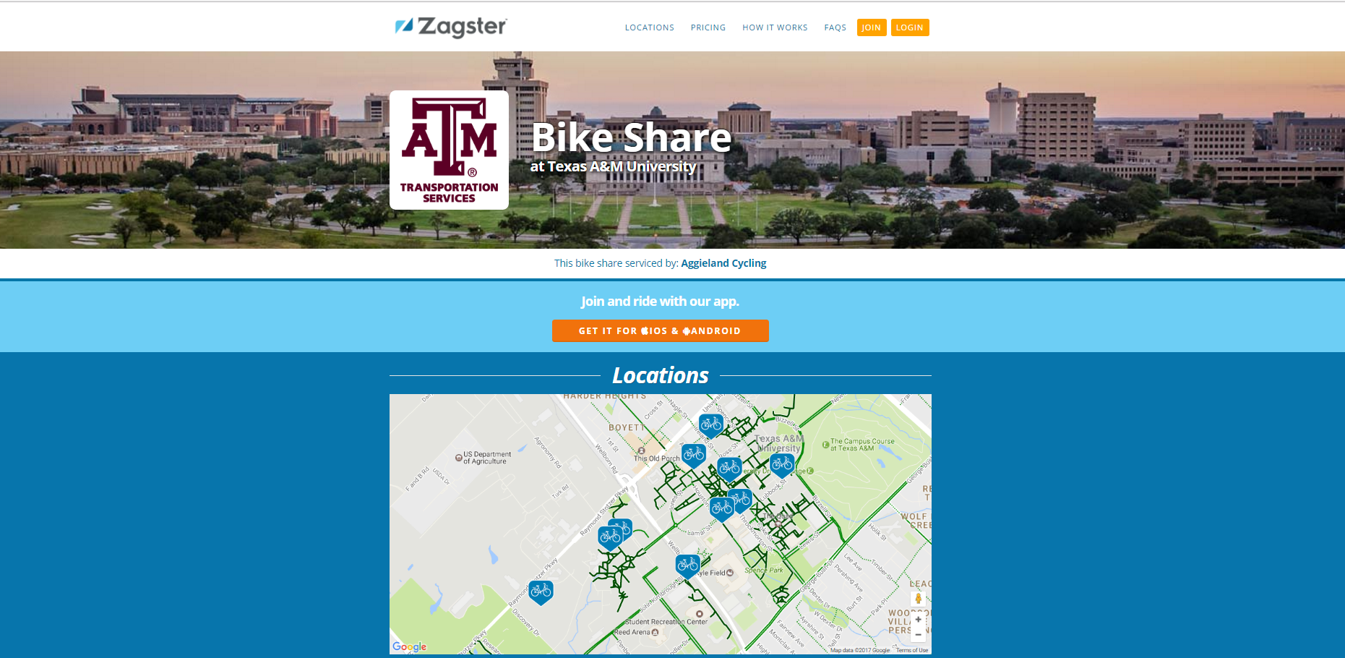




TDM @ A&M
Association of Commuter Transportation
July 31, 2007
Debbie Hoffmann, Associate Director
Texas A&M University, Transportation Services

Slide 2
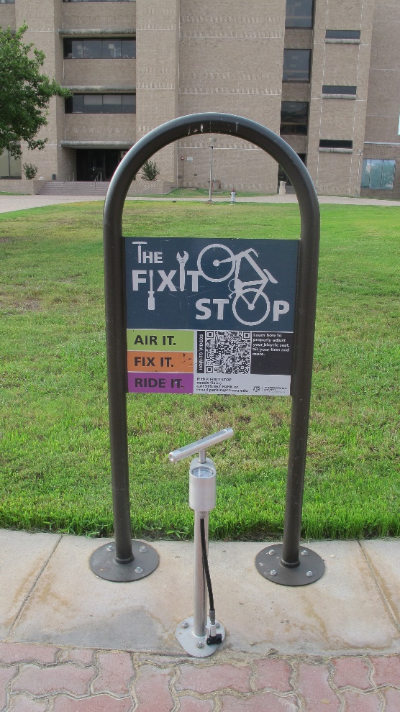
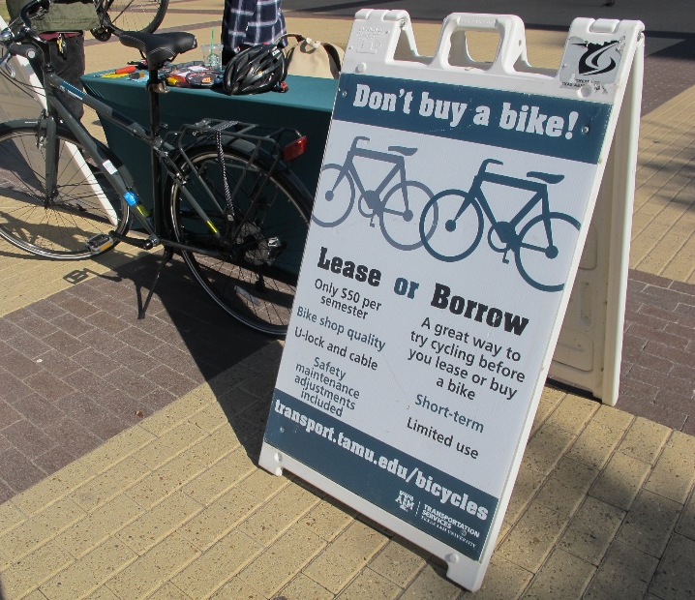
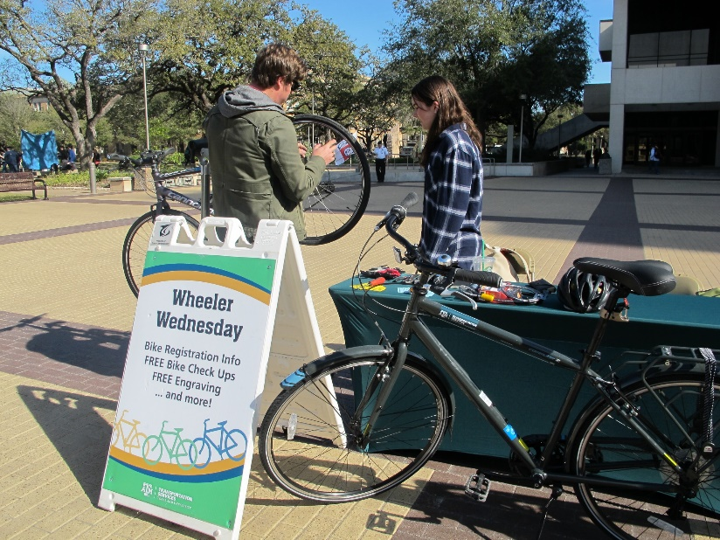
About Texas A&M
College Station, Texas
Fourth-largest U.S. university – 5200 acres
12,000 faculty/staff, 60,978 students
35,027 parking spaces; 6 garages; 2/3 space in surface lots

Slide 3
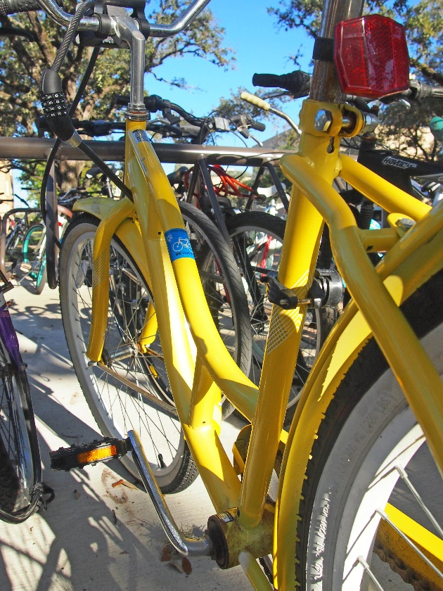
TDM at Texas A&M
11,000 bikes; 15,000 bike parking spaces
95 bikes in bike lease fleet
75 bikes in bike share fleet
10 vehicles in car share fleet; 15-25% utilization
Ride share
Break/Weekend shuttles
Electric vehicle charging
Park and Ride

Slide 4
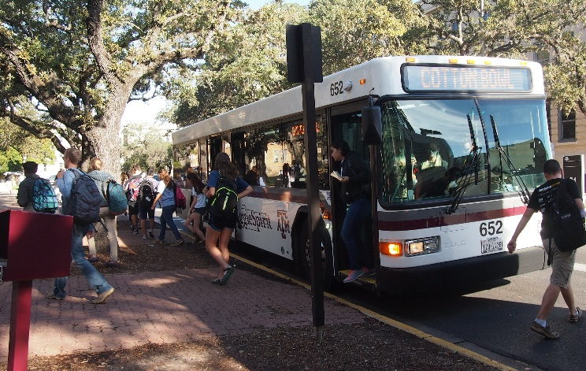
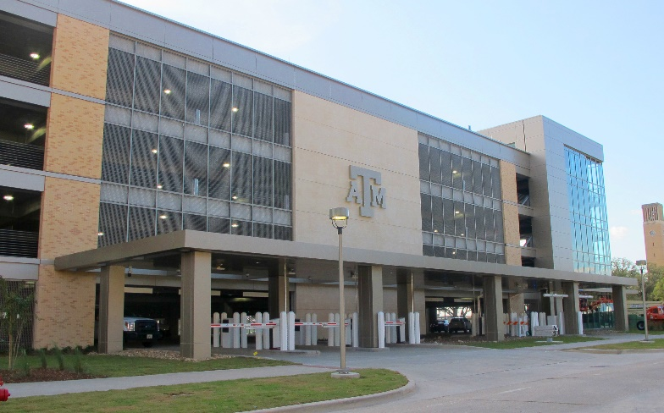
What drives choosing TDM at
Texas A&M?
At or nearing capacity of transit
  7.5 million rides per year
  10 off-campus routes; 8 on-campus routes
  Limited city transit service
Finally…… parking!
  Convenience of available spaces
Green what?

Slide 5
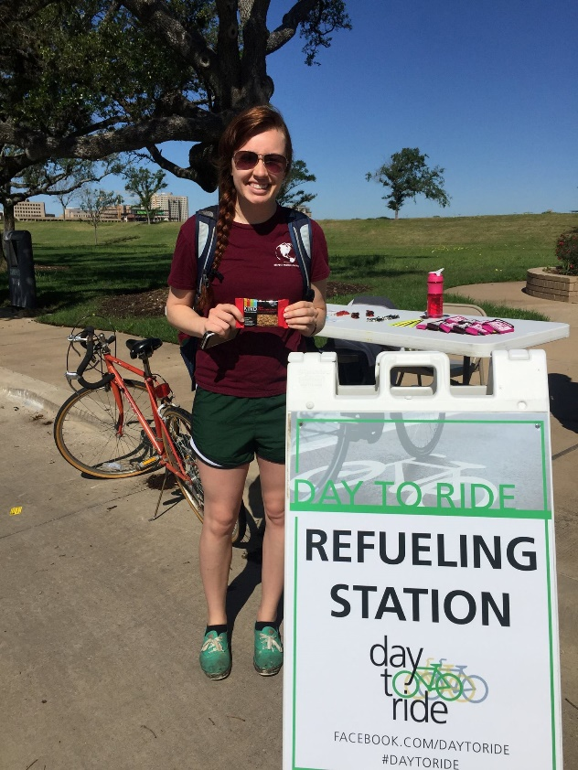
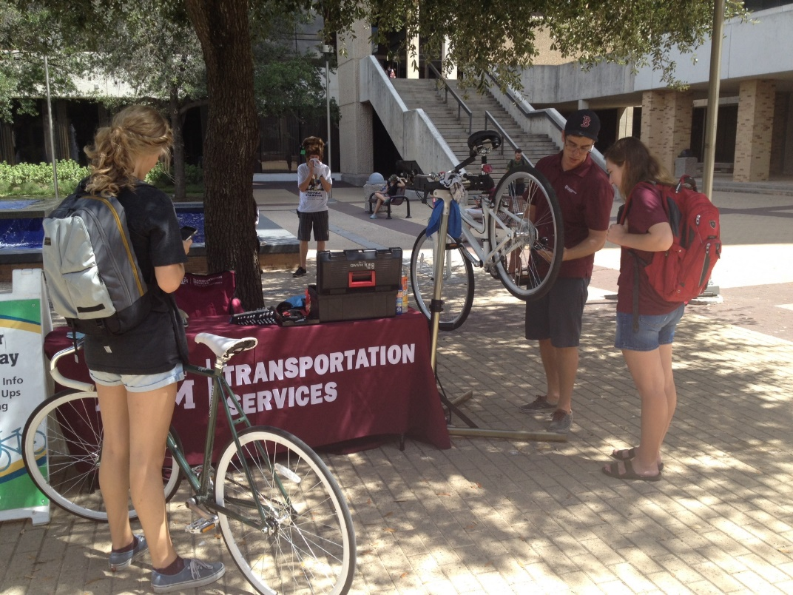
TDM Challenges
Customer demand levels
Funding sources

Slide 6
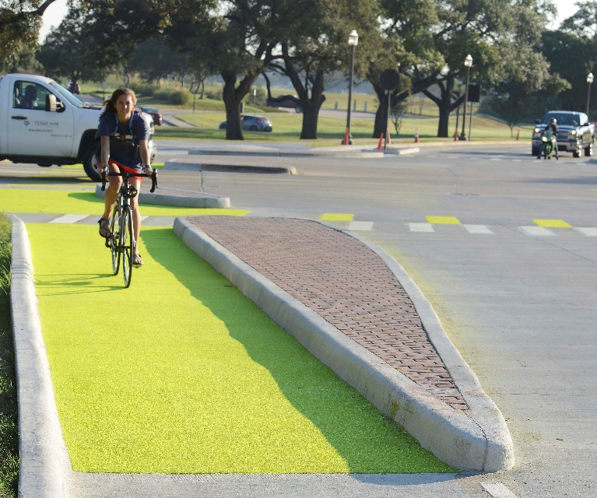
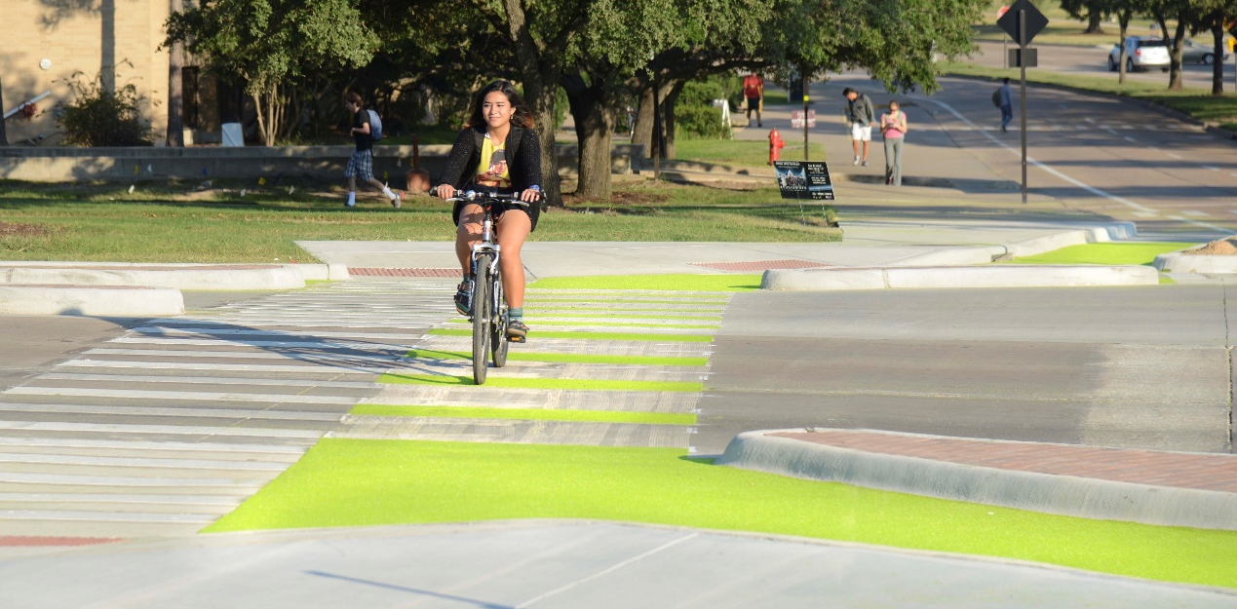
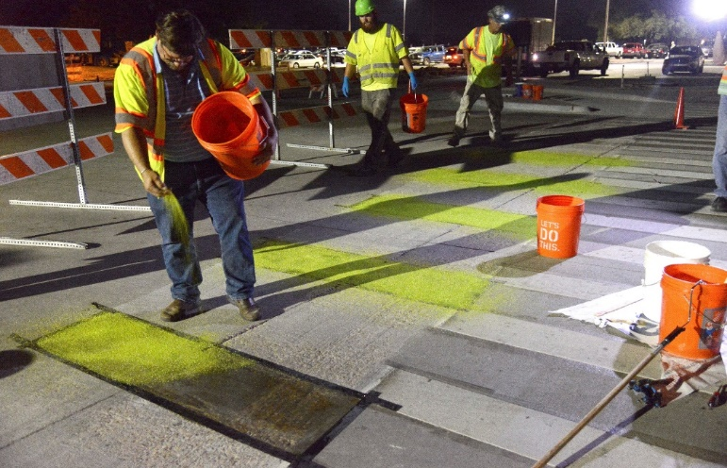
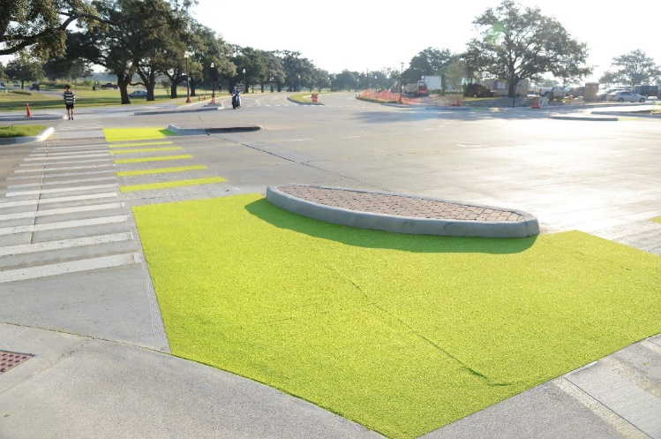
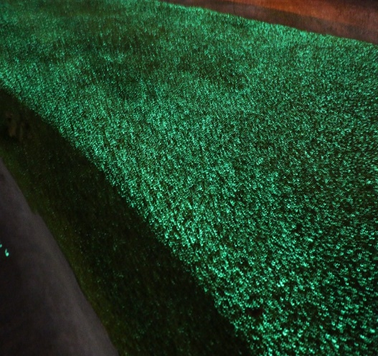
Recent TDM Win - Dutch Junction

Slide 7
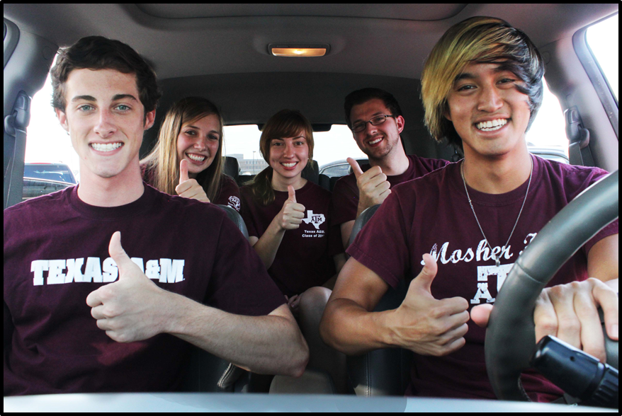
Debbie Hoffmann
dhoffmann@tamu.edu

