Slide 1
Alt Trans Update
TSAC
November 2, 2011

Slide 2
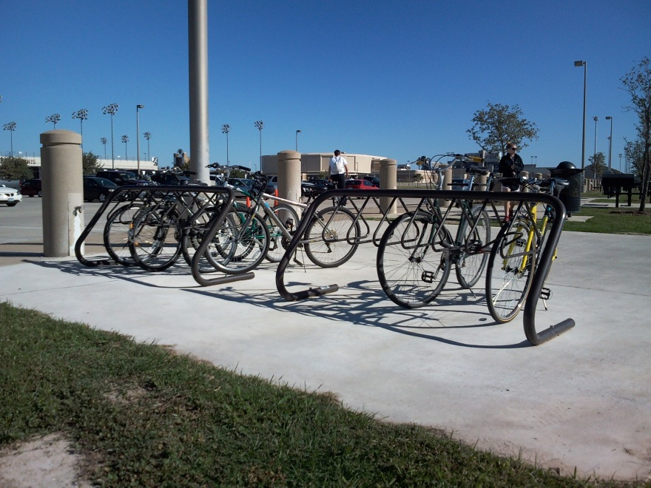
Bike Racks
New bike rack order should arrive next week
Rated capacity for double sided access is 1,500 bike spaces (150 racks)

Slide 3
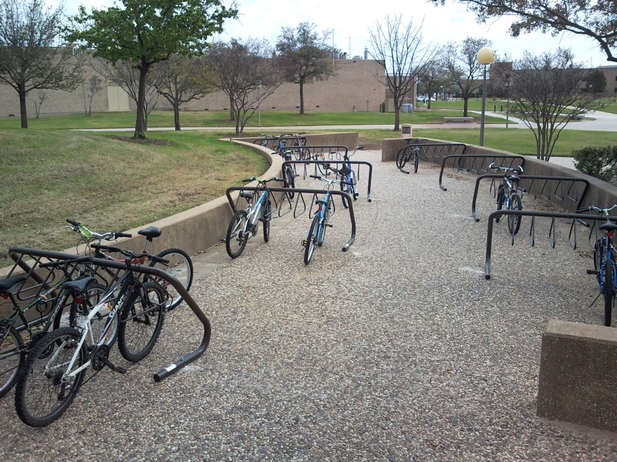
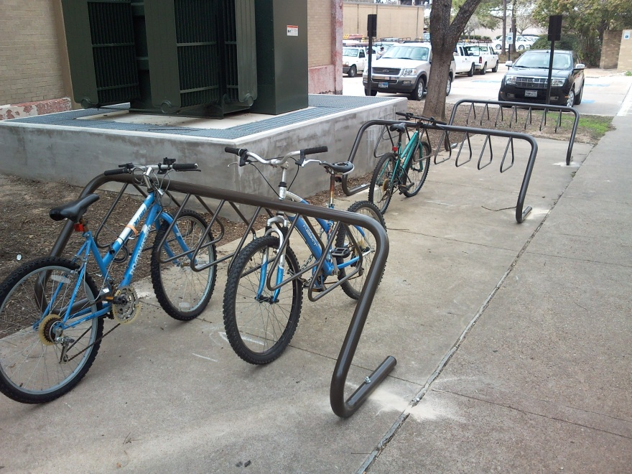
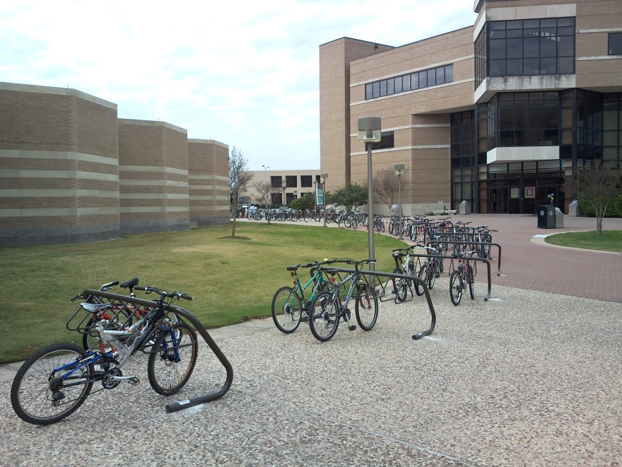
New Racks

Slide 4
Expansion/Replacement
We can readily do bike parking expansion without interrupting current parking
Replacement will need to be done during breaks when the demand for bike parking is lower.
This permits pushing bikes to other nearby racks

Slide 5
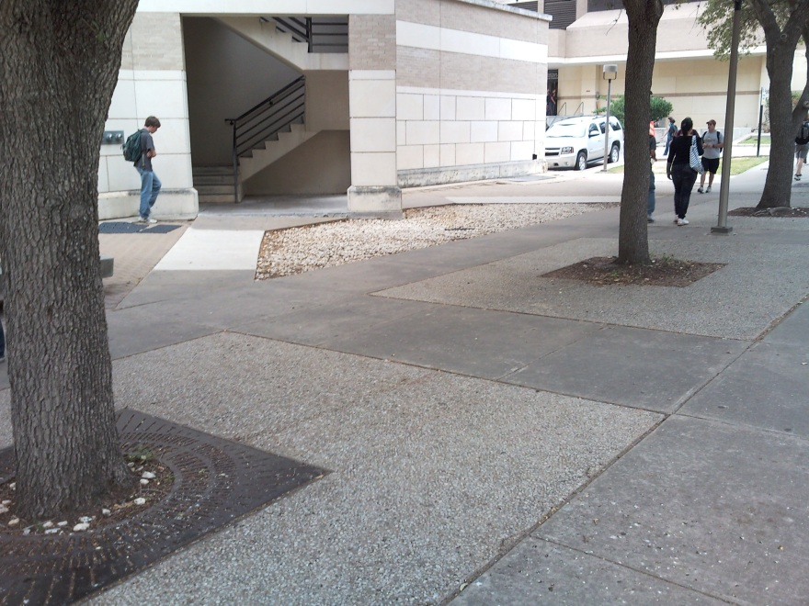
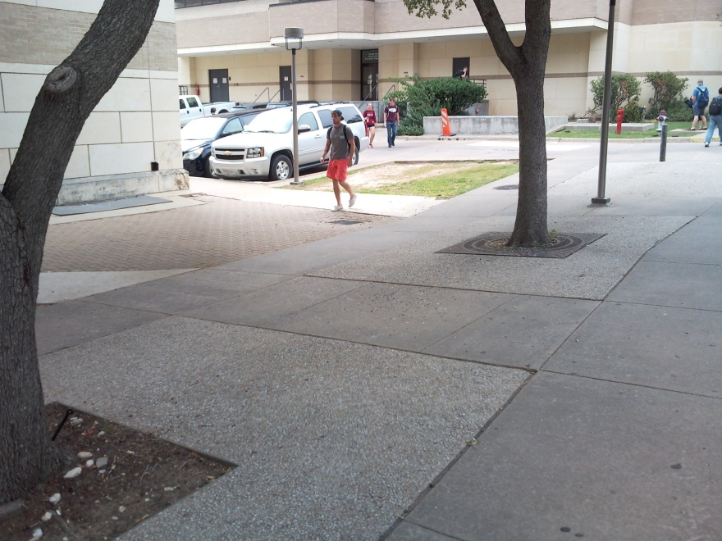
Expansion Projects
Civil Engineering Lab Building
4 racks at the end of the building

Slide 6
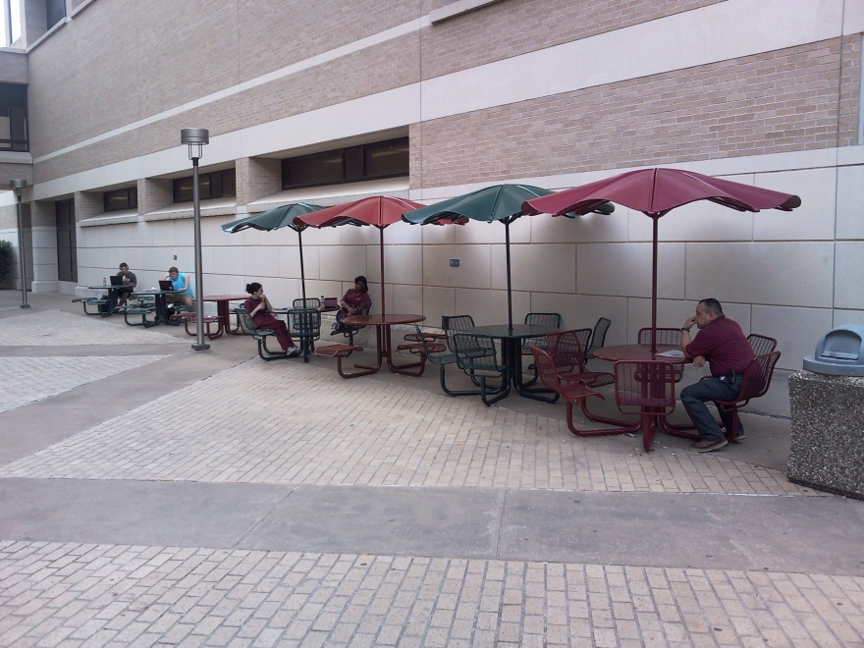
Expansion Projects
Pi R Square
Racks along the wall (6-8 racks)

Slide 7
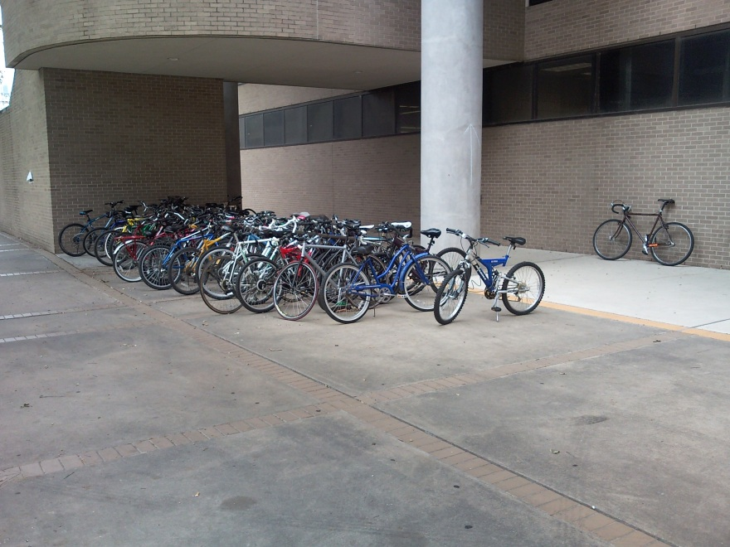
Expansion Projects
Physics (Cain) Building
2 new racks inline with existing racks

Slide 8
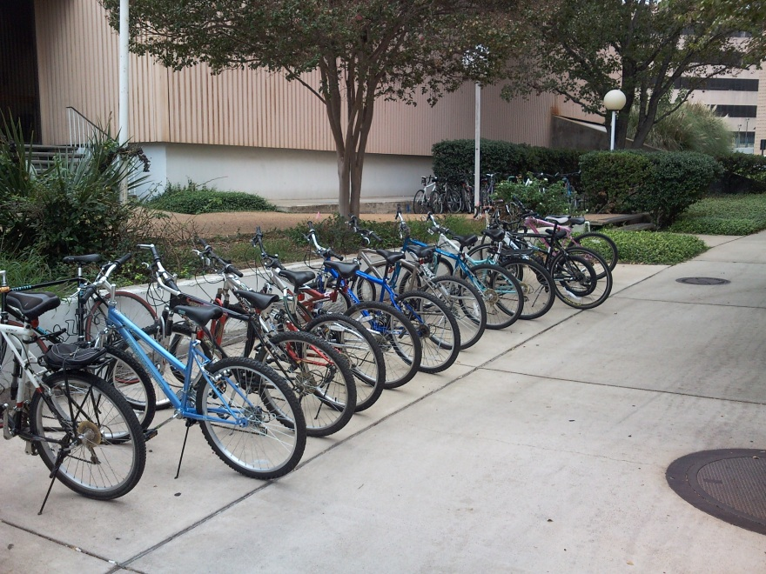
Expansion Projects
Jack E. Brown / Cyclotron
Moveable Ring Racks

Slide 9
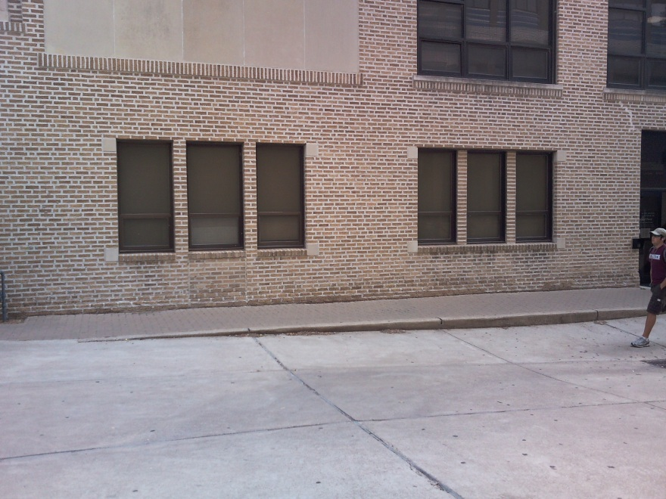
Expansion Projects
Pavilion
Ring racks along wall

Slide 10
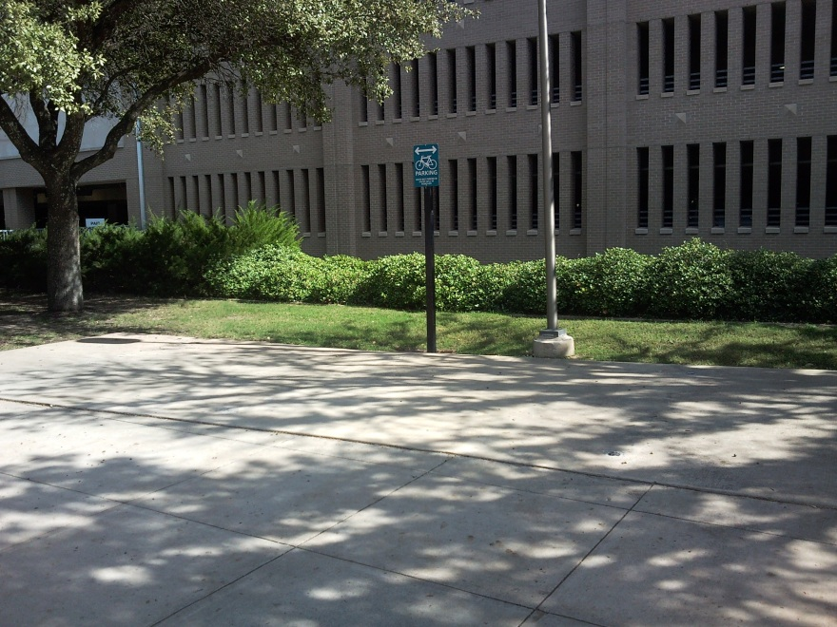
Expansion Projects
West Campus Garage (North Side)
4-6 Racks

Slide 11
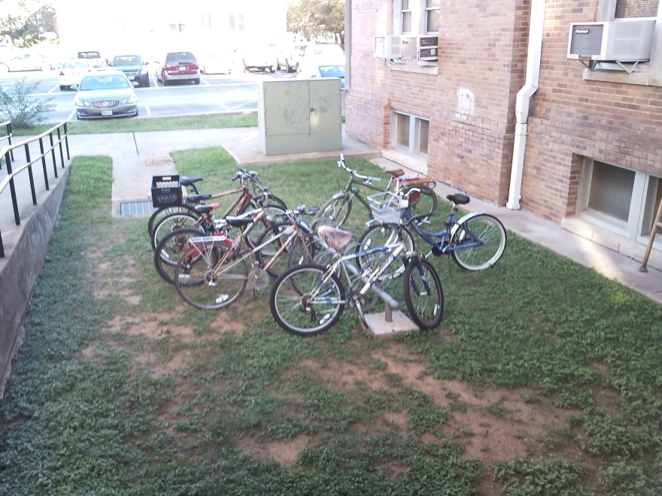
Expansion Projects
Bizzell Hall
3 racks

Slide 12
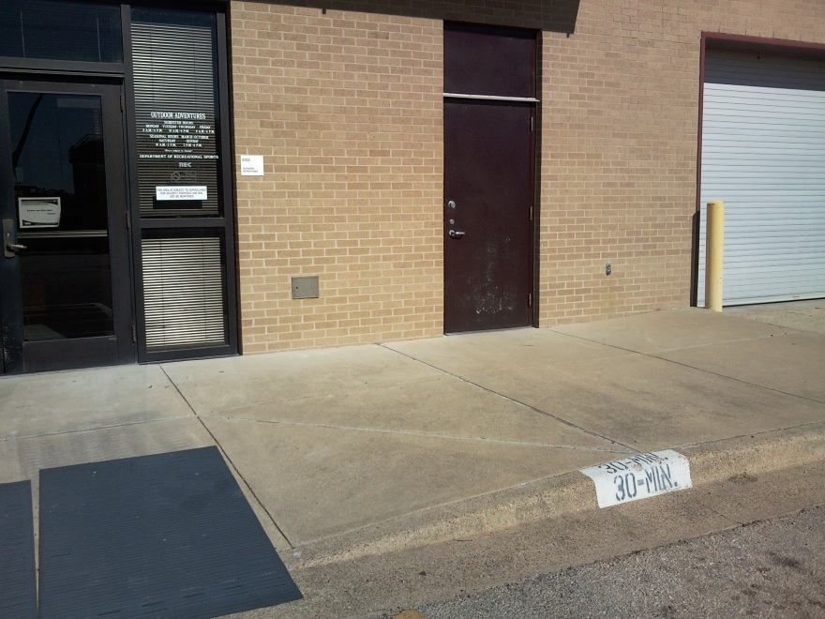
Expansion Projects
Outdoor Adventures
Ring racks or 1 rack (single sided access)

Slide 13
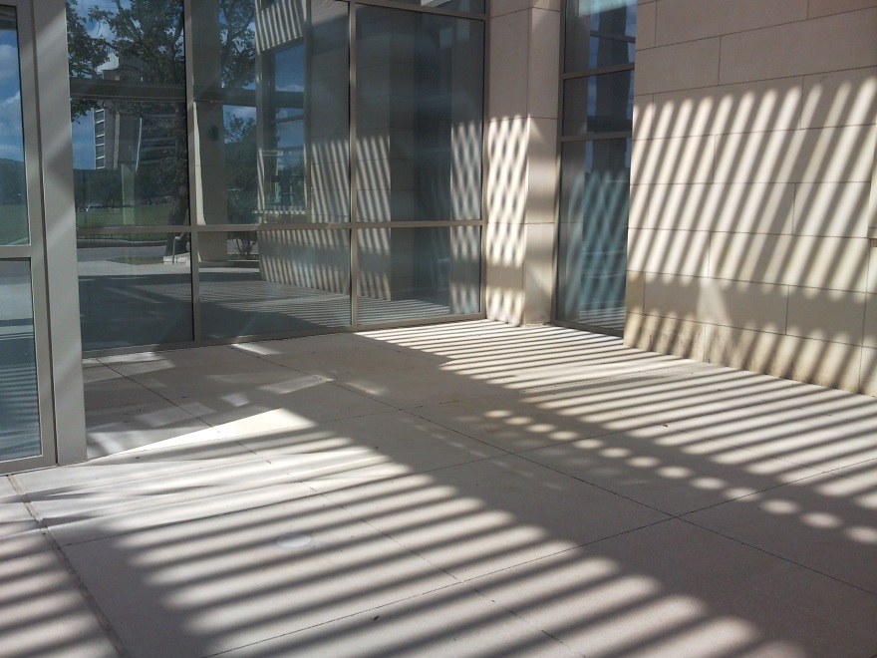
Expansion Projects
Life Sciences
4 racks

Slide 14
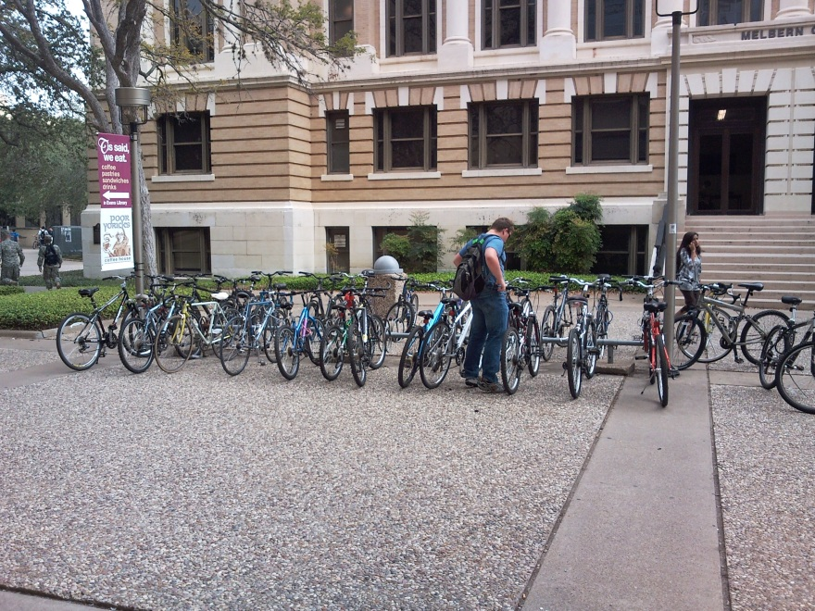
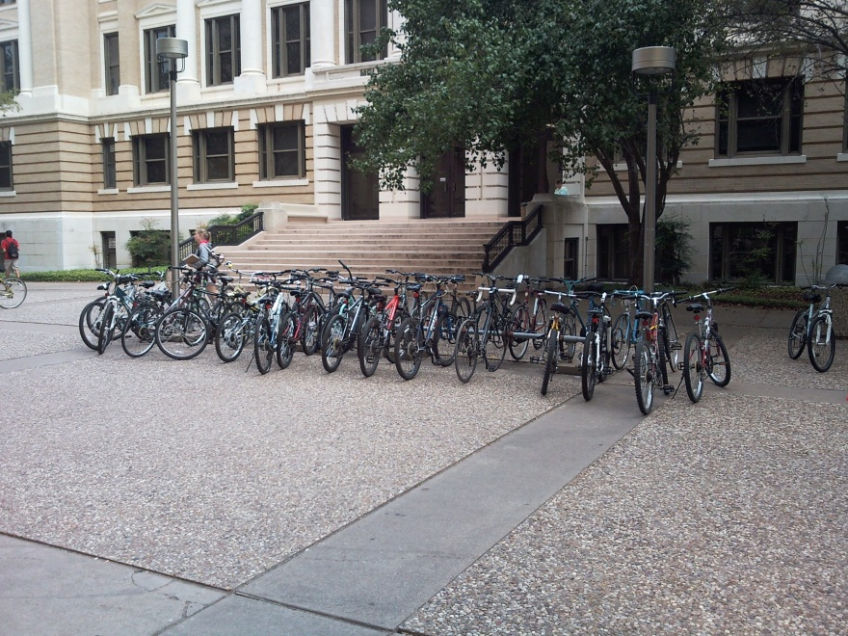
Replacement Projects
Evans (East Side)
6 racks

Slide 15
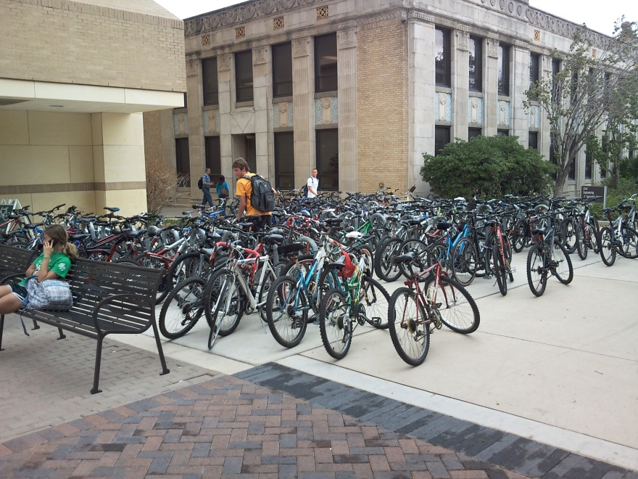
Replacement Projects
Petroleum Engineering Building
9 racks

Slide 16
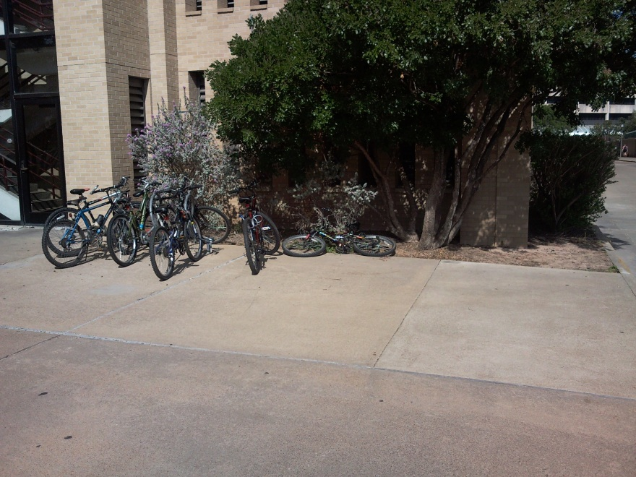
Replacement Projects
North Side Garage
3 racks

Slide 17
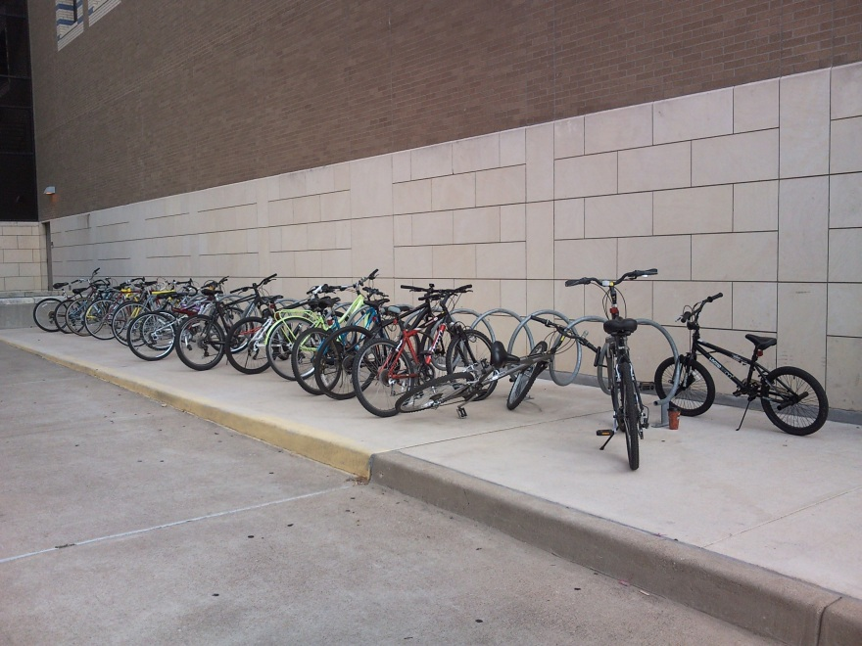
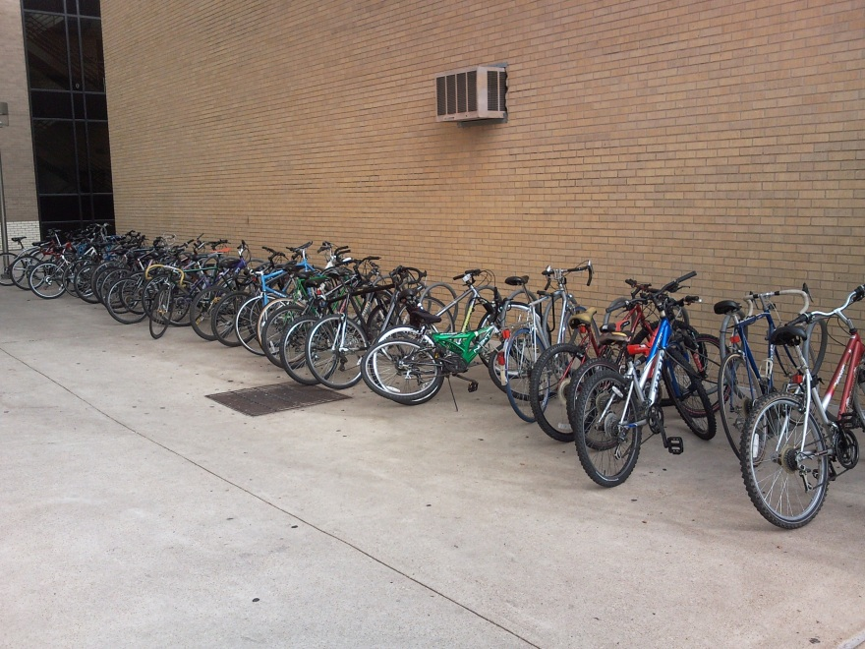
Replacement Projects
SCC (east and west sides)
4-5 on each side (may be able to double up on east side for expansion)

Slide 18
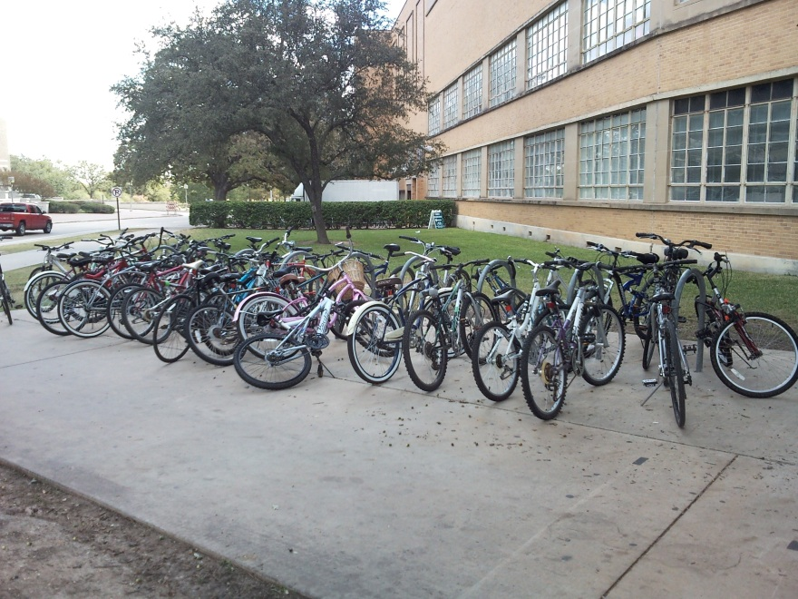
Replacement Project
G. Rollie
4 Racks

Slide 19
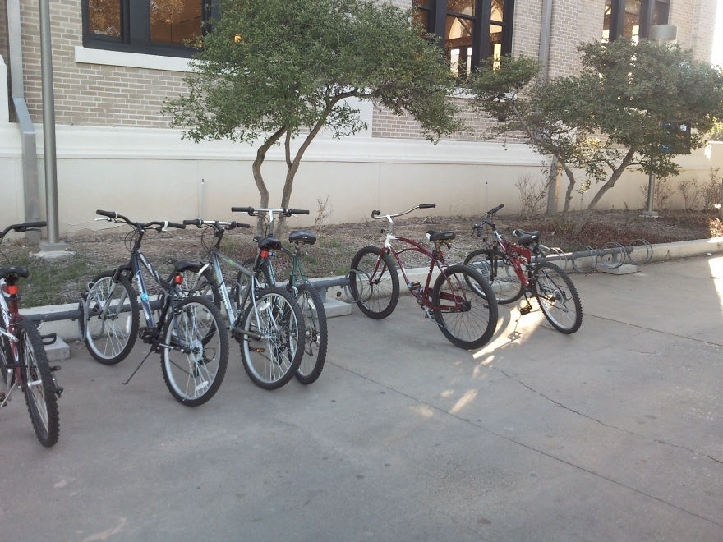
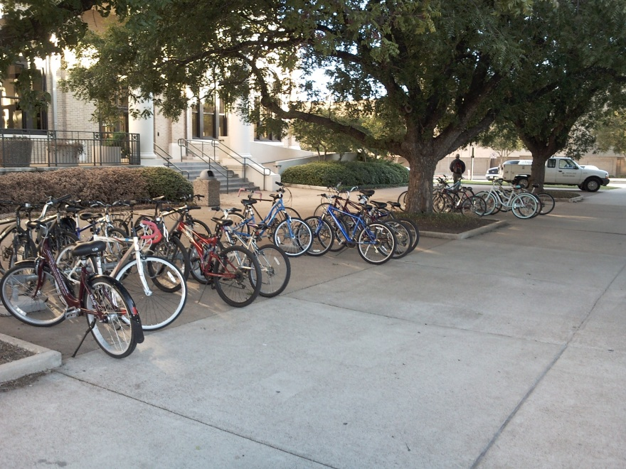
Replacement Projects
Sbisa
Ring racks were placed to provide some immediate relief.

Slide 20
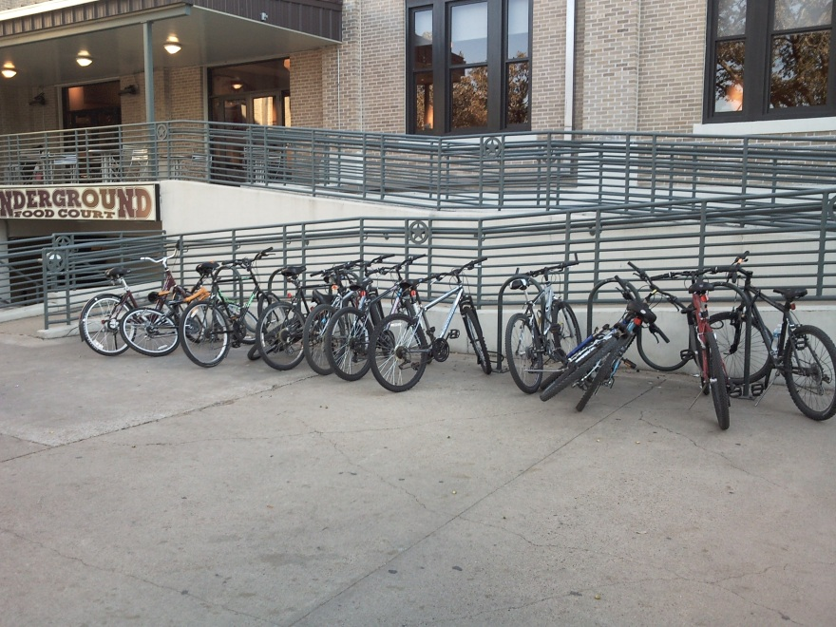
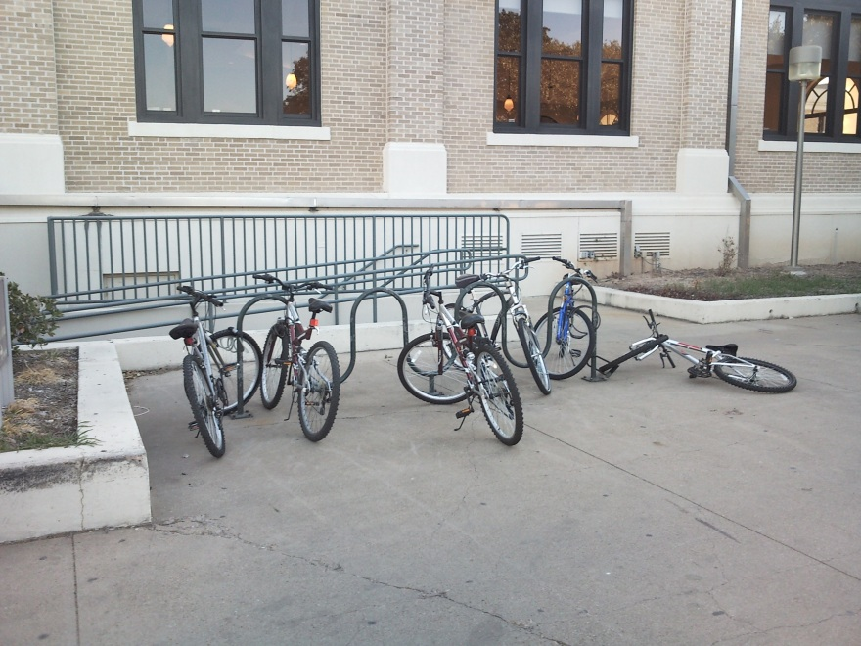
Replacement Projects
Sbisa
The existing racks will be replaced with the new style racks over winter break (up to 10 total)

Slide 21
Expansion/Replacement
Summary
Expansion: 26-30 Racks (260-300 rated spaces)
Pi R Square is only proposed at this time
Replacement: 40-42 Racks (400-420 spaces)

Slide 22
Bike Booting/Impound
Spring 2011
Moved bikes to racks no matter if cutting locks was necessary
Feedback showed the bike owner understood “why”, but did not like bike not being secure
Summer 2011
Beta test on booting

Slide 23
Bike Booting/Impound
Fall 2011
Locking bikes with TS lock if
Improperly parked with rack space within a reasonable distance
Bikes must be cut and moved due to safety or accessibility violations
Locked to lights, gas meters, ingress/egress blockage, handicap access

Slide 24
Booting/Impound
Impound
Bikes are impounded if bike owner does not call to get bike released from boot within a minimum of 72 hours
Bikes meet other qualifications for impound
http://transport.tamu.edu/bicycles/regulations.aspx

Slide 25
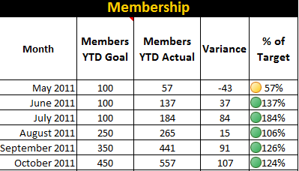
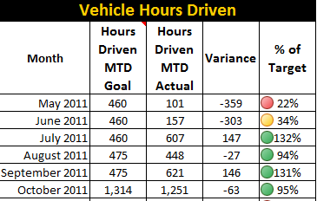
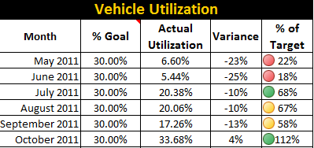
Car Share
Hertz On Demand
October 31st Update

Slide 26
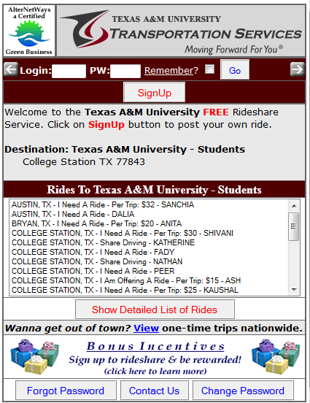
Ride Share - AlterNetRides
Existing TS Rideshare Service
1108 Total Rides
27 Active Rides

Slide 27
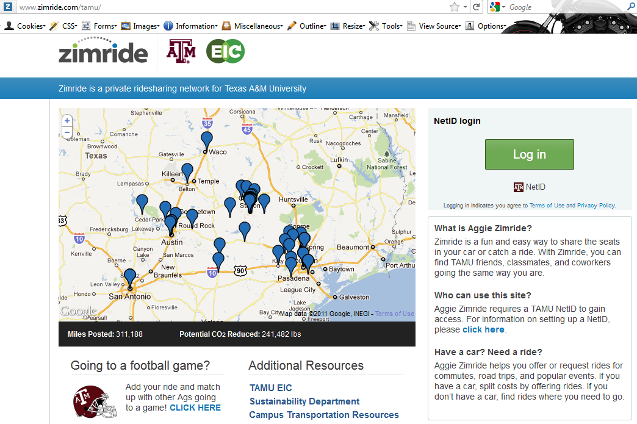
Ride Share - Zimride
http://zimride.com/tamu/
981 users since 7/28/2011
399 Total Rides
108 Active Rides

