Slide 1
Important Conversations
Departmentally Purchased Permits
Kenneth Kimball & Therese Kucera
Texas A&M Transportation Services

Slide 2
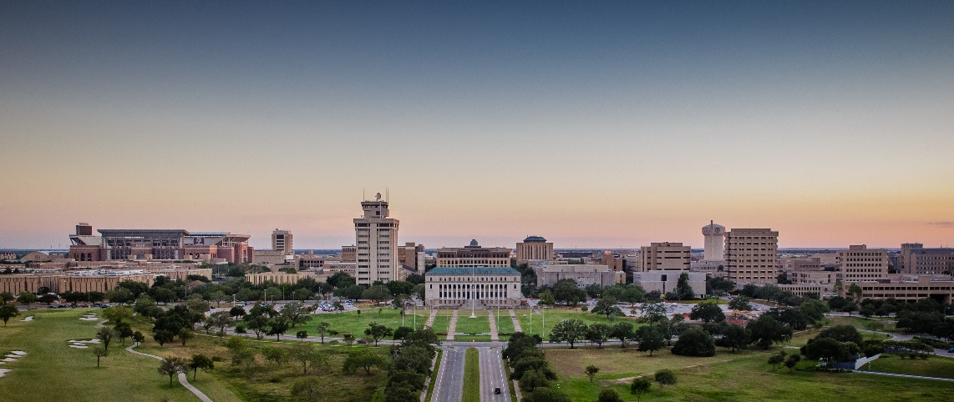
Introduction
As the university grows, Transportation Services would like to start the discussion about services or policies that create inefficiencies or are provided at no cost.
Continued university growth will make efficient use of our resources more and more important.
The purpose of these discussions is to bring up items of interest that could be modified, charged for or eliminated in order to accommodate more customers on campus.

Slide 3
Retiree Permit Follow up

Slide 4
Retiree Permit Use

Slide 5
Retiree Permit (Cont’d)
Garage Visits by Retiree Permit FY 2017

Slide 6
Retiree Permit (Cont’d)
Based on the preceding graphic, 50% of Retiree permit holders access a garage two or less times each year. (747 of the total issued accessed these facilities during the year)
We do not have data on non gated facilities.
It is unrealistic for general permit holders to pay for the cost and logistics of providing retiree permits which are not used as well as subsidizing those which are used frequently.
If we were to set up a pricing system to address high users or abusers, the following would be needed:
Access would have to be limited to gated facilities such as the garages.
A pricing schedule based on use would be developed.
The pricing would be structured to have regular occurring use charged at normal permit rates with occasional use at a significant discount or free.
Thoughts?

Slide 7
Departmentally Purchased Permits

Slide 8
What we are seeing?
One department pays for any employee making less than $90k.
Some departments pay for all of their employees’ parking permits.
Some departments pay the surface lot price and the employee is responsible for the remaining balance.

Slide 9
Taxable Income
IRS Guidance on Qualifying Transportation
According to IRC 132(f)(1) transportation fringes to be provided tax free with some limits.
(f) Qualified transportation fringe (1) In general for purposes of this section, the term “qualified transportation fringe” means any of the following provided by an employer to an employee: (A) Transportation in a commuter highway vehicle if such transportation is in connection with travel between the employee’s residence and place of employment.
(B) Any transit pass.
(C) Qualified parking.
(D) Any qualified bicycle commuting reimbursement.
So:
Notes:
It has been questioned as to whether the departments are reporting the purchase of permits as taxable income to the staff member.

Slide 10
Permit Data
(Departments)

Slide 11
Problems Created
It took approximately (1) day to process 47 permits to one department that paid with manual (IDT) authorization
Possible Solution: Process online by logging into employees My Parking Account and pay via pro-card. Or allow employee to process using pro-card.
Departments wish to pay but want to have the permit in the employee’s name. At termination, there is the expectation that a refund should come back to the department.
Possible Solution: Follow current business rules which instruct to only refund holder of the permit.
Split-paid permit purchases (between department and employee) are logistically challenging.
Possible Solution: Only allow full payment online by procurement card.

Slide 12
What are the issues?
The Issue of Fairness:
Some employees enjoy paid parking and most do not.
Some departments will pay for permits when merit pay is not available because they have the resources to do so.
Supply and Demand:
The fact remains that if growing numbers of faculty/staff are subsidized in regard to parking, essentially cost sensitivity is removed.
As we try to diversify the mode split for campus to achieve efficient use of resources, is it desirable to have a large portion of permit holders who do not look for alternatives because parking is free to them?

Slide 13
Questions/Discussion?

