Slide 1
Donations for Citations
Transportation Services Advisory Committee
March 1, 2017

Slide 2
Idea: What Can We Do Together to Give Back to the Community?
Brainstormed ideas of how our department could give back to the community possibly on an annual basis.
Wanted to find a way to take something that is perceived as “negative” and transform it into a “positive” experience for our customers and the community.
Researched other campaigns such as Food for Fines, which is hosted across the nation and also right here at Texas A&M through the library.
Took guidance from our Parking Industry partners who have had successful turnouts for similar programs.
Notes:
Note: There have been a number of committees and task forces assigned to address this topic throughout the years

Slide 3
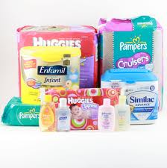
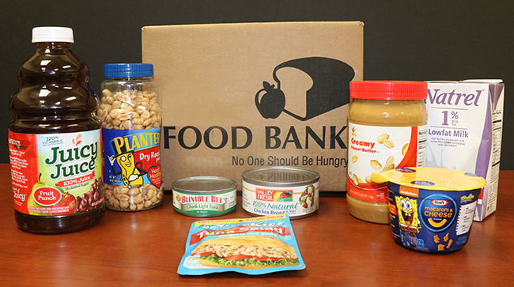
Proposed Event:
Donations For Citations
Partner with Brazos Valley Food Bank for the collection of “needed” items.
Customers with any parking citation issued before the start of the campaign with a balance due can donate from the following categories to receive a designated dollar amount up to $30 towards their citation fee:
Non-perishable canned goods (5oz = $1 off)
Diapers and other baby goods
Packages of up to 30 diapers = $10
Packages of 31-50 diapers = $20
Packages of more than 50 diapers = $30
Wipes = $5 per container
Dry goods (5oz = $1 off)

Slide 4
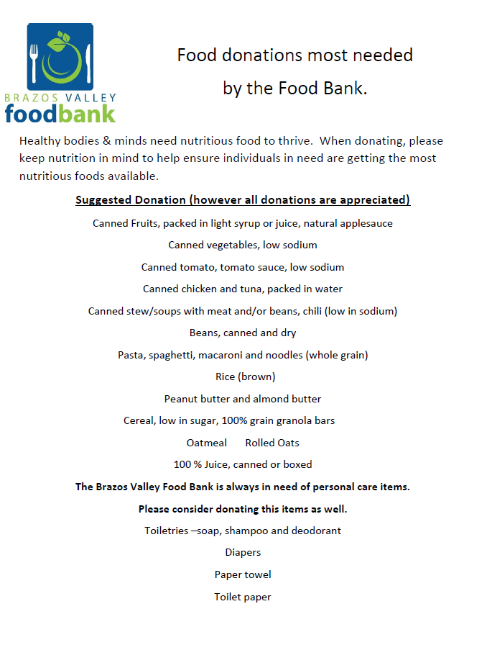
Brazos Valley Food Bank Needed Donations

Slide 5
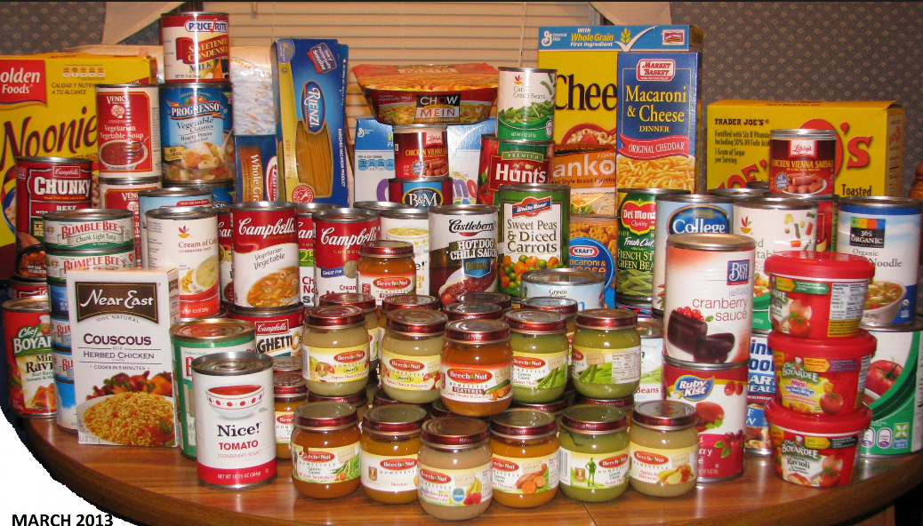
Proposed: Donations For Citations
Collection Period
Proposal to run campaign for two weeks.
Submit approved dates to Brazos Valley Food Bank for official registration.
Food collection station located at the Customer Assistance Office in Koldus.
Delivery of goods to Brazos Valley Food Bank at the completion of collection period.
Submit news release with photos/possible media coverage

Slide 6
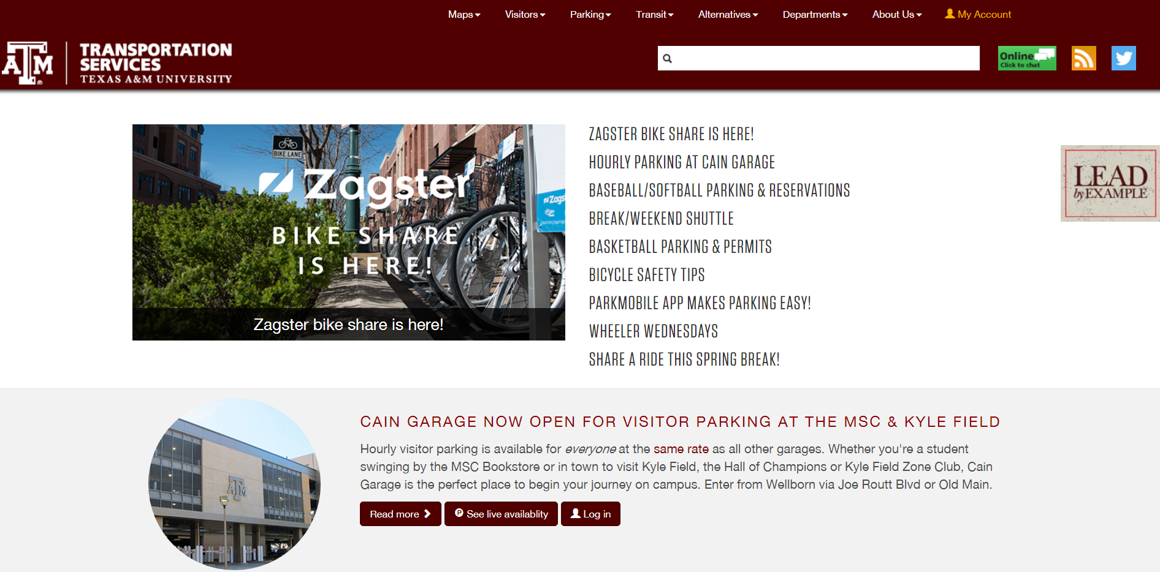
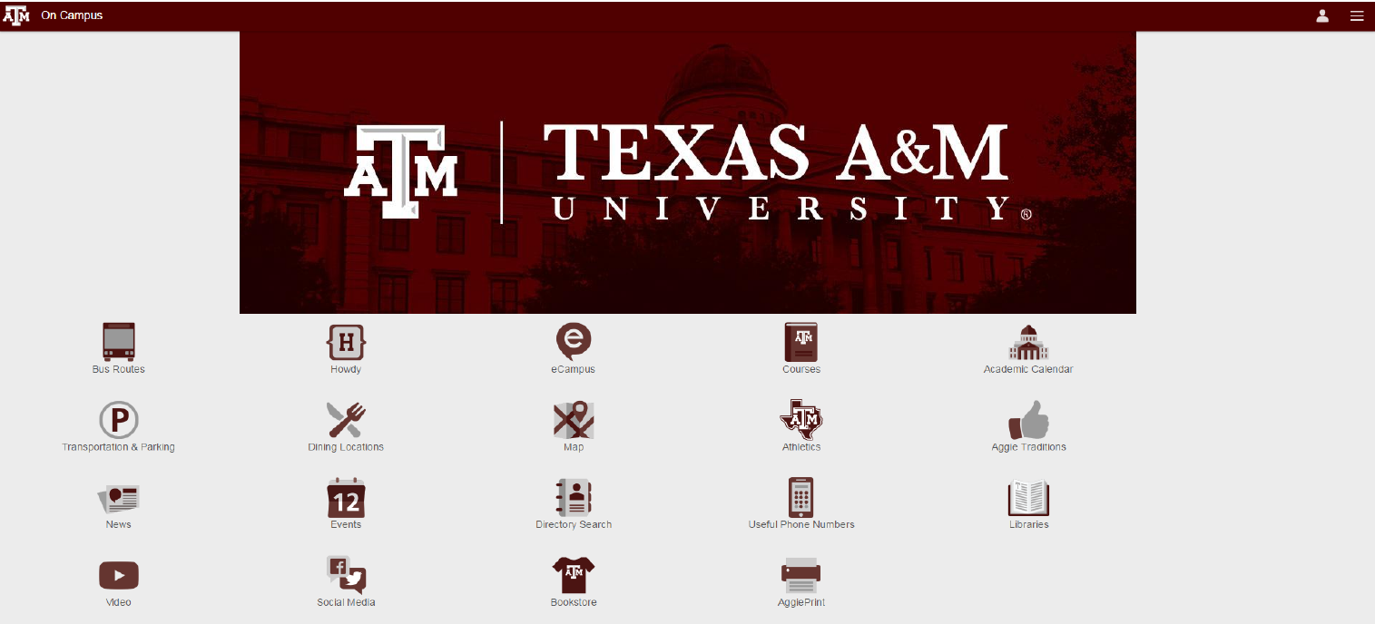
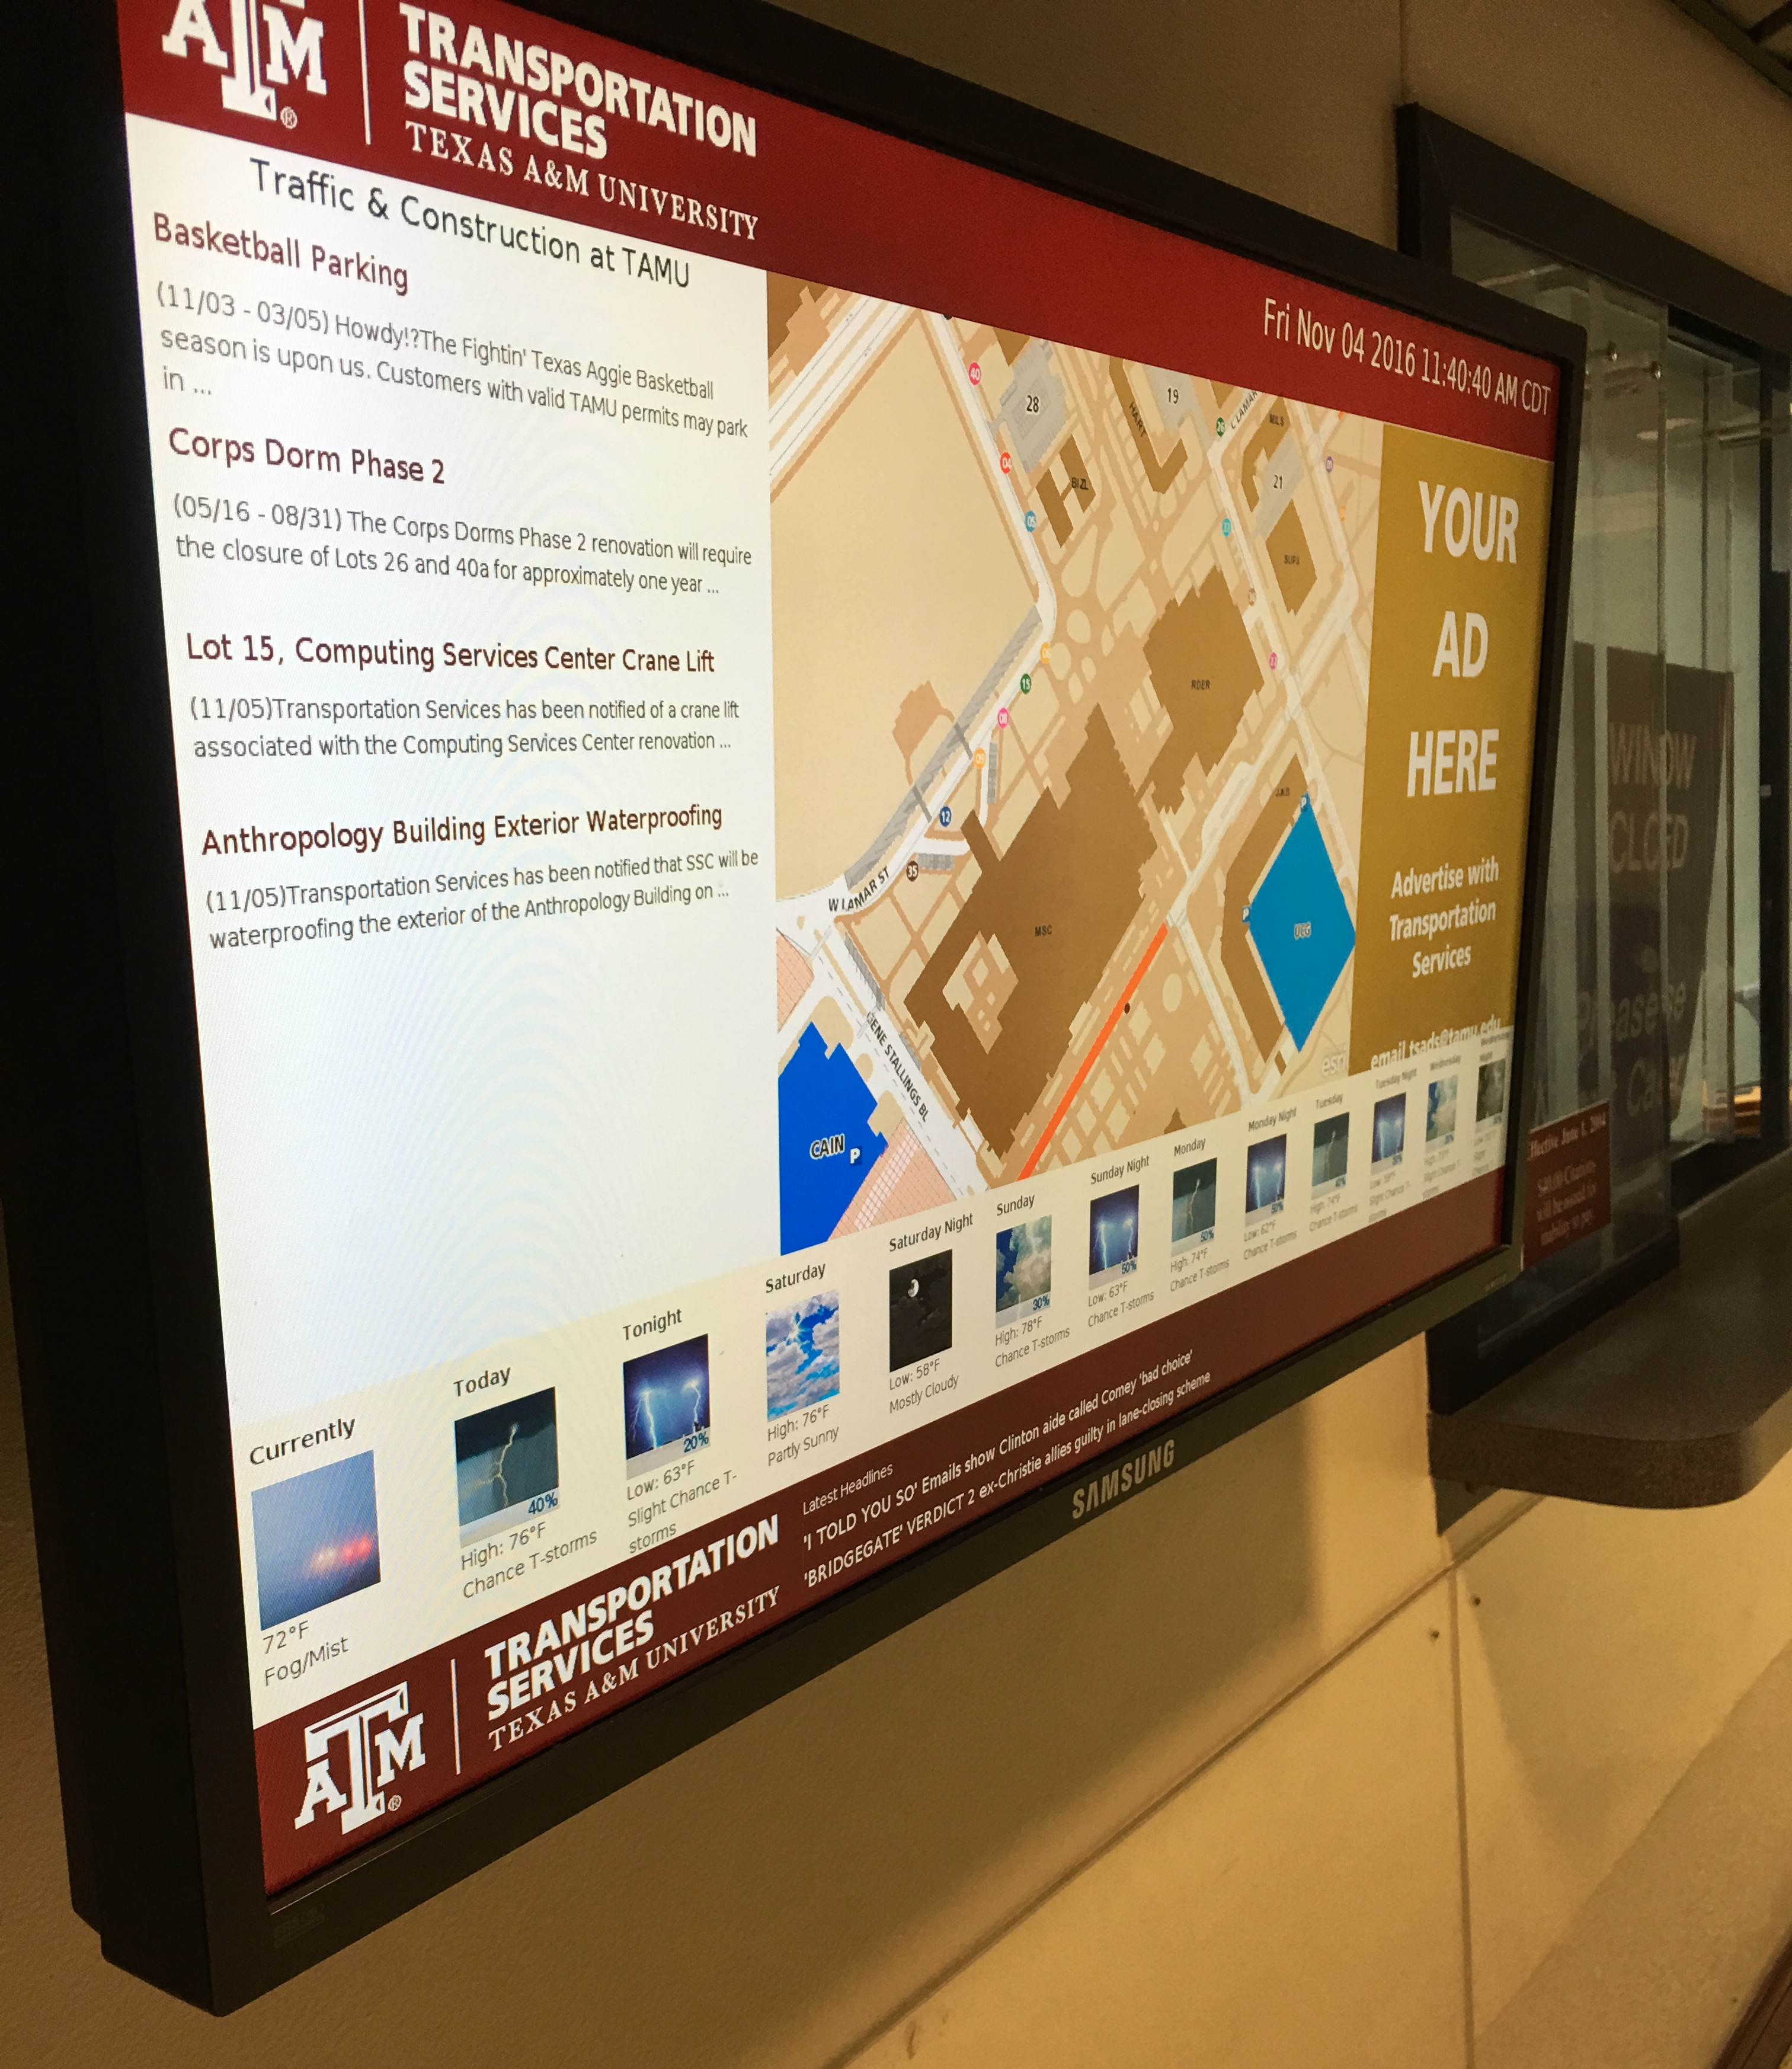
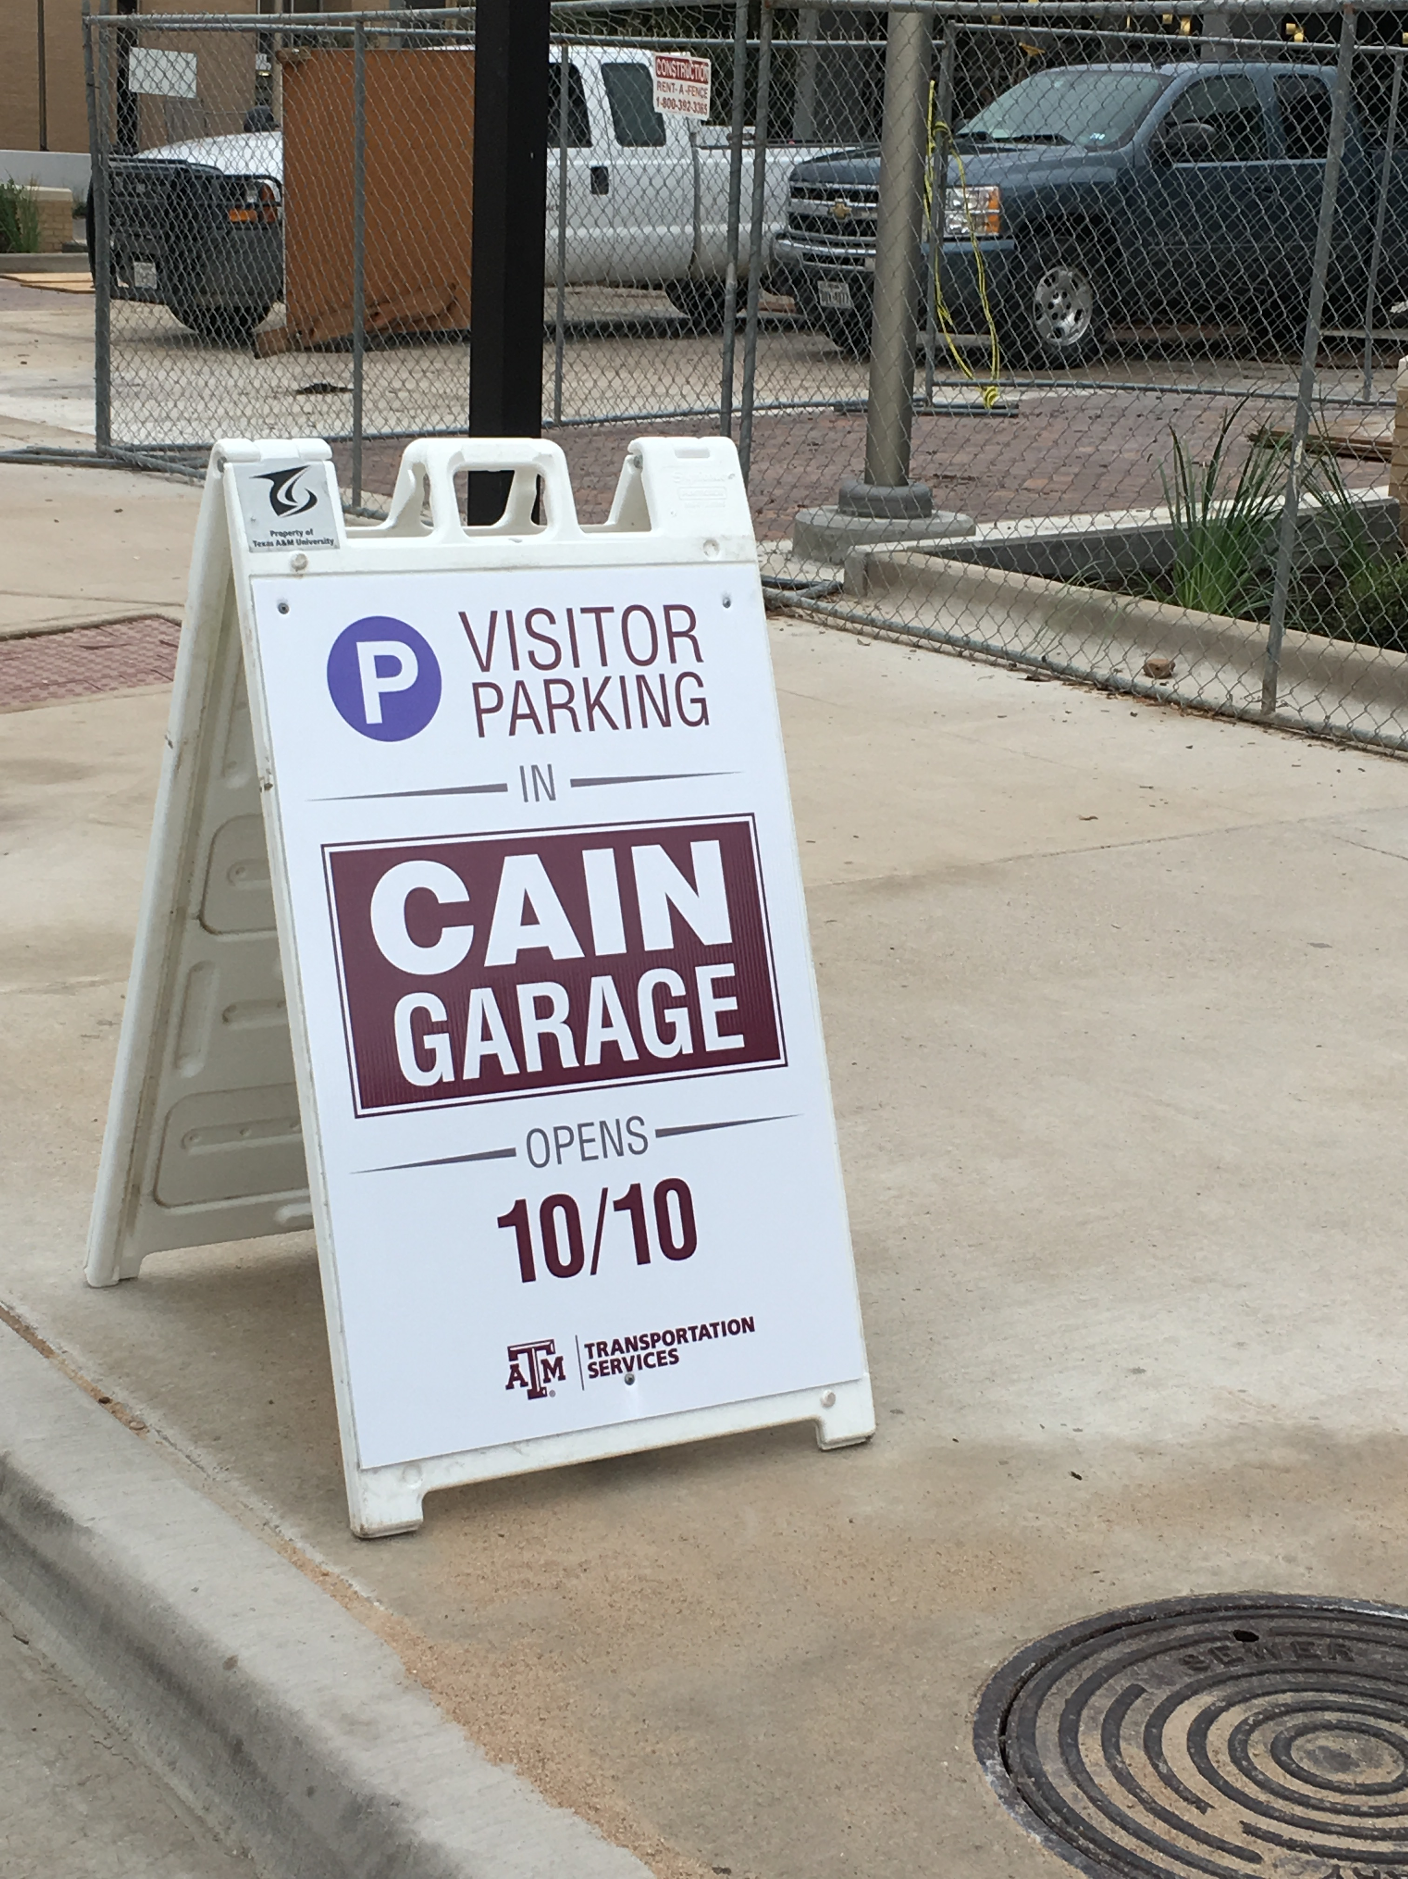
Proposed: Communications
Transport.tamu.edu website
Texas A&M mobile app
Digital signage throughout campus
Signage at parking facilities
Social media accounts
Battalion news story
Texas A&M Today
Bulk mail notification
Target email notification to customers with citations due

Slide 7
Questions?

