Slide 1
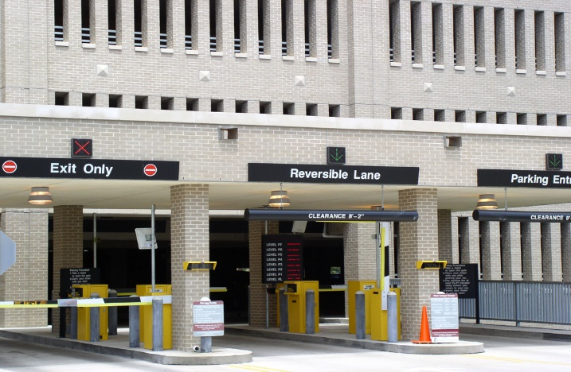
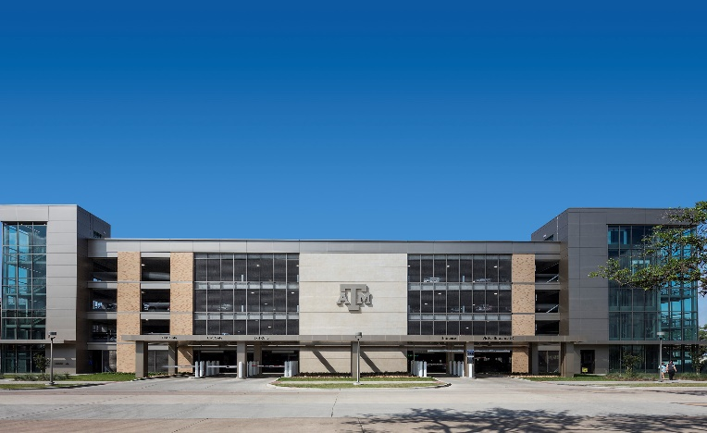
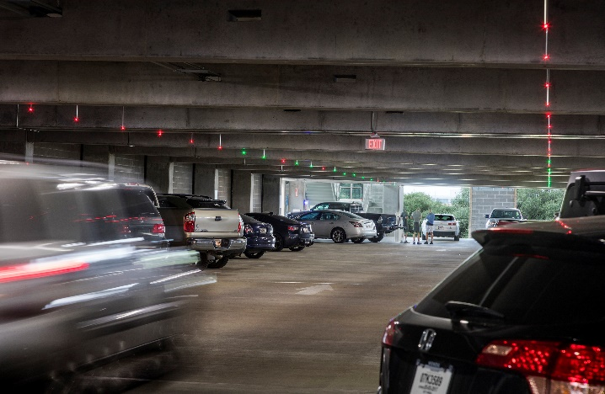
Strategic Planning Parking Topics to Review Over the Next Year(s)
Transportation Services Advisory Committee
Sept. 6, 2017

Slide 2
Overview
With increasing student population and decreasing surface space expected with the Campus Master Plan:
Transportation Services wants to explore areas where efficiencies could be gained to best serve the most customers.
This will involve studying certain policies and services which could be charged for, changed or eliminated to serve more customers in desirable portions of campus.
We will start with gathering peer information.

Slide 3
Peer Information to be Gathered
Are you an urban campus, how large in acres is your contiguous campus?
How is your parking operation funded?
How is your permit pricing structured? Salary, Market, Operating Cost
Do you have Reserved Numbered Spaces, if so how many? Who can buy them? Other restrictions?
Total all Parking Revenue per space. Considering sellable spaces only.
Do you have retiree permits? Charge? Privileges?

Slide 4
Peer Information to be Gathered
Do you have a VIP permit? What privileges does it provide? How much is charged?
Do departments purchase permits for employees? If so are there restrictions? Are there payment options for departments? Are there related attempts for parity among employees?
What equates to a “Business Permit” on campus? What access is afforded?
Do you provide service permits? Do they pay for them? If so how close will this get them?

Slide 5
Peer Information to be Gathered
What are your hourly visitor rates? Are the prices market driven or determined by operational needs?
What is the maximum number of students that can park on campus?
Is there variable pricing for resident permits?
Do you charge for parking on nights and weekends?
Do you charge for event parking?
Do you receive revenue from football game day parking? What costs do you incur?
Do you offer staff transit service? Is there a charge? Is it subsidized by the local community or city?

